Slide 1
5 Parts of Speech
Aphasia-friendly toolkit Feb 2024
Disclaimer: These materials were created using funding from the Provincial Community Stroke Rehabilitation Initiative and crafted by Aran Oberle, Speech Language Pathologist, with input from regional rehab programs. They are not meant to replace professional expertise. Readers should seek advice from a qualified healthcare provider for any concerns. The content of this PowerPoint can be adjusted to suit the needs of healthcare professionals. Users are accountable for confirming the accuracy and suitability of the information for their unique situations.

Slide 2
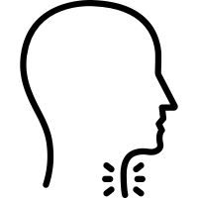
5 Parts of Speech
PROSODY
​ARTICULATION
​RESONANCE
PHONATION
BREATHING
BREATHING:
Air in lungs is the volume for voice.
2. PHONATION:
Vocal folds vibrate to make sound.

Slide 3
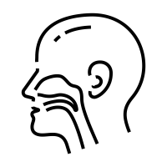
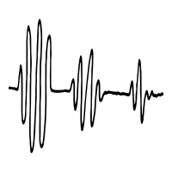
5 Parts of Speech
​RESONANCE
PHONATION
BREATHING
PROSODY
​ARTICULATION
3. RESONANCE:
Air going through nose can change the meaning of words or make words unclear.
4. ARTICULATION:
Different mouth shapes make different sounds to make words.
5. PROSODY:
The music of your voice gives meaning, emotion and emphasis.

Slide 4
5 Parties de la parole
PROSODIE
​ARTICULATION
​RÉSONANCE
PHONATION
RESPIRATION
RESPIRATION:
L'air dans les poumons donne du volume à la voix.
2. PHONATION:
Les plis vocaux vibrent pour produire du son.

Slide 5
5 Parties de la parole
​RÉSONANCE
PHONATION
RESPIRATION
PROSODIE
​ARTICULATION
3. RÉSONANCE:
L'air qui passe par le nez change le sens des mots et peut rendre les mots flous.
4. ARTICULATION:
Différentes formes de bouche font de différents sons pour faire des mots.
5. PROSODIE:
La musique de la voix donne du sens, de l'émotion et de l'accent aux mots.

