Slide 1

Appointment Notices
Aphasia-friendly toolkit November 2024
Disclaimer: These materials were created using funding from the Provincial Community Stroke Rehabilitation Initiative and crafted by Aran Oberle, Speech Language Pathologist, with input from regional rehab programs. They are not meant to replace professional expertise. Readers should seek advice from a qualified healthcare provider for any concerns. The content of this PowerPoint can be adjusted to suit the needs of healthcare professionals. Users are accountable for confirming the accuracy and suitability of the information for their unique situations.

Slide 2

Index
Topic | English Slide # | French Slide #
Imaging Xray CT/MRI/PET Ultrasound | 3 | 4
Echocardiogram | 5 | 6
MRI | 7 | 8
Swallow Study - VFSS | 9 | 10
Swallow Study - FEES | 11 | 12
Dialysis | 13 | 14
Chemotherapy | 15 | 16
Radiation Therapy | 17 | 18
Oncology | 19 | 20
Nephrology | 21 | 22
Cardiology | 23 | 24
Index
Topic | English Slide # | French Slide #
Follow Up Appointment Dentist Family Doctor Opthamology/ Optometry Audiology | 25 | 26
Follow Up Appointment Neurology Nephrology Oncology Cardiology | 27 | 28
Follow Up Appointment Orthopedics Geriatrics ENT Pulmonology | 29 | 30
Follow Up Appointment Gastroenterology Urology OB/GYN Endocrinology | 31 | 32
Follow Up Appointment Podiatry / Nail Care Research Hair Dressing __________________ | 33 | 34
Template | 35 | 36
Additional Pictures | 37

Slide 3




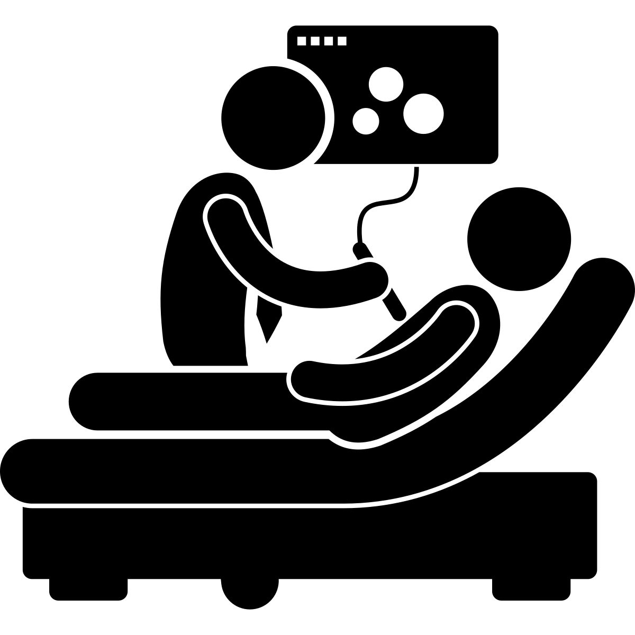

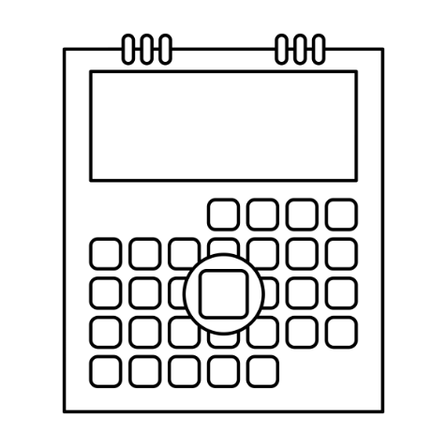

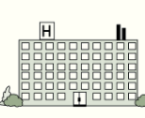


Imaging
X ray
CT / MRI / PET Scan
Ultrasound
Date: __________________________________
Time: __________________________________
Place: _________________________________
Transportation: _________________________
Family/Support: ________________________
________________________________________
Images used are from ParticiPics – a free, searchable database of pictographic images developed by the Aphasia Institute, ​https://www.aphasia.ca/participics

Slide 4
Imagerie
Rayon X
CT / IRM / TEP Scan
Échographie
Date: __________________________________
Heure: _________________________________
Endroit: ________________________________
Transportation: _________________________
Famille/ Soutien:_______________________
_______________________________________
Images used are from ParticiPics – a free, searchable database of pictographic images developed by the Aphasia Institute, ​https://www.aphasia.ca/participics

Slide 5

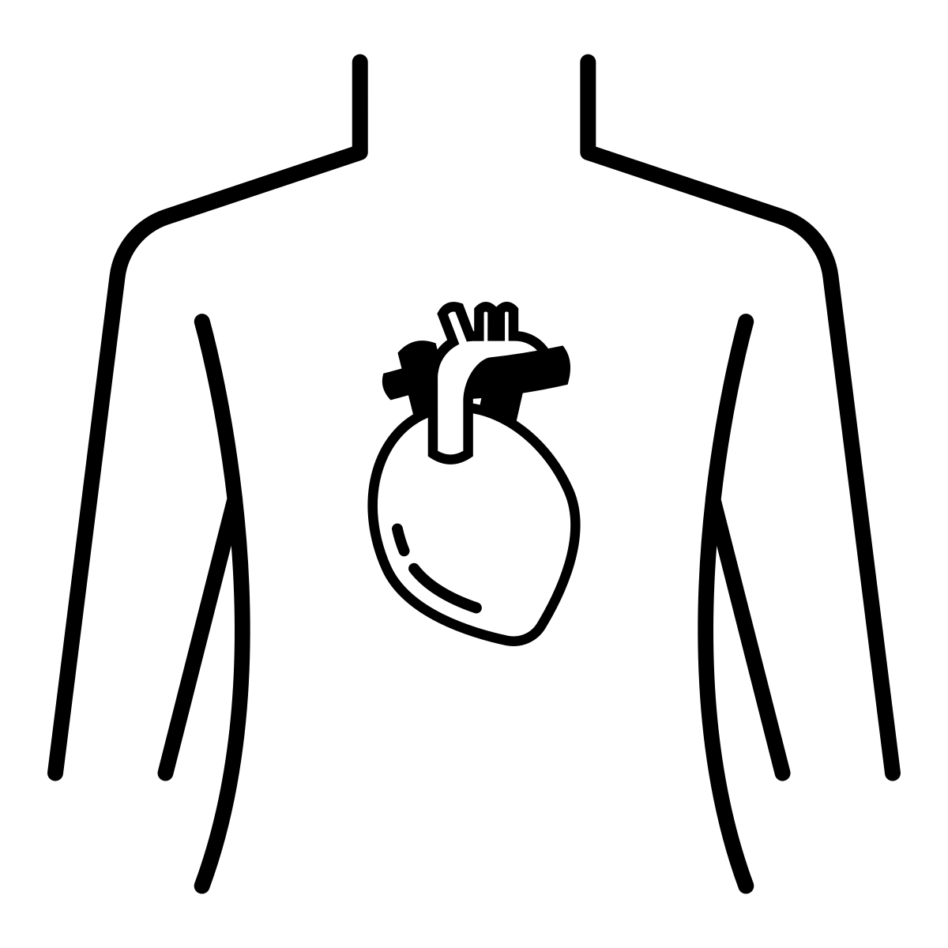
Echocardiogram
Date: __________________________________
Time: __________________________________
Place: _________________________________
Transportation: _________________________
Family/Support: ________________________
________________________________________
Images used are from ParticiPics – a free, searchable database of pictographic images developed by the Aphasia Institute, ​https://www.aphasia.ca/participics

Slide 6
Échocardiogramme
Date: __________________________________
Heure: _________________________________
Endroit: ________________________________
Transportation: _________________________
Famille/ Soutien:_______________________
_______________________________________
Images used are from ParticiPics – a free, searchable database of pictographic images developed by the Aphasia Institute, ​https://www.aphasia.ca/participics

Slide 7

MRI
Date: __________________________________
Time: __________________________________
Place: _________________________________
Transportation: _________________________
Family/Support: ________________________
________________________________________
Images used are from ParticiPics – a free, searchable database of pictographic images developed by the Aphasia Institute, ​https://www.aphasia.ca/participics

Slide 8
IRM
Date: __________________________________
Heure: _________________________________
Endroit: ________________________________
Transportation: _________________________
Famille/ Soutien:_______________________
_______________________________________
Images used are from ParticiPics – a free, searchable database of pictographic images developed by the Aphasia Institute, ​https://www.aphasia.ca/participics

Slide 9

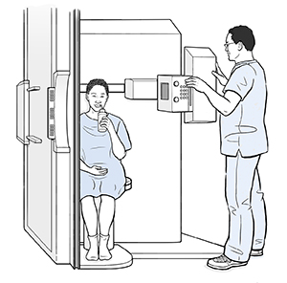
Swallow Study - Videofluoroscopy
Date: __________________________________
Time: __________________________________
Place: _________________________________
Transportation: _________________________
Family/Support: ________________________
________________________________________
Images used are from ParticiPics – a free, searchable database of pictographic images developed by the Aphasia Institute, ​https://www.aphasia.ca/participics
“Modified Barium Swallow” Saint Luke's, 20 August 2024, Modified Barium Swallow | Saint Luke's Health System (saintlukeskc.org)

Slide 10
Évaluation de la déglutition
- Vidéofluoroscopie
Date: __________________________________
Heure: _________________________________
Endroit: ________________________________
Transportation: _________________________
Famille/ Soutien:_______________________
_______________________________________
Images used are from ParticiPics – a free, searchable database of pictographic images developed by the Aphasia Institute, ​https://www.aphasia.ca/participics
“Modified Barium Swallow” Saint Luke's, 20 August 2024, Modified Barium Swallow | Saint Luke's Health System (saintlukeskc.org)

Slide 11

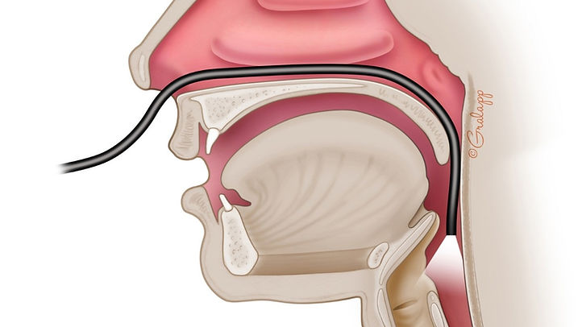
Swallow Study - FEES
Date: __________________________________
Time: __________________________________
Place: _________________________________
Transportation: _________________________
Family/Support: ________________________
________________________________________
Images used are from ParticiPics – a free, searchable database of pictographic images developed by the Aphasia Institute, ​https://www.aphasia.ca/participics
Image from: Langmore, S.E. (2017). History of Fiberoptic Endoscopic Evaluation of Swallowing for Evaluation and Management of Pharyngeal Dysphagia: Changes over the Years. Dysphagia, 32: 27. doi;10.1007/s00455-016-9775-x.

Slide 12
Évaluation de la déglutition
- FEES
Date: __________________________________
Heure: _________________________________
Endroit: ________________________________
Transportation: _________________________
Famille/ Soutien:_______________________
_______________________________________
Images used are from ParticiPics – a free, searchable database of pictographic images developed by the Aphasia Institute, ​https://www.aphasia.ca/participics
Image from: Langmore, S.E. (2017). History of Fiberoptic Endoscopic Evaluation of Swallowing for Evaluation and Management of Pharyngeal Dysphagia: Changes over the Years. Dysphagia, 32: 27. doi;10.1007/s00455-016-9775-x.

Slide 13
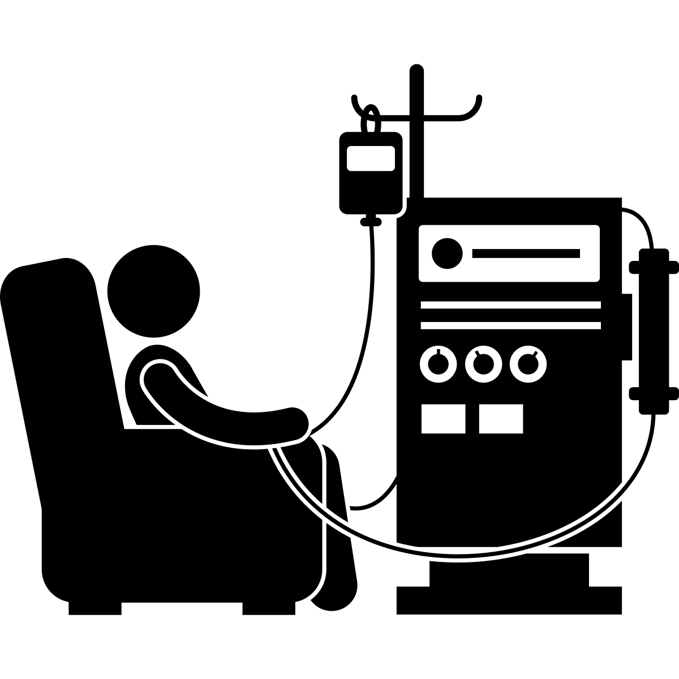

Dialysis
Date: __________________________________
Time: __________________________________
Place: _________________________________
Transportation: _________________________
Family/Support: ________________________
________________________________________
Images used are from ParticiPics – a free, searchable database of pictographic images developed by the Aphasia Institute, ​https://www.aphasia.ca/participics

Slide 14
Dialyse
Date: __________________________________
Heure: _________________________________
Endroit: ________________________________
Transportation: _________________________
Famille/Soutien: ________________________
________________________________________
Images used are from ParticiPics – a free, searchable database of pictographic images developed by the Aphasia Institute, ​https://www.aphasia.ca/participics

Slide 15
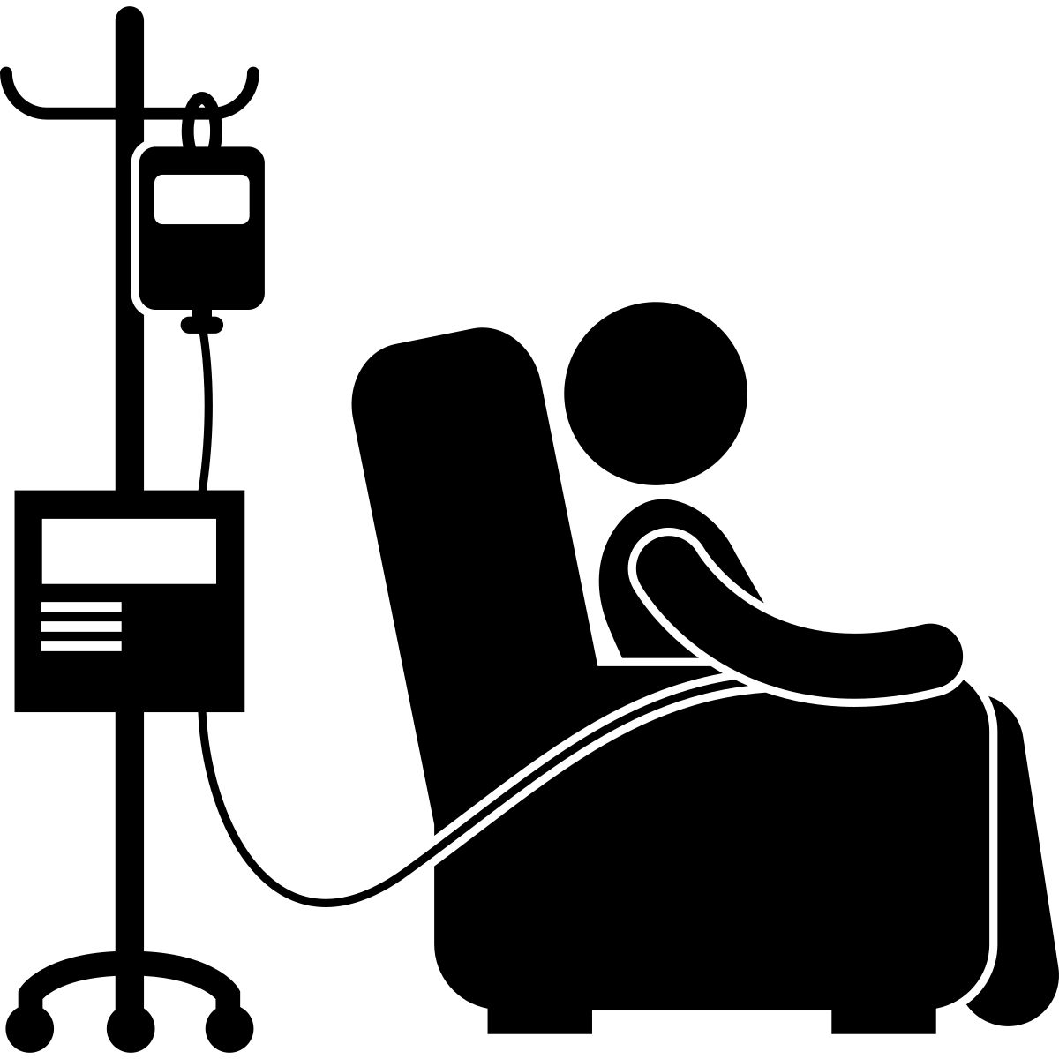
Chemotherapy
Date: __________________________________
Time: __________________________________
Place: _________________________________
Transportation: _________________________
Family/Support: ________________________
________________________________________
Images used are from ParticiPics – a free, searchable database of pictographic images developed by the Aphasia Institute, ​https://www.aphasia.ca/participics

Slide 16
Chimiothérapie
Date: __________________________________
Heure: _________________________________
Endroit: ________________________________
Transportation: _________________________
Famille/Soutien: ________________________
________________________________________
Images used are from ParticiPics – a free, searchable database of pictographic images developed by the Aphasia Institute, ​https://www.aphasia.ca/participics

Slide 17

Radiation Therapy
Date: __________________________________
Time: __________________________________
Place: _________________________________
Transportation: _________________________
Family/Support: ________________________
________________________________________
Images used are from ParticiPics – a free, searchable database of pictographic images developed by the Aphasia Institute, ​https://www.aphasia.ca/participics

Slide 18
Radiothérapie
Date: __________________________________
Heure: _________________________________
Endroit: ________________________________
Transportation: _________________________
Famille/Soutien: ________________________
________________________________________
Images used are from ParticiPics – a free, searchable database of pictographic images developed by the Aphasia Institute, ​https://www.aphasia.ca/participics

Slide 19


Oncology
Date: __________________________________
Time: __________________________________
Place: _________________________________
Transportation: _________________________
Family/ Support:________________________
_______________________________________
Images used are from ParticiPics – a free, searchable database of pictographic images developed by the Aphasia Institute, ​https://www.aphasia.ca/participics

Slide 20
Oncologie
Date: __________________________________
Heure: _________________________________
Endroit: ________________________________
Transportation: _________________________
Famille/ Soutien:_______________________
_______________________________________
Images used are from ParticiPics – a free, searchable database of pictographic images developed by the Aphasia Institute, ​https://www.aphasia.ca/participics

Slide 21

Nephrology
Date: __________________________________
Time: __________________________________
Place: _________________________________
Transportation: _________________________
Family/ Support:________________________
_______________________________________
Images used are from ParticiPics – a free, searchable database of pictographic images developed by the Aphasia Institute, ​https://www.aphasia.ca/participics

Slide 22
Néphrologie
Date: __________________________________
Heure: _________________________________
Endroit: ________________________________
Transportation: _________________________
Famille/ Soutien:_______________________
_______________________________________
Images used are from ParticiPics – a free, searchable database of pictographic images developed by the Aphasia Institute, ​https://www.aphasia.ca/participics

Slide 23


Cardiology
Date: __________________________________
Time: __________________________________
Place: _________________________________
Transportation: _________________________
Family/ Support:________________________
_______________________________________
Images used are from ParticiPics – a free, searchable database of pictographic images developed by the Aphasia Institute, ​https://www.aphasia.ca/participics

Slide 24
Cardiologie
Date: __________________________________
Heure: _________________________________
Endroit: ________________________________
Transportation: _________________________
Famille/ Soutien:_______________________
_______________________________________
Images used are from ParticiPics – a free, searchable database of pictographic images developed by the Aphasia Institute, ​https://www.aphasia.ca/participics

Slide 25





Follow Up Appointment
Dentist / Denturist
Ophthalmology
Family Doctor
​
Audiology​
/ Optometry
Date: __________________________________
Time: __________________________________
Place: _________________________________
Transportation: _________________________
Family/Support: ________________________
________________________________________
Images used are from ParticiPics – a free, searchable database of pictographic images developed by the Aphasia Institute, ​https://www.aphasia.ca/participics

Slide 26
Rendez-vous de suivi
Dentiste /
Ophthalmologie
Médecin de
​
Audiologie​
Denturologiste
famille​
/ Optométrie
Date: __________________________________
Heure: _________________________________
Endroit: ________________________________
Transportation: _________________________
Famille/Soutien: ________________________
________________________________________
Images used are from ParticiPics – a free, searchable database of pictographic images developed by the Aphasia Institute, ​https://www.aphasia.ca/participics

Slide 27




Follow Up Appointment
Neurology
Oncology
Nephrology
​
Cardiology
Date: __________________________________
Time: __________________________________
Place: _________________________________
Transportation: _________________________
Family/Support: ________________________
________________________________________
Images used are from ParticiPics – a free, searchable database of pictographic images developed by the Aphasia Institute, ​https://www.aphasia.ca/participics

Slide 28
Rendez-vous de suivi
Neurologie
Oncologie
Néphrologie
​
Cardiologie
Date: __________________________________
Heure: _________________________________
Endroit: ________________________________
Transportation: _________________________
Famille/Soutien: ________________________
________________________________________
Images used are from ParticiPics – a free, searchable database of pictographic images developed by the Aphasia Institute, ​https://www.aphasia.ca/participics

Slide 29




Follow Up Appointment
Orthopedics
ENT
Geriatrics
​
Pulmonology
Date: __________________________________
Time: __________________________________
Place: _________________________________
Transportation: _________________________
Family/Support: ________________________
________________________________________
Images used are from ParticiPics – a free, searchable database of pictographic images developed by the Aphasia Institute, ​https://www.aphasia.ca/participics

Slide 30
Rendez-vous de suivi
Orthopédie
ORL
Gériatrie
​
Pneumologie
Date: __________________________________
Heure: _________________________________
Endroit: ________________________________
Transportation: _________________________
Famille/Soutien: ________________________
________________________________________
Images used are from ParticiPics – a free, searchable database of pictographic images developed by the Aphasia Institute, ​https://www.aphasia.ca/participics

Slide 31




Follow Up Appointment
Gastroenterology
OB/ GYN
Urology
​
Endocrinology
Date: __________________________________
Time: __________________________________
Place: _________________________________
Transportation: _________________________
Family/Support: ________________________
________________________________________
Images used are from ParticiPics – a free, searchable database of pictographic images developed by the Aphasia Institute, ​https://www.aphasia.ca/participics

Slide 32
Rendez-vous de suivi
Gastro-entérologie
Gynécologie
Urologie
​
Endocrinologie
Obstétrique​
Date: __________________________________
Heure: _________________________________
Endroit: ________________________________
Transportation: _________________________
Famille/Soutien: ________________________
________________________________________
Images used are from ParticiPics – a free, searchable database of pictographic images developed by the Aphasia Institute, ​https://www.aphasia.ca/participics

Slide 33




Follow Up Appointment
Podiatry / Nail care
Research
Hairdressing
​
Date: __________________________________
Time: __________________________________
Place: _________________________________
Transportation: _________________________
Family/Support: ________________________
________________________________________
Images used are from ParticiPics – a free, searchable database of pictographic images developed by the Aphasia Institute, ​https://www.aphasia.ca/participics

Slide 34
Rendez-vous de suivi
Podologie/
Recherche
Coiffure
​
Soins des ongles
Date: __________________________________
Heure: _________________________________
Endroit: ________________________________
Transportation: _________________________
Famille/Soutien: ________________________
________________________________________
Images used are from ParticiPics – a free, searchable database of pictographic images developed by the Aphasia Institute, ​https://www.aphasia.ca/participics

Slide 35
Title
Date: __________________________________
Time: __________________________________
Place: _________________________________
Transportation: _________________________
Family/Support: ________________________
________________________________________
Images used are from ParticiPics – a free, searchable database of pictographic images developed by the Aphasia Institute, ​https://www.aphasia.ca/participics

Slide 36
Titre
Date: __________________________________
Heure: _________________________________
Endroit: ________________________________
Transportation: _________________________
Famille/ Soutien:_______________________
_______________________________________
Images used are from ParticiPics – a free, searchable database of pictographic images developed by the Aphasia Institute, ​https://www.aphasia.ca/participics

Slide 37
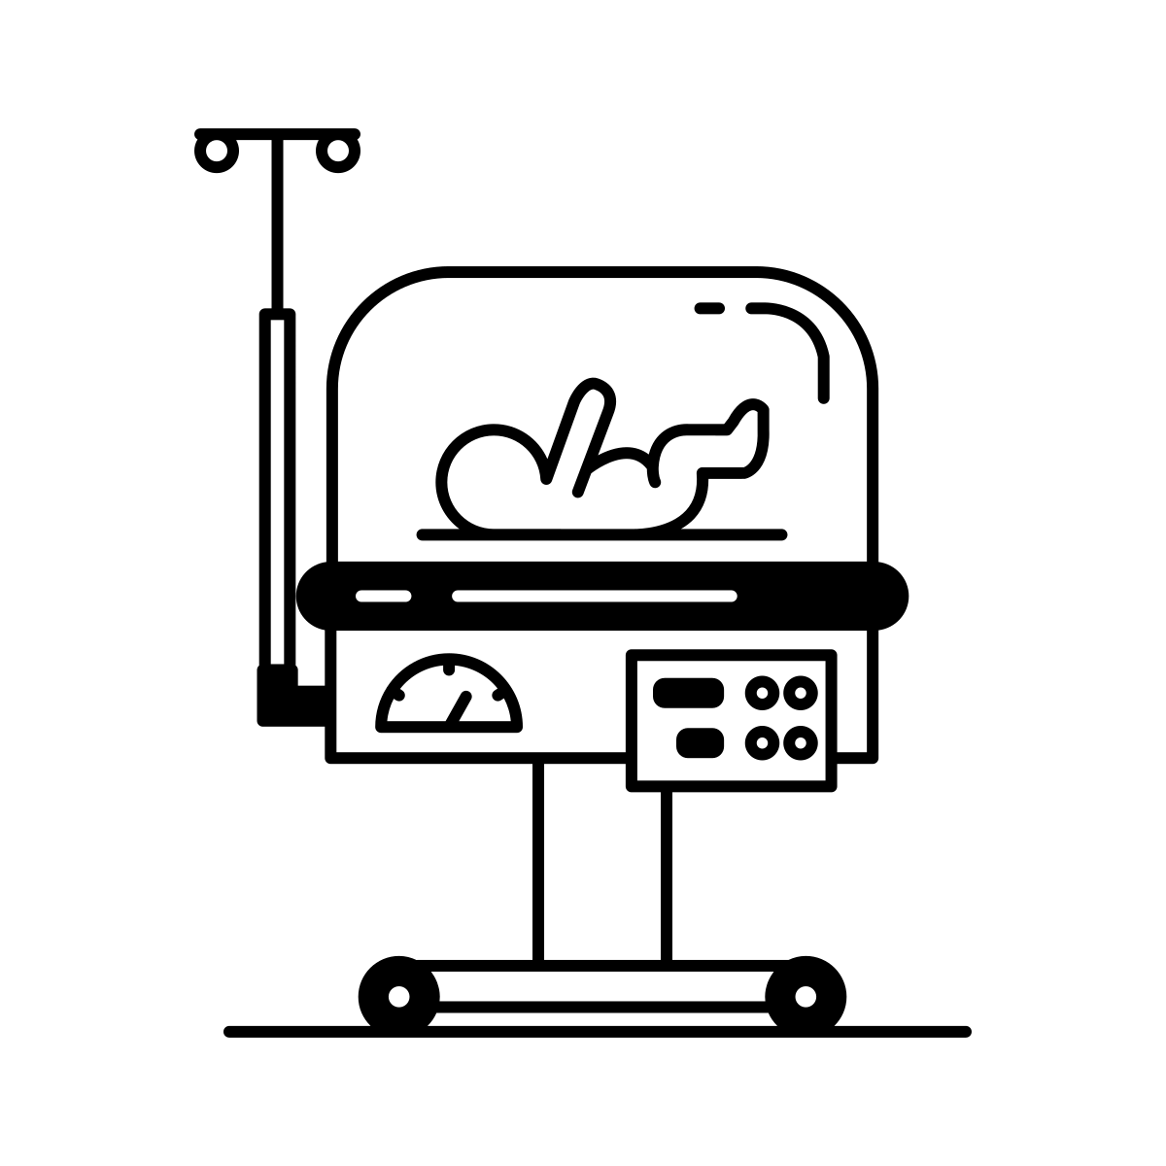

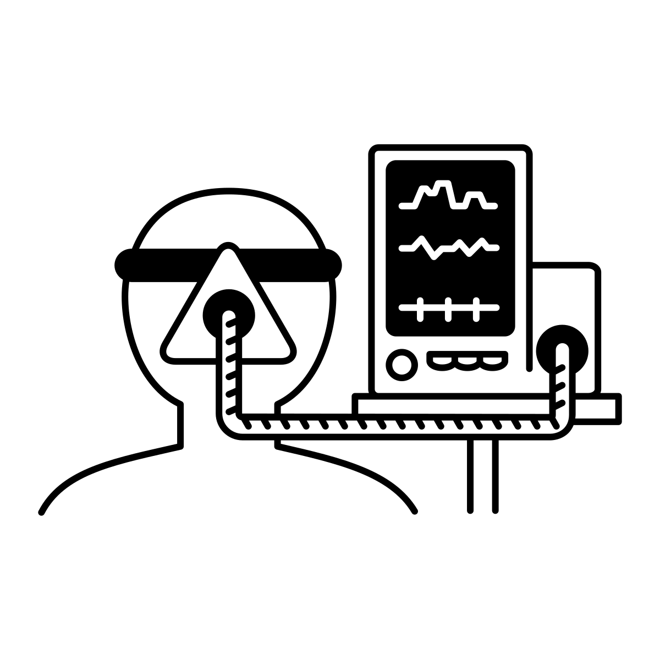
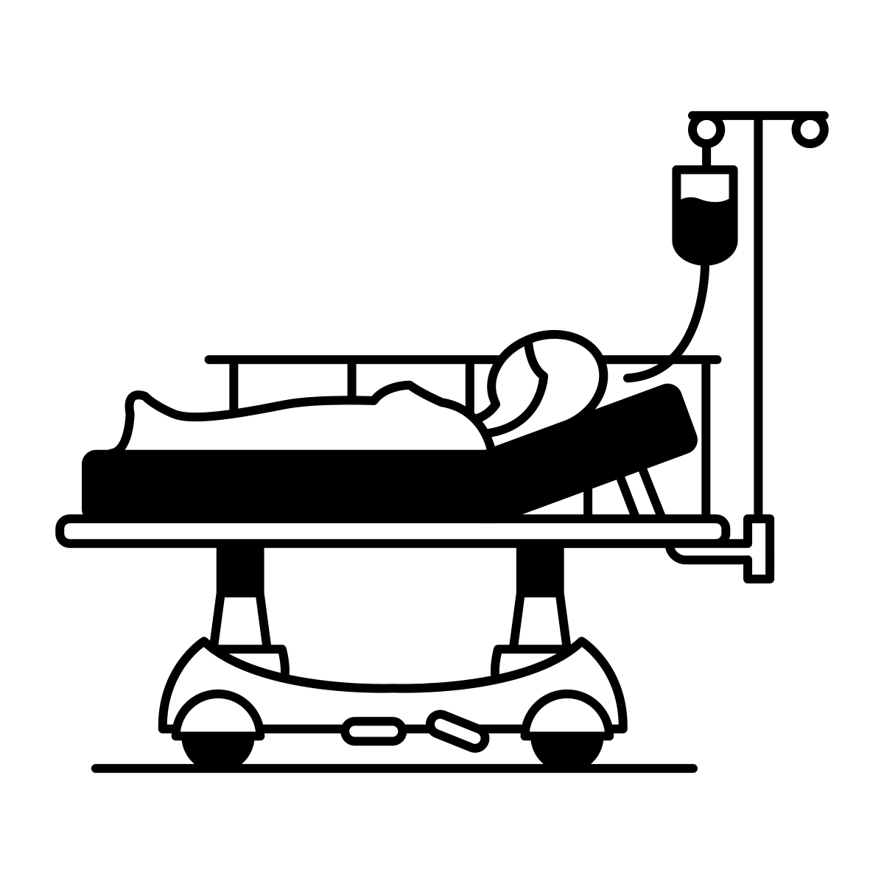


Additional Pictures

