Slide 1


Discharge Services
Package
Aphasia-friendly toolkit Feb 2024
Disclaimer: These materials were created using funding from the Provincial Community Stroke Rehabilitation Initiative and crafted by Aran Oberle, Speech Language Pathologist, with input from regional rehab programs. They are not meant to replace professional expertise. Readers should seek advice from a qualified healthcare provider for any concerns. The content of this PowerPoint can be adjusted to suit the needs of healthcare professionals. Users are accountable for confirming the accuracy and suitability of the information for their unique situations.

Slide 2
Document | English | French
Accessible Parking Permit | pg. 2 | pg. 36
Aphasia Centre | pg. 3 | pg. 37
Bruyere at Home | pg. 4 | pg. 38
Bruyere Geriatric Day Hospital | pg. 5 | pg. 39
Bruyere Outpatient Stroke | pg. 6 | pg. 40
CPP Regular | pg. 7-8 | pg. 41-42
CPP Non-terminal Illness | pg. 9-11 | pg. 43-45
CPP Terminal Illness | pg. 12-14 | pg. 46-48
Champlain Acquired Brain ABI Coalition | pg. 15 | pg. 49
Community Connections | pg. 16 | pg. 50-51
Community Paramedicine Program | pg. 17 | pg. 51
The Dementia Society | pg. 18 | pg. 52
Developmental Services Ontario | pg. 19-20 | pg. 53-54
Disability Tax Credit | pg. 21-22 | pg. 55-56
HCCSS Regular | pg. 23-24 | pg. 57-58
HCCSS H2H | pg. 25-26 | pg. 59-60
HCCSS ALS-HRS | pg. 27-28 | pg. 61-62
HCCSS Conval | pg. 29 | pg. 63
Increasing Access to Structures Psychotherapy Program | pg. 30 | pg. 64
March of Dines Home and Vehicle Modification Program | pg. 31-32 | pg. 65-66
Paratranspo | pg. 33-34 | pg. 67-68
Trilium Drug Program | pg. 35 | pg. 69

Slide 3




Accessible Parking Permit
Allow legal parking in accessible parking spots.
A regulated healthcare worker must certify that you qualify.
ONLY the permit holder can use an accessible parking spot
Permit used without permit holder
↓
$5000 fine and vehicle seizer possible
Recommended permit for you:
  PERMANENT PERMIT → valid 5 years + renewal needed
  SUBJECT TO CHANGE PERMIT → valid 5 years + recertification needed
  TEMPORARY PERMIT→ valid 12 months + recertification needed
Mail completed application to:
Service Ontario
Accessible Parking Permit Services Office
P.O. Box 9800
Kingston ON
K7L 5N8
​ Questions? ​
Government of Ontario Toll-free: 1-800-387-3445
Adapted from: Service Ontario. (2024). Get an accessible parking permit. Retrieved from https://www.ontario.ca/page/get-accessible-parking-permit

Slide 4





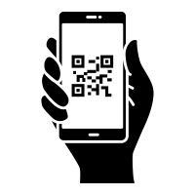
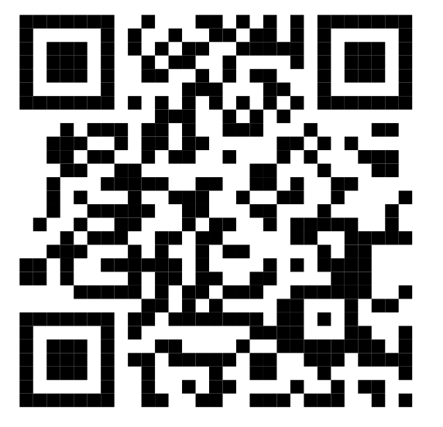
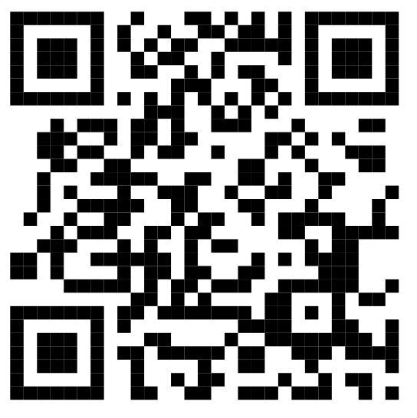

Aphasia Centre of Ottawa
The Aphasia Centre of Ottawa (ACO) is a not-for-profit
organization which works to make aphasia easier to live with by
reducing isolation, improving communication with family,
providing communication education, communication groups,
speech therapy and counselling.
The ACO employs social workers, communication disorders assistants, speech language pathologists, and volunteers who all help to provide their services.
More information: Programs at ACO: Workshops at ACO:
​ Questions? ​
Aphasia Centre of Ottawa: 613-567-1119
Info@aphasiaottawa.org
Adapted from: Aphasia Centre of Ottawa (2024). Ongoing Programs and Services. Retrieved from https://aphasiaottawa.org/programs-services/ongoing-programs/

Slide 5










Bruyère @ Home Program
Collaboration between Bruyère + Bayshore Home Health to provide services at your home. Before discharge, they will create an at home care plan
and schedule your first home visit.
Length: up to 16 weeks
Visit types: Home visits, Telephone calls, or Telemonitoring
Services:
  Service coordinator
  Registered nurses
  Personal support workers
  Occupational therapists
  Physiotherapists
  Speech-language pathologists
  Social workers
​ Questions? ​
Bruyère @ Home Toll Free 24/7: 1 866-697-4523
Adapted from: Bruyère Continuing Care. (2024).Bruyère @ Home Patient & Family Information [Brochure]

Slide 6

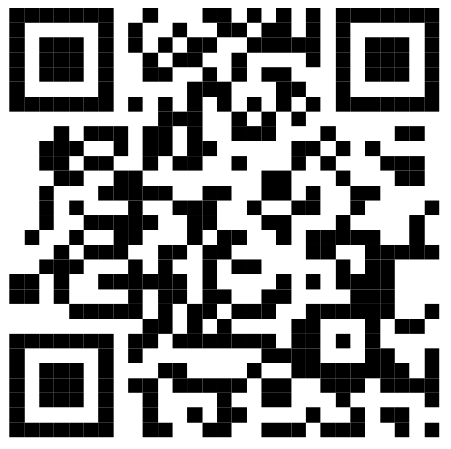
Bruyère Geriatric Day Hospital
Therapy appointments at Élisabeth Bruyère Hospital
43 Bruyère Street, Ottawa, ON, K1N 5C8
Program details:
Length of up to a maximum 8 weeks
Appointments usually 2 ½ days per week
More information:
​ Questions? ​
Bruyère Geriatric Day Hospital:
613-562-6262 ext. 4010
Adapted from: Bruyere Continuing Care. (2019). The John and Jennifer Ruddy Geriatric Day Hospital. Retrieved from https://www.bruyere.org/en/geriatric-day-hospital

Slide 7
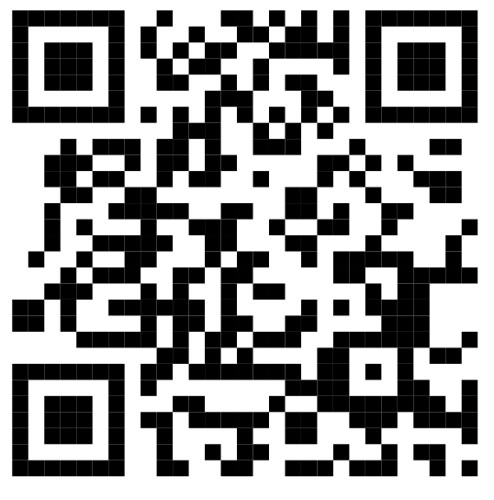
Bruyère Outpatient Stroke
Rehabilitation Program
Therapy appointments at Élisabeth Bruyère Hospital
43 Bruyère Street, Ottawa, ON, K1N 5C8
Program details:
Length of up to a maximum 12 sessions
Appointments usually 1-3 times per week
More information:
​ Questions?
Bruyère Outpatient Stroke Rehabilitation Program:
613-562-6262 ext. 1758
Adapted from: Bruyere Continuing Care. (2019). Outpatient Stroke Rehabilitation. Retrieved from https://www.bruyere.org/en/outpatient-stroke-rehab

Slide 8

Canada Pension Plan (CPP)
Regular
PAGE 1/2
Federal government program that gives a monthly, taxable payment that replaces part of income when you retire for the rest of your life.
How to qualify:
Are 60+ years old
Have paid to CPP at least once in lifetime
Factors determining how much money you receive:
Average earnings throughout life
CPP contributions throughout life
  Working in Canada
  Receiving credits from spouse/common-law partner
Age you begin receiving CPP
  The maximum monthly amount is reached at age 70. There is no benefit waiting to apply after age 70.
Adapted from: Government of Canada. (2024). CPP Retirement Pension. Retrieved from https://www.canada.ca/en/services/benefits/publicpensions/cpp.html

Slide 9

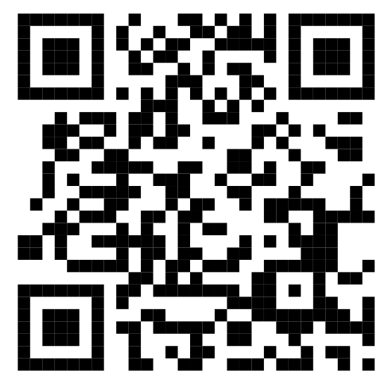

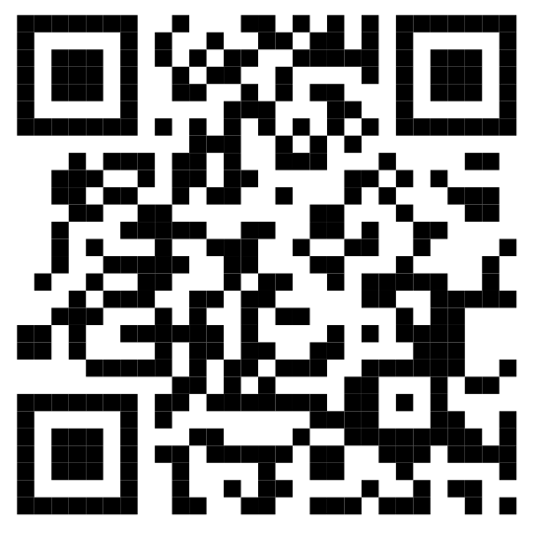
Canada Pension Plan (CPP)
Regular
PAGE 2/2
How to apply:
            Online application
            Processed in 7-14 days
  Visit website here:
  2. Click Apply Now
  -------------------------------------------------------------------
            Mail-in application
            Processed in 120 days
  Download ISP-1000 application form here:
  2. Send completed form to mailing address on page 8 of application.
​ Questions?
Canadian Pension Plan Toll-Free: 1-800-277-9914
Adapted from: Government of Canada. (2024). CPP Retirement Pension. Retrieved from https://www.canada.ca/en/services/benefits/publicpensions/cpp.html

Slide 10
Canada Pension Plan (CPP)
Non-terminal illness
PAGE 1/3
Federal government program that provides a monthly payment to people who meet all of the following criteria:
Younger than 65 years old
Have paid to CPP throughout your life
Have a mental and/or physical disability that restricts income to less than:
  $18,508.36 before tax (in 2023)
Have a disability that is long-term and/or permanent or have a disability that is likely to result in death.
​ Questions?
Canadian Pension Plan Toll-Free: 1-800-277-9914
Adapted from: Government of Canada. (2024). CPP Pension Plan Disability Benefits. Retrieved from https://www.canada.ca/en/services/benefits/publicpensions/cpp/cpp-disability-benefit.html

Slide 11
Canada Pension Plan (CPP)
Non-terminal illness
PAGE 2/3
Two types of CPP disability benefits:​
Type 1: CPP disability benefit:​
  <65 years old who ​
  are not receiving ​CPP retirement pension​
Type 2: CPP post-retirement disability benefit
  60-64 years​ old
  either already received the CPP retirement pension for 15+ months or have become disabled after receiving CPP retirement pension​
For types 1 + 2, when you turn 65 years old, CPP disability benefit is automatically changed to CPP retirement pension.​
​ Questions?
Canadian Pension Plan Toll-Free: 1-800-277-9914
Adapted from: Government of Canada. (2024). CPP Pension Plan Disability Benefits. Retrieved from https://www.canada.ca/en/services/benefits/publicpensions/cpp/cpp-disability-benefit.html

Slide 12
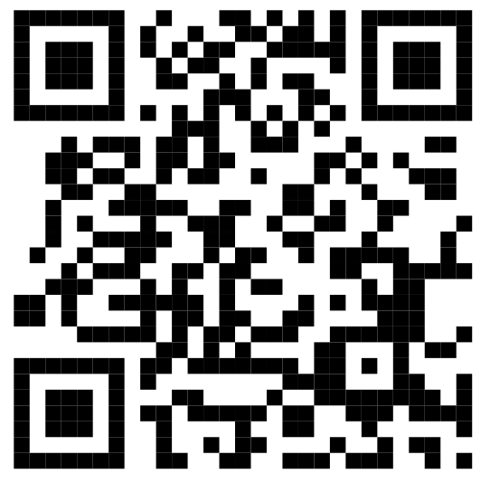
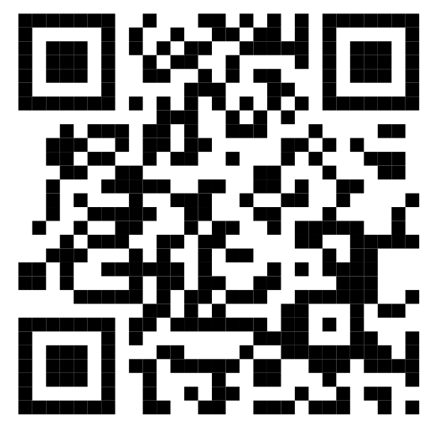
Canada Pension Plan (CPP)
Non-terminal illness
PAGE 3/3
How To Apply:
Download form ISP-1151 here:
2. Send completed form to mailing address on page 4 of the application.
Processing time: ∼120 days
If you have dependent children, you may also be eligible for CPP Children’s Benefit. More information about CPP Children's Benefit:
​ Questions?
Canadian Pension Plan Toll-Free: 1-800-277-9914
Adapted from: Government of Canada. (2024). CPP Pension Plan Disability Benefits. Retrieved from https://www.canada.ca/en/services/benefits/publicpensions/cpp/cpp-disability-benefit.html

Slide 13
Canada Pension Plan (CPP)
Terminal illness
PAGE 1/3
Federal government program that provides a monthly payment to people who meet all of the following criteria:
Younger than 65 years old
Have paid to CPP throughout your life
Have a mental and/or physical disability that restricts income to less than:
  $18,508.36 before tax (in 2023)
Have a disability that is long-term and/or permanent or have a disability that is likely to result in death.
​ Questions?
Canadian Pension Plan Toll-Free: 1-800-277-9914
Adapted from: Government of Canada. (2024). CPP Pension Plan Disability Benefits. Retrieved from https://www.canada.ca/en/services/benefits/publicpensions/cpp/cpp-disability-benefit.html

Slide 14
Canada Pension Plan (CPP)
Terminal illness
PAGE 2/3
Two types of CPP disability benefits:​
Type 1: CPP disability benefit:​
  <65 years old who ​
  are not receiving ​CPP retirement pension​
Type 2: CPP post-retirement disability benefit
  60-64 years​ old
  either already received the CPP retirement pension for 15+ months or have become disabled after receiving CPP retirement pension​
For types 1 + 2, when you turn 65 years old, CPP disability benefit is automatically changed to CPP retirement pension.​
​ Questions?
Canadian Pension Plan Toll-Free: 1-800-277-9914
Adapted from: Government of Canada. (2024). CPP Pension Plan Disability Benefits. Retrieved from https://www.canada.ca/en/services/benefits/publicpensions/cpp/cpp-disability-benefit.html

Slide 15

Canada Pension Plan (CPP)
Terminal illness
PAGE 3/3
How To Apply:
Download form ISP-2530A here:
2. Send completed form to mailing address on page 4 of the application.
Processing time: ∼5 business days
If you have dependent children, you may also be eligible for CPP Children’s Benefit. More information about CPP Children's Benefit:
​ Questions?
Canadian Pension Plan Toll-Free: 1-800-277-9914
Adapted from: Government of Canada. (2024). CPP Pension Plan Disability Benefits. Retrieved from https://www.canada.ca/en/services/benefits/publicpensions/cpp/cpp-disability-benefit.html

Slide 16



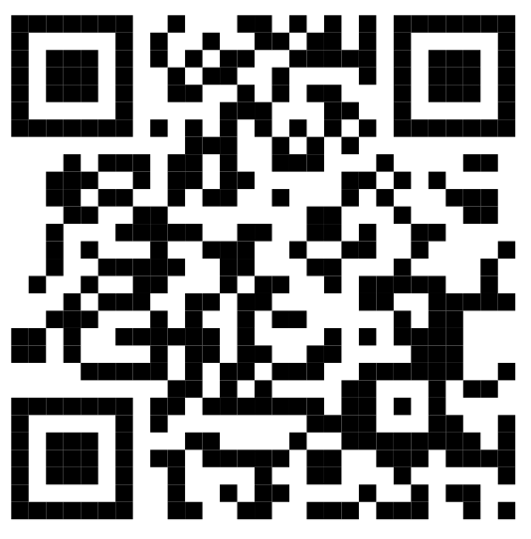

Champlain Acquired Brain Injury (ABI)
Coalition
The Champlain ABI Coalition is a group of service providers,
professionals, and brain injury survivors.
Members meet to:
Share information
Provide support + education
Help brain injury survivors + caregivers
Referral services for members by ABI System Navigators:
  Mental health supports
  Addictions supports
  Support for people with developmental delay
  Geriatric service providers
  Corrections
  Housing
More information:
​ Questions?
Champlain Acquired Brain Injury Coalition:
Info@champlainabicoalition.ca
Adapted from: Home and Community Care Support Services. (2024). ACQUIRED BRAIN INJURY - CHAMPLAIN. Retrieved from https://www.champlainhealthline.ca/listservices.aspx?id=10385

Slide 17




Community Connections
Partnership between VHA Health, the Regional Geriatric Program of Eastern Ontario (RGPEO), and the Dementia Society of Ottawa & Renfrew County. The program provides you with referral and support services during the first 8-12 weeks after discharge from hospital. You will be assigned a staff member to be your "guide".
Who it is for:
Older adults who:
  Are on wait lists for other services like:
    Home and Community Care (LHIN/ HCCSS)
    Adult day programs
    Long term care
    Specialized geriatric assessment
  Are socially isolated
  Have caregivers needing support
  Need review/expansion of existing care plans
Services include:
Health supports
Social supports
Housing supports​
Financial supports
​ Questions?
______________________________________________
Adapted from: Innovative Community Support Services. (2024). Community Connection Program. Retrieved from https://icss.ca/how-we-help/community-connection-program/

Slide 18




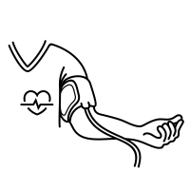



Community Paramedicine Program
The Community Paramedicine Program helps give a smooth transition home and help you feel better about your health, safety, and ability to cope.
You have been referred for:
      Remote Patient Monitoring (calls/ virtual)
      Reduced ED Visits
      Regular Check-ins
      Bedside Blood Analysis
      Vital Signs
      Palliative Care
      Episodic Exacerbation Management
      Reduced Anxiety
      _______________________________________________
​ Questions?
Community Paramedicine Program: 613-580-2418
communityparapmedicine@ottawa.ca
Adapted from: Eastern Ontario Community Paramedic Programs. (2024). About the Eastern Ontario Community Paramedic Programs. Retrieved from https://www.communityparamedics.ca/about

Slide 19
The Dementia Society
The Dementia Society of Ottawa and Renfrew County supports people who live with dementia, including people who have been diagnosed with dementia as well as their caregivers, spouses, children, and close friends.
The Dementia Society provides:
Free education
Programs
Activities
Services
​ Questions?
Dementia Society of Ottawa and Renfrew: 613-523-4004
info@dsorc.org
Adapted from: The Dementia Society Ottawa and Renfrew County. (2024). Connect with a Care Coach. Retrieved from https://dementiahelp.ca/get-help-now/connect-with-a-care-coach/

Slide 20





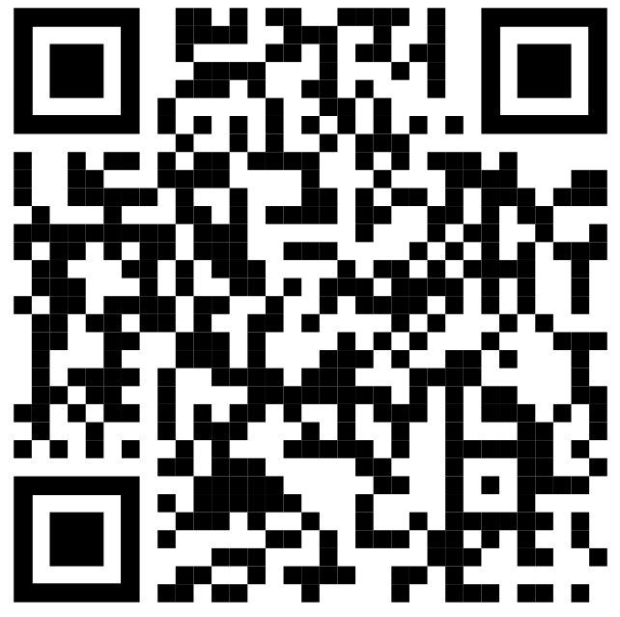
Developmental Services Ontario (DSO)
PAGE 1/2
Developmental Services Ontario (DSO) helps organize adult developmental services in Ontario.
Services include:
Housing supports
Respite for your caregivers
Supports to help you take part in the community
Specialized and clinical supports
The Adult Protective Service Worker Program
The Passport Program
​ Questions?
Developmental Services Ontario (DSO): 1-855-376-3737
Adapted from: Developmental Services Ontario. (2024). Resources. Retrieved from https://www.dsontario.ca/resources

Slide 21



Developmental Services Ontario (DSO)
To apply you must:
  Live in Ontario
  Diagnosed with developmental disability before 18th birthday
  Be 18+ years old
  How to apply:
  If you qualify, you will receive a letter and be called by DSO staff.
  They will set up 2 meetings with you to help you complete an application package. Each meeting is 3 hours long.
  You will need to bring at least 2 people who know you well (such as a parent, guardian, or teacher) to each meeting.
PAGE 2/2
​ Questions?
Developmental Services Ontario (DSO): 1-855-376-3737
Adapted from: Developmental Services Ontario. (2024). Resources. Retrieved from https://www.dsontario.ca/resources

Slide 22


Disability Tax Credit
PAGE 1/2
The disability tax credit is a government program to allow people with physical and/or mental impairments pay less income tax.
To apply you must:
Live in Ontario
Be 18+ years old
Diagnosed with developmental disability before 18th birthday
Send an application
Send a letter from a health professional
​ Questions?
Developmental Tax Credit Office: 1-800-959-8281
Adapted from: Government of Canada. (2024). Disability Tax Credit (DTC). Retrieved from https://www.canada.ca/en/revenue-agency/services/tax/individuals/segments/tax-credits-deductions-persons-disabilities/disability-tax-credit.html

Slide 23









Disability Tax Credit
PAGE 2/2
A medical health professional must provide letter saying you have:
A severe prolonged impairment in 1 area,
OR significant difficulties in 2 areas:
  Walking
  Mental function
  Dressing
  Feeding
  Life sustaining therapy (dialysis, insulin, oxygen etc.)
  Bladder/bowl function​
  Hearing​
  Speaking​
  Vision
Mail application to:
Sudbury Tax Centre, ​
PO Box 20000​
Station A​
Sudbury, ON​
P3A 5C1​
​
​ Questions?
Developmental Tax Credit Office: 1-800-959-8281
Adapted from: Government of Canada. (2024). Disability Tax Credit (DTC). Retrieved from https://www.canada.ca/en/revenue-agency/services/tax/individuals/segments/tax-credits-deductions-persons-disabilities/disability-tax-credit.html

Slide 24





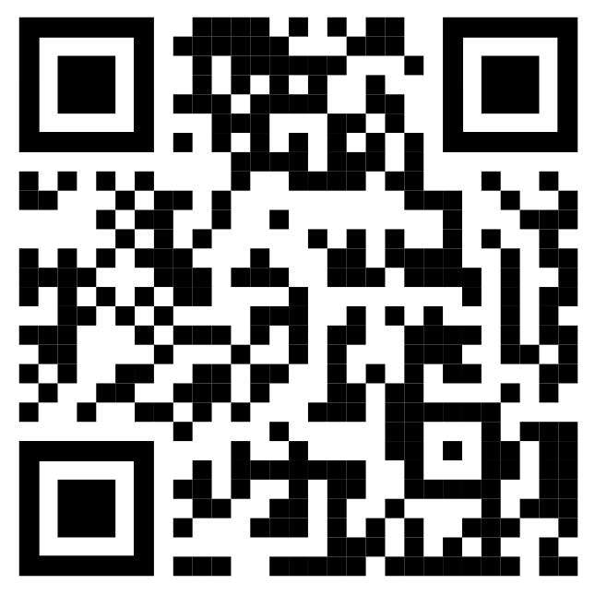
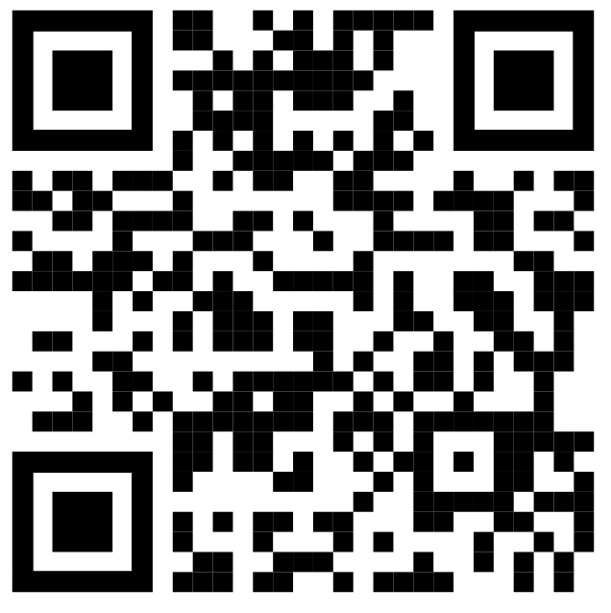
Home Care and Community Support Services (HCCSS) A.K.A. Local Health Integration Network (LHIN)
Regular
PAGE 1/2
The HCCSS helps access free or subsidized therapy and community supports.
You have been referred for:
Physiotherapy (PT)
Occupational Therapy (OT)
Speech-Language Pathology (SLP)
Nursing (RN)
Dietician (RD)
Social Work (SW)
Personal Support Services (PSS/PSW)
If the wait time is too long you can hire private services. Private services can be very expensive ($150+/hour). Private Services: Champlain Healthline Caredove
Adapted from: Home Care and Community Support Services (2024). Home Care. Retrieved from https://healthcareathome.ca/home-care/

Slide 25
Home Care and Community Support Services (HCCSS) A.K.A. Local Health Integration Network (LHIN)
Regular
PAGE 2/2
HCCSS will call you within 2 weeks of your return home for a phone assessment. The wait time after phone assessment before services start may be long, especially for PSS/PSW.
If you do not receive a call from HCCSS within 2 weeks, Call them directly at (613) 745-8124.
If the wait time is too long you can hire private services. Private services can be very expensive ($150+/hour). Private Services: Champlain Healthline Caredove
Adapted from: Home Care and Community Support Services (2024). Home Care. Retrieved from https://healthcareathome.ca/home-care/

Slide 26
Home Care and Community Support Services (HCCSS) A.K.A. Local Health Integration Network (LHIN)
H2H
PAGE 1/2
The HCCSS helps access free or subsidized therapy and community supports.
You have been referred for the Hospital 2 Home Program (H2H).
This program gives:
What: Personal support worker (PSS/ PSW) services
When: the first 2 months home
How long: Maximum 4 hours/day
How often: More often at the beginning and less often later
(ex. 4 hours/day vs 2 hours/week)
If the wait time is too long you can hire private services. Private services can be very expensive ($150+/hour). Private Services: Champlain Healthline Caredove
Adapted from: Home Care and Community Support Services (2024). Home Care. Retrieved from https://healthcareathome.ca/home-care/

Slide 27
Home Care and Community Support Services (HCCSS) A.K.A. Local Health Integration Network (LHIN)
H2H
PAGE 2/2
This program is a temporary solution for 2 month while you find a long-term solution for your care needs.
HCCSS will call you within 2 weeks of your return home for a phone assessment. The wait time after phone assessment before services start may be long, especially for PSS/PSW.
If you do not receive a call from HCCSS within 2 weeks, Call them directly at (613) 745-8124.
If the wait time is too long you can hire private services. Private services can be very expensive ($150+/hour). Private Services: Champlain Healthline Caredove
Adapted from: Home Care and Community Support Services (2024). Home Care. Retrieved from https://healthcareathome.ca/home-care/

Slide 28
Home Care and Community Support Services (HCCSS) A.K.A. Local Health Integration Network (LHIN)
ALS-HRS
PAGE 1/2
The HCCSS helps access free or subsidized therapy and community supports.
You have been referred for the Assisted Living Services for High-Risk Seniors (ALS-HRS) Program.
This program gives:
What: Personal support worker (PSS/PSW) services
Why: Instrumental activities of daily living
(ex. cooking, medications, laundry, driving etc.)
This program is for people who already have PSS/PSW services.
If the wait time is too long you can hire private services. Private services can be very expensive ($150+/hour). Private Services: Champlain Healthline Caredove
Adapted from: Ottawa West Community Support (2024). ALS-Brochure-English. Retrieved from https://owcs.ca/wp-content/uploads/ALS-Brochure-English.pdf

Slide 29
Home Care and Community Support Services (HCCSS) A.K.A. Local Health Integration Network (LHIN)
ALS-HRS
PAGE 2/2
HCCSS will call you within 2 weeks of your return home for a phone assessment. The wait time after phone assessment before services start may be long, especially for PSS/PSW.
If you do not receive a call from HCCSS within 2 weeks, Call them directly at (613) 745-8124.
If the wait time is too long you can hire private services. Private services can be very expensive ($150+/hour). Private Services: Champlain Healthline Caredove
Adapted from: Ottawa West Community Support (2024). ALS-Brochure-English. Retrieved from https://owcs.ca/wp-content/uploads/ALS-Brochure-English.pdf

Slide 30
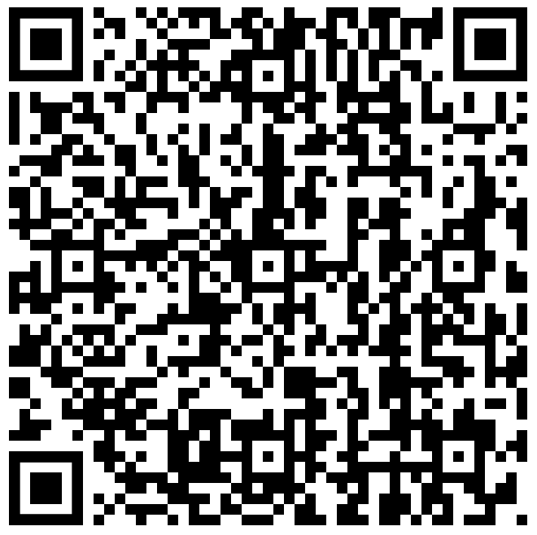
Home Care and Community Support Services (HCCSS) A.K.A. Local Health Integration Network (LHIN)
Conval
The HCCSS helps access free or subsidized therapy and community supports.
You have been referred for the Convalescent Care Program.
This program gives a living space with rehab services including:
  Occupational Therapy (OT)
  Physiotherapy (PT)
  Personal Support Services (PSS/PSW)
This program is for a maximum of 90 days.
If you do not receive a call from HCCSS within 2 weeks, Call them directly at (613) 745-8124.
More Information:
Adapted from: Home Care and Community Support Services (2024). Short Stay. Retrieved from https://healthcareathome.ca/long-term-care/short-stay/

Slide 31





Increasing Access to Structured Psychotherapy (IASP) Program
The IASP program helps access cognitive behavioural therapy (CBT) appointments that are publicly funded.
IASP therapists see clients for ~12 sessions.
Sessions are in-person or virtual.
What is CBT?
Therapy
Goal-oriented
Time-limited
Teaches practical skills
  Manage mental health
  Improve quality of life
​ Questions?
Royal Ottawa Health Care Group: 1-877-527-8207
Adapted from: The Royal (2024). IASP Champlain Region Referral Form EN. Retrieved from https://www.theroyal.ca/sites/default/files/2020-07/IASP_Champlain_Region_Referral_Form_EN_0.pdf

Slide 32









March of Dimes Home and Vehicle Modification Program
PAGE 1/2
The Home and Vehicle Modification Program (HVMP) gives up to $15,000 for home / vehicle modifications.
Applicants must first access any other funding before applying for HVMP.
HVMP eligibility criteria:
You must be a permanent resident of Ontario
You must have an ongoing or recurring disability or impairment that is anticipated to last more than 1 year
Your disability must impede mobility and restrict activities of daily living
​ Questions?
HVMP: 1-877-369-4867
hvmp@marchofdimes.ca
Adapted from: The March of Dimes. (2024). MODC's Home & Vehicle Modification® Program. Retrieved from https://www.marchofdimes.ca/en-ca/programs/am/hvmp/Pages/modchvmp.aspx

Slide 33


March of Dimes Home and Vehicle Modification Program
PAGE 2/2
People with gross annual income >$35,000 may need to help pay.
Earnings of spouses/life partners is considered.
People who receive ODSP, Ontario Works, or the Old-Age Security Guaranteed Income Supplement as the only income source do not have to help pay.
​ Questions?
HVMP: 1-877-369-4867
hvmp@marchofdimes.ca
Adapted from: The March of Dimes. (2024). MODC's Home & Vehicle Modification® Program. Retrieved from https://www.marchofdimes.ca/en-ca/programs/am/hvmp/Pages/modchvmp.aspx

Slide 34
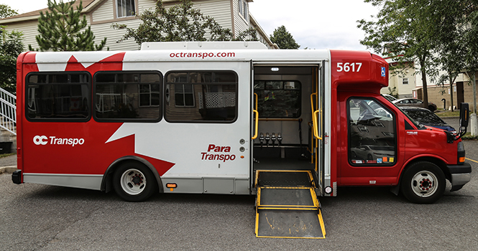

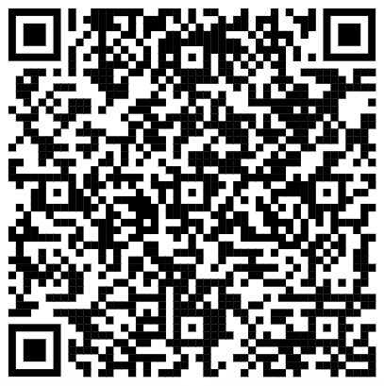
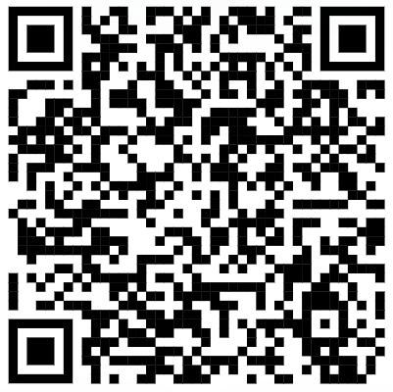

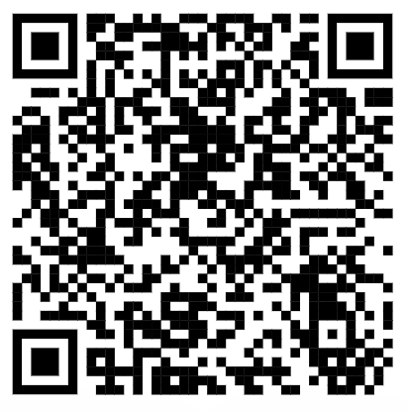

Para Transpo
Accessible bus service by OCTranspo
Does not run on a regular schedule
Need to book appointments
  at least 24 hours (1 day) in advance
How to apply for program:
  Complete application form
How to book a ride:
  My Para Transpo App
​ Fees: ​
Pay per ride​
Per 1-7 days​
Per month​
Payment Options​​
Cash​​
Debit/Credit card
ParaPay​​
Presto​​
​ Questions?
Para Transpo: 1-613-560-5000 press 1 for English, 2 for French
Adapted from: OC Transpo. (2024). Para Transpo. Retrieved from https://www.octranspo.com/en/para-transpo/

Slide 35







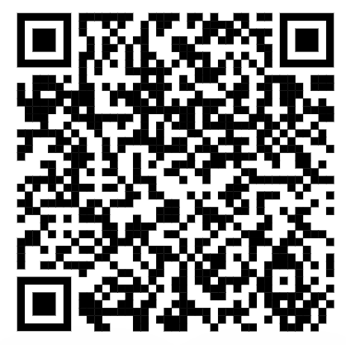
Para Transpo
RURAL Address Trips:
Rides available from rural to urban or urban to rural destinations
Extra $10 charge in cash required
Rural to rural trips possible with taxi coupon program
Taxi Coupon Program:
​ Questions?
Para Transpo: 1-613-560-5000 press 1 for English, 2 for French
Adapted from: OC Transpo. (2024). Para Transpo. Retrieved from https://www.octranspo.com/en/para-transpo/

Slide 36





Trillium Drug Program (TDP)
Program for Ontario residents with that pays for expensive prescription drug costs.
The TDP covers for over 5,000 drug products including:
  Prescription medicines
  Nutrition products
  Diabetic test agents
Deductibles and co-payments will apply to the TDP
Non-listed items are considered on case-by-case basis
  Email requests: eapfeedback.moh@ontario.ca
More information:
​ Questions? ​
Trillium Drug Program Toll-free: 1-866-811-9893
Publicdrugprgrms.moh@ontario.ca
Adapted from: Government of Ontario. (2024). Get help with high prescription drug costs. Retrieved from https://www.ontario.ca/page/get-help-high-prescription-drug-costs

Slide 37
Permit de parking accessible
Stationnement légal sur les places de parking accessibles
Un travailleur de la santé réglementé doit certifier que vous remplissez les conditions requises.
SEUL le titulaire de l'autorisation peut utiliser une place de stationnement accessible.
Permis utilisé sans titulaire
↓
Amende de 5 000 $ et possibilité de saisie du véhicule
Permis recommandé pour vous:
PERMANENT PERMIT → valable 5 ans + renouvellement nécessaire
PERMIS SOUMIS DE MODIFIER → valable 5 ans + renouvellement nécessaire
PERMIS TEMPORAIRE → valable 12 mois + renouvellement nécessaire
Envoyer le formulaire rempli à l'adresse suivante:
Service Ontario
Bureau des services des permis de stationnement accessible
Boîte postale 9800
Kingston ON
K7L 5N8
​ Questions? ​
Government d'Ontario, numéro gratuit: 1-800-387-3445
Adapté de: Service Ontario. (2024). Get an accessible parking permit. Retrieved from https://www.ontario.ca/page/get-accessible-parking-permit

Slide 38
Centre de l'aphasie d'Ottawa
Le Centre de l'aphasie d'Ottawa (CAO) est une organisation à but non lucratif qui s'efforce de rendre l'aphasie plus facile à vivre en réduisant l'isolement, en améliorant la communication avec la famille, en proposant des ateliers d'éducation à la communication, des groupes de communication, des séances d'orthophonie et des conseils.
Le Centre de l'aphasie d'Ottawa emploie des travailleurs sociaux, des assistants en troubles de la communication, des orthophonistes et des bénévoles qui contribuent tous à la prestation de leurs services.
Plus d'informations: Programmes: Ateliers:
​ Questions? ​
Centre de l'aphasie d'Ottawa: 613-567-1119
Info@aphasiaottawa.org
Adapté de: Aphasia Centre of Ottawa (2024). Ongoing Programs and Services. Retrieved from https://aphasiaottawa.org/programs-services/ongoing-programs/

Slide 39
Bruyère @ Home Program
Collaboration entre Bruyère + Bayshore pour fournir des services à domicile. Avant votre sortie, ils établiront un plan de soins à domicile et planifieront votre première visite à domicile.
Durée : jusqu'à 16 semaines
Types de visites:
Visites à domicile, appels téléphoniques ou télésurveillance
Services:
Coordinateur de service
Infirmier(e)s diplômé(e)s
Agents d'assistance personnelle
Ergothérapeutes
Physiothérapeutes
Orthophonistes
Travailleurs sociaux
​ Questions? ​
Bruyère @ Home, numéro gratuit, 24/7: 1 866-697-4523
Adapté de: Bruyère Continuing Care. (2024).Bruyère @ Home Patient & Family Information [Brochure]

Slide 40
Hôpital de jour gériatrique de Bruyère
Rendez-vous thérapeutiques à l'hôpital Élisabeth Bruyère
43 rue Bruyère, Ottawa, ON, K1N 5C8
Détails du programme:
Durée maximale de 8 semaines
Rendez-vous généralement 2 ½ jours par semaine
Plus d'information:
​ Questions? ​
Hôpital de jour gériatrique de Bruyère
613-562-6262 ext. 4010
Adapté de: Bruyere Continuing Care. (2019). The John and Jennifer Ruddy Geriatric Day Hospital. Retrieved from https://www.bruyere.org/en/geriatric-day-hospital

Slide 41
Réadaptation ambulatoire post-AVC
Rendez-vous thérapeutiques à l'hôpital Élisabeth Bruyère
43 rue Bruyère, Ottawa, ON, K1N 5C8
Détails du programme:
Durée maximale de 12 séances
Rendez-vous généralement 1 à 3 fois par semaine
Plus d'information:
​ Questions?
Réadaptation ambulatoire post-AVC:
613-562-6262 ext. 1758
Adapté de: Bruyere Continuing Care. (2019). Outpatient Stroke Rehabilitation. Retrieved from https://www.bruyere.org/en/outpatient-stroke-rehab

Slide 42
Pension de retraite du RPC
Regulier
PAGE 1/2
Programme du gouvernement fédéral qui prévoit le versement d'une somme mensuelle imposable remplaçant une partie du revenu au moment de la retraite et ce, pour le reste de la vie.
Comment en bénéficier:
Avoir plus de 60 ans
Avoir cotisé au RPC au moins une fois dans sa vie
Facteurs déterminant le montant que vous recevrez:
Salaire moyen tout au long de la vie
Cotisations au RPC tout au long de la vie
  Travailler au Canada
  Recevoir des crédits de l'époux/conjoint de fait
Âge auquel vous commencez à recevoir des prestations du RPC
  Le montant mensuel maximum est atteint à l'âge de 70 ans.
Il n'y a pas d'avantage à attendre pour faire une demande après l'âge de 70 ans.
Adapté de: Government of Canada. (2024). CPP Retirement Pension. Retrieved from https://www.canada.ca/en/services/benefits/publicpensions/cpp.html

Slide 43

Pension de retraite du RPC
Regulier
PAGE 2/2
Comment s'inscrire au programme :
          Inscription en ligne
          Traitement dans les 7 à 14 jours
1. Visiter le site web ici
2. Cliquez sur Présenter votre demande
------------------------------------------------------------------------------------------------
          Demande par courrier
          Traitée en 120 jours
1. Télécharger le formulaire de demande ISP-1000 ici:
2. Envoyer le formulaire rempli à l'adresse postale indiquée à la page 8 de la demande.
​ Questions?
Pension de retraite du RPC, numéro gratuit: 1-800-277-9914
Adapté de: Government of Canada. (2024). CPP Retirement Pension. Retrieved from https://www.canada.ca/en/services/benefits/publicpensions/cpp.html

Slide 44
Régime de pensions du Canada (RPC)
Maladie non terminale
PAGE 1/3
Programme du gouvernement fédéral qui fournit un paiement mensuel aux personnes qui répondent à tous les critères suivants:
être âgé de moins de 65 ans
Avoir cotisé au RPC tout au long de sa vie
Have a mental and/or physical disability that restricts income to less than:
Avoir un handicap mental et/ou physique qui limite le revenu à moins de:
  18 508,36 $ avant impôt (en 2023)
Avoir une incapacité de longue durée et/ou permanente ou une incapacité susceptible d'entraîner la mort.
​ Questions?
Pension de retraite du RPC, numéro gratuit: 1-800-277-9914
Adapté de: Government of Canada. (2024). CPP Pension Plan Disability Benefits. Retrieved from https://www.canada.ca/en/services/benefits/publicpensions/cpp/cpp-disability-benefit.html

Slide 45
Régime de pensions du Canada (RPC)
Maladie non terminale
PAGE 2/3
​Deux types de prestations d'invalidité du RPC:
​Type 1 : prestation d'invalidité du RPC
  <65 ans qui
  ne reçoivent pas de pension de retraite du RPC
Type 2 : prestation d'invalidité du RPC après la retraite
  60-64 ans
  ont déjà perçu la pension de retraite du RPC pendant plus de 15 mois ou sont devenus invalides après avoir perçu la pension de retraite du RPC
Pour les types 1 et 2, lorsque vous atteignez l'âge de 65 ans, la prestation d'invalidité du RPC est automatiquement transformée en pension de retraite du RPC
​ Questions?
Pension de retraite du RPC, numéro gratuit: 1-800-277-9914
Adapté de: Government of Canada. (2024). CPP Pension Plan Disability Benefits. Retrieved from https://www.canada.ca/en/services/benefits/publicpensions/cpp/cpp-disability-benefit.html

Slide 46
Régime de pensions du Canada (RPC)
Maladie non terminale
PAGE 3/3
Comment s'inscrire au programme :
Téléchargez le formulaire ISP-1151 ici:
2. Envoyer le formulaire complété à l'adresse postale indiquée à la page 4 de la demande.
Délai de traitement : ∼120 jours
Si vous avez des enfants à charge, vous pouvez également avoir droit à la prestation pour enfants du RPC. Plus d'informations sur la prestation pour enfants du RPC :
​ Questions?
Pension de retraite du RPC, numéro gratuit: 1-800-277-9914
Adapté de: Government of Canada. (2024). CPP Pension Plan Disability Benefits. Retrieved from https://www.canada.ca/en/services/benefits/publicpensions/cpp/cpp-disability-benefit.html

Slide 47
Régime de pensions du Canada (RPC)
Maladie terminale
PAGE 1/3
Programme du gouvernement fédéral qui fournit un paiement mensuel aux personnes qui répondent à tous les critères suivants:
être âgé de moins de 65 ans
Avoir cotisé au RPC tout au long de sa vie
Have a mental and/or physical disability that restricts income to less than:
Avoir un handicap mental et/ou physique qui limite le revenu à moins de:
  18 508,36 $ avant impôt (en 2023)
Avoir une incapacité de longue durée et/ou permanente ou une incapacité susceptible d'entraîner la mort.
​ Questions?
Pension de retraite du RPC, numéro gratuit: 1-800-277-9914
Adapté de: Government of Canada. (2024). CPP Pension Plan Disability Benefits. Retrieved from https://www.canada.ca/en/services/benefits/publicpensions/cpp/cpp-disability-benefit.html

Slide 48
Régime de pensions du Canada (RPC)
Maladie terminale
PAGE 2/3
​Deux types de prestations d'invalidité du RPC:
​Type 1 : prestation d'invalidité du RPC
  <65 ans qui
  ne reçoivent pas de pension de retraite du RPC
Type 2 : prestation d'invalidité du RPC après la retraite
  60-64 ans
  ont déjà perçu la pension de retraite du RPC pendant plus de 15 mois ou sont devenus invalides après avoir perçu la pension de retraite du RPC
Pour les types 1 et 2, lorsque vous atteignez l'âge de 65 ans, la prestation d'invalidité du RPC est automatiquement transformée en pension de retraite du RPC
​ Questions?
Pension de retraite du RPC, numéro gratuit: 1-800-277-9914
Adapté de: Government of Canada. (2024). CPP Pension Plan Disability Benefits. Retrieved from https://www.canada.ca/en/services/benefits/publicpensions/cpp/cpp-disability-benefit.html

Slide 49
Régime de pensions du Canada (RPC)
Maladie terminale
PAGE 3/3
Comment s'inscrire au programme :
Téléchargez le formulaire ISP-2530A ici:
2. Envoyer le formulaire complété à l'adresse postale indiquée à la page 4 de la demande.
Délai de traitement : ∼5 jours
Si vous avez des enfants à charge, vous pouvez également avoir droit à la prestation pour enfants du RPC. Plus d'informations sur la prestation pour enfants du RPC :
​ Questions?
Pension de retraite du RPC, numéro gratuit: 1-800-277-9914
Adapté de: Government of Canada. (2024). CPP Pension Plan Disability Benefits. Retrieved from https://www.canada.ca/en/services/benefits/publicpensions/cpp/cpp-disability-benefit.html

Slide 50
Coalition de la région de Champlain contre les lésions cérébrales acquises (ABI)
La Champlain ABI Coalition est un groupe de fournisseurs de services, professionnels et de survivants de lésions cérébrales.
Les membres se réunissent pour:
Partager des informations
Fournir du soutien et de l'éducation
Aider les survivants et les aidants
Services pour les membres par les navigateurs du système ABI:
  Soutien à la santé mentale
  Soutien aux toxicomanes
  Soutien aux personnes souffrant d'un retard de développement
  Fournisseurs de services gériatriques
  Services pénitentiaires
  Logement
Plus d'informations:
​ Questions?
Coalition ABI de Champlain:
Info@champlainabicoalition.ca
Adapté de: Government of Canada. (2024). CPP Pension Plan Disability Benefits. Retrieved from https://www.canada.ca/en/services/benefits/publicpensions/cpp/cpp-disability-benefit.html

Slide 51
Connexions Communautaires
Ce programme vous offre des services de soutien au cours des
8 à 12 semaines suivant votre sortie de l'hôpital. Un membre du personnel vous sera attribué pour vous servir de "guide".
À qui s'adresse ce programme ? Les personnes âgées qui:
sont sur des listes d'attente pour d'autres services tels que :
  Soins à domicile et communautaires (LHIN/ HCCSS)
  Programmes de jour pour adultes
  Soins de longue durée
  Évaluation gériatrique spécialisée
  Sont isolés socialement
  Les soignants qui ont besoin de soutien
  Ceux qui ont besoin de revoir/élargir les plans de soins existants
Les services comprennent :
Soutien à la santé ​
​
Soutien social
Aide au logement
Aides financières ​
​ Questions?
Natasha Poushinsky: npoushinsky@dsorc.org
Adapté de: Innovative Community Support Services. (2024). Community Connection Program. Retrieved from https://icss.ca/how-we-help/community-connection-program/

Slide 52
Programme des services paramédicaux communautaires
Le programme permet une transition en douceur vers le retour à la maison et vous aide à vous sentir mieux en ce qui concerne votre santé, votre sécurité et votre capacité à faire face à la situation.
Vous avez été référé pour:
      Surveillance à distance (appels/virtuels)
      Réduction des visites aux urgences
      Contrôles réguliers
      Analyse sanguine au chevet du patient
      Signes vitaux
      Soins palliatifs
      Gestion des exacerbations épisodiques
      Réduction de l'anxiété
      _______________________________________________
​ Questions?
Community Paramedicine Program: 613-580-2418
communityparapmedicine@ottawa.ca
Adapté de: Eastern Ontario Community Paramedic Programs. (2024). About the Eastern Ontario Community Paramedic Programs. Retrieved from https://www.communityparamedics.ca/about

Slide 53
La Société de la démence d'Ottawa
La Société de la démence d'Ottawa et du comté de Renfrew soutient les personnes qui vivent avec la démence, y compris les personnes qui ont reçu un diagnostic de démence ainsi que leurs aidants, leurs conjoints, leurs enfants et leurs amis proches.
La Société de la démence offre:
De l'éducation gratuite
des programmes
des activités
des services
​ Questions?
La Société de la démence d'Ottawa et du comté de Renfrew:
613-523-4004 info@dsorc.org
Adapté de: The Dementia Society Ottawa and Renfrew County. (2024). Connect with a Care Coach. Retrieved from https://dementiahelp.ca/get-help-now/connect-with-a-care-coach/

Slide 54
Services de l'Ontario pour les personnes ayant une déficience intellectuelle (SOPDI)
PAGE 1/2
Ce programme aide à organiser les services de développement pour adultes en Ontario.
Ces services comprennent:
Soutien au logement
Services de répit pour les personnes qui s'occupent de vous
Soutien pour vous aider à participer à la vie de la communauté
Soutien spécialisé et clinique
Le programme des travailleurs des services de protection des adultes
Le programme Passeport
​ Questions?
Developmental Services Ontario (DSO): 1-855-376-3737
Adapté de: Developmental Services Ontario. (2024). Resources. Retrieved from https://www.dsontario.ca/resources

Slide 55
Services de l'Ontario pour les personnes ayant une déficience intellectuelle (SOPDI)
PAGE 2/2
Pour faire la demande, vous devez:
  Vivre en Ontario
  Avoir reçu un diagnostic de déficience intellectuelle avant son 18e anniversaire
  Avoir 18 ans et plus
Comment s'inscrire ?
Si vous remplissez les conditions requises, vous recevrez une lettre et serez appelé par le personnel.
Ils organiseront 2 réunions avec vous pour vous aider à remplir une demande. Chaque réunion dure 3 heures.
Vous devrez être accompagné d'au moins 2 personnes qui vous connaissent bien (un parent, un tuteur ou un enseignant, par exemple) à chaque réunion.
​ Questions?
Developmental Services Ontario (DSO): 1-855-376-3737
Adapté de: Developmental Services Ontario. (2024). Resources. Retrieved from https://www.dsontario.ca/resources

Slide 56
Crédit d’impôt pour personnes handicapées (CIPH)
PAGE 1/2
Le crédit d'impôt pour personnes handicapées est un programme gouvernemental qui permet aux personnes souffrant de déficiences physiques et/ou mentales de payer moins d'impôts sur le revenu.
Pour en bénéficier, vous devez:
Habiter en Ontario
Avoir 18 ans et plus
Avoir reçu un diagnostic de déficience intellectuelle avant votre 18e
anniversaire
Envoyer une demande
Envoyer une lettre d'un professionnel de la santé
​ Questions?
Developmental Tax Credit Office: 1-800-959-8281
Adapté de: Government of Canada. (2024). Disability Tax Credit (DTC). Retrieved from https://www.canada.ca/en/revenue-agency/services/tax/individuals/segments/tax-credits-deductions-persons-disabilities/disability-tax-credit.html

Slide 57
Crédit d’impôt pour personnes handicapées (CIPH)
PAGE 2/2
Un professionnel de la santé doit fournir une lettre attestant que vous avez:
Une déficience grave et prolongée dans 1 domaine
OU des difficultés importantes dans 2 domaines:
  Marcher
  Capacités cognitives
  S'habiller
  Alimentation
  Thérapie de maintien en vie (dialyse, insuline, oxygène, etc.)
.
  Problèmes intestinaux
  Audition
  Parole
  Vision
Envoyer l'application à:
Sudbury Tax Centre, ​
PO Box 20000​
Station A​
Sudbury, ON​
P3A 5C1​
​
​ Questions?
Developmental Tax Credit Office: 1-800-959-8281
Adapté de: Government of Canada. (2024). Disability Tax Credit (DTC). Retrieved from https://www.canada.ca/en/revenue-agency/services/tax/individuals/segments/tax-credits-deductions-persons-disabilities/disability-tax-credit.html

Slide 58
Services de soutien à domicile et en milieu communautaire
Regulier
PAGE 1/2
Ce programme aide à accéder à des thérapies gratuites ou subventionnées et à des aides communautaires.
Vous avez été référé pour:
Physiothérapie (PT)
Ergothérapie (OT)
Orthophonie (SLP)
Soins infirmiers (RN)
Diététicien (RD)
Travail social (SW)
Services d'aide à la personne (PSS/PSW)
Si le temps d'attente est trop long, vous pouvez faire appel à des services privés. Les services privés peuvent être très coûteux (plus de 150 $/heure). Services privés: Champlain Healthline Caredove
Adapté de: Home Care and Community Support Services (2024). Home Care. Retrieved from https://healthcareathome.ca/home-care/

Slide 59
Services de soutien à domicile et en milieu communautaire
Regulier
PAGE 2/2
Ce programme vous appellera dans les deux semaines suivant votre retour à la maison pour une évaluation téléphonique.
Le temps d'attente après l'évaluation téléphonique avant le début des services peut être long, en particulier pour les PSS/PSW.
Si vous ne recevez pas d'appel du HCCSS dans les deux semaines, appelez-le directement au (613) 745-8124.
Si le temps d'attente est trop long, vous pouvez faire appel à des services privés. Les services privés peuvent être très coûteux (plus de 150 $/heure). Services privés: Champlain Healthline Caredove
Adapté de: Home Care and Community Support Services (2024). Home Care. Retrieved from https://healthcareathome.ca/home-care/

Slide 60
Services de soutien à domicile et en milieu communautaire
H2H
PAGE 1/2
Ce programme aide à accéder à des thérapies gratuites ou
subventionnées et à des aides communautaires.
Vous avez référé au programme Hospital 2 Home (H2H).
Ce programme offre:
Quoi : Services d'aide à la personne (PSS/PSW)
Quand : les deux premiers mois à domicile
Pendant combien de temps ? Maximum 4 heures par jour Fréquence : plus souvent au début et moins souvent par la suite (ex. 4 heures/jour vs 2 heures/semaine)
Si le temps d'attente est trop long, vous pouvez faire appel à des services privés. Les services privés peuvent être très coûteux (plus de 150 $/heure). Services privés: Champlain Healthline Caredove
Adapté de: Home Care and Community Support Services (2024). Home Care. Retrieved from https://healthcareathome.ca/home-care/

Slide 61
Services de soutien à domicile et en milieu communautaire
H2H
PAGE 2/2
Ce programme est une solution temporaire pour 2 mois, le temps que vous trouviez une solution à long terme pour vos besoins en matière de soins.
Ce programme vous appellera dans les deux semaines suivant votre retour à la maison pour une évaluation téléphonique.
Le temps d'attente après l'évaluation téléphonique avant le début des services peut être long, en particulier pour les PSS/PSW.
Si vous ne recevez pas d'appel du HCCSS dans les deux semaines, appelez-le directement au (613) 745-8124.
Si le temps d'attente est trop long, vous pouvez faire appel à des services privés. Les services privés peuvent être très coûteux (plus de 150 $/heure). Services privés: Champlain Healthline Caredove
Adapté de: Home Care and Community Support Services (2024). Home Care. Retrieved from https://healthcareathome.ca/home-care/

Slide 62
Services de soutien à domicile et en milieu communautaire
ALS-HRS
PAGE 1/2
.
Ce programme aide à accéder à des thérapies gratuites ou subventionnées et à des aides communautaires.
Vous avez été référé au programme de services d'aide à la vie autonome pour les personnes âgées à haut risque (ALS-HRS).
Ce programme offre:
Quoi : Services d'aide à la personne (PSS/PSW)
Pourquoi : activités instrumentales de la vie quotidienne
(ex. cuisine, médicaments, lessive, conduite automobile, etc.)
Ce programme s'adresse aux personnes qui bénéficient déjà de services d'aide à la personne.
Si le temps d'attente est trop long, vous pouvez faire appel à des services privés. Les services privés peuvent être très coûteux (plus de 150 $/heure). Services privés: Champlain Healthline Caredove
Adapté de: Ottawa West Community Support (2024). ALS-Brochure-English. Retrieved from https://owcs.ca/wp-content/uploads/ALS-Brochure-English.pdf

Slide 63
Services de soutien à domicile et en milieu communautaire
ALS-HRS
PAGE 2/2
Ce programme vous appellera dans les deux semaines suivant votre retour à la maison pour une évaluation téléphonique.
Le temps d'attente après l'évaluation téléphonique avant le début des services peut être long, en particulier pour les PSS/PSW.
Si vous ne recevez pas d'appel du HCCSS dans les deux semaines, appelez-le directement au (613) 745-8124.
Si le temps d'attente est trop long, vous pouvez faire appel à des services privés. Les services privés peuvent être très coûteux (plus de 150 $/heure). Services privés: Champlain Healthline Caredove
Adapté de: Ottawa West Community Support (2024). ALS-Brochure-English. Retrieved from https://owcs.ca/wp-content/uploads/ALS-Brochure-English.pdf

Slide 64
Services de soutien à domicile et en milieu communautaire
Conval
Ce programme aide à accéder à des thérapies gratuites ou subventionnées et à des aides communautaires.
Vous avez été référé au programme de soins de convalescence. Ce programme offre un espace de vie et des services de réadaptation:
  Ergothérapie (OT)
  Physiothérapie (PT)
  Services d'aide à la personne (PSS/PSW)
Ce programme est d'une durée maximale de 90 jours.
Si vous ne recevez pas d'appel du programme dans les deux semaines, appelez-le directement au (613) 745-8124.
Plus d'information:
Adapté de: Home Care and Community Support Services (2024). Short Stay. Retrieved from https://healthcareathome.ca/long-term-care/short-stay/

Slide 65

Increasing Access to Structured Psychotherapy (IASP) Program
Ce programme permet d'accéder à des rendez-vous de thérapie cognitivocomportementale (TCC) financés par l'État. Les thérapeutes du programme reçoivent les clients pour environ 12 séances.
Les séances se déroulent en personne ou virtuellement.
Qu'est-ce que la TCC ?
La thérapie
Orientée vers un objectif
Limitée dans le temps
Enseigne des compétences pratiques
Gérer la santé mentale
Améliorer la qualité de vie
​ Questions?
Royal Ottawa Health Care Group: 1-877-527-8207
Adapté de: The Royal (2024). IASP Champlain Region Referral Form EN. Retrieved from https://www.theroyal.ca/sites/default/files/2020-07/IASP_Champlain_Region_Referral_Form_EN_0.pdf

Slide 66
Programme d'adaptatin des habitations et des véhicules (PAHV)
de la MDSC
PAGE 1/2
Le programme de modification des habitations et des véhicules (HVMP) offre jusqu'à 15 000 dollars pour la modification des habitations et des véhicules.
Vous devez d'abord accéder à tout autre financement avant de faire une demande au HVMP.
Critères d'admissibilité:
Vous devez être un résident permanent de l'Ontario
Vous devez être atteint d'un handicap ou d'une déficience permanente ou récurrente qui devrait durer plus d'un an.
Votre handicap doit entraver la mobilité et restreindre les activités de la vie quotidienne.
​ Questions?
HVMP: 1-877-369-4867
hvmp@marchofdimes.ca
Adapté de: The March of Dimes. (2024). MODC's Home & Vehicle Modification® Program. Retrieved from https://www.marchofdimes.ca/en-ca/programs/am/hvmp/Pages/modchvmp.aspx

Slide 67
Programme d'adaptatin des habitations et des vehicules (PAHV)
de la MDSC
PAGE 1/2
Les personnes dont le revenu annuel brut est supérieur à 35 000 dollars pourraient devoir contribuer au paiement.
Les revenus des conjoints/partenaires de vie sont pris en compte
Les personnes qui reçoivent le POSPH, le programme Ontario au travail ou le Supplément de revenu garanti de la Sécurité de la vieillesse comme seule source de revenu n'ont pas à contribuer au paiement.
​ Questions?
HVMP: 1-877-369-4867
hvmp@marchofdimes.ca
Adapté de: The March of Dimes. (2024). MODC's Home & Vehicle Modification® Program. Retrieved from https://www.marchofdimes.ca/en-ca/programs/am/hvmp/Pages/modchvmp.aspx

Slide 68
Para Transpo
Service de bus accessible par OCTranspo
Ne fonctionne pas selon un horaire régulier
Nécessité de prendre rendez-vous
  au moins 24 heures (1 jour) à l'avance
Comment s'inscrire au programme :
Remplir le formulaire de candidature
Comment réserver un trajet:
  App My Para Transpo
​ Frais: ​
Payer par trajet
Par 1-7 jours​
Par mois​
Options de paiement​​
En espèces
Carte de débit/crédit
ParaPay​​
Presto​​
​ Questions?
Para Transpo: 1-613-560-5000 press 1 for English, 2 for French
Adapté de: OC Transpo. (2024). Para Transpo. Retrieved from https://www.octranspo.com/en/para-transpo/

Slide 69
Para Transpo
Trajets RURAUX:
Trajets possibles de la campagne à la ville
ou de la ville à la campagne
Frais supplémentaires de 10 $ en espèces requis
Possibilité de voyager d'une zone rurale à l'autre grâce
au programme de coupons de taxi
Coupons de Taxi:
​ Questions?
Para Transpo: 1-613-560-5000 appuyer 2 pour le français,
1 pour l'anglais
Adapté de: OC Transpo. (2024). Para Transpo. Retrieved from https://www.octranspo.com/en/para-transpo/

Slide 70
Programme de médicaments Trillium (PMT)
Programme destiné aux résidents de l'Ontario atteints d'une maladie grave qui prend en charge les coûts élevés des médicaments sur ordonnance. Le PMT couvre plus de 5 000 produits pharmaceutiques, notamment:
Médicaments sur ordonnance
Produits nutritionnels
Agents de test pour diabétiques
Les franchises et les quotes-parts s'appliquent au TDP.
Les produits non listés sont examinés au cas par cas.
  Demandes par courriel : eapfeedback.moh@ontario.ca
Plus d'information:
​ Questions? ​
Programme de médicaments Trillium (PMT), numéro gratuit:
1-866-811-9893
Publicdrugprgrms.moh@ontario.ca
Adapté de: Government of Ontario. (2024). Get help with high prescription drug costs. Retrieved from https://www.ontario.ca/page/get-help-high-prescription-drug-costs

