Slide 1


Family Meeting Handout
Aphasia-friendly toolkit Feb 2024
Disclaimer: These materials were created using funding from the Provincial Community Stroke Rehabilitation Initiative and crafted by Aran Oberle, Speech Language Pathologist, with input from regional rehab programs. They are not meant to replace professional expertise. Readers should seek advice from a qualified healthcare provider for any concerns. The content of this PowerPoint can be adjusted to suit the needs of healthcare professionals. Users are accountable for confirming the accuracy and suitability of the information for their unique situations.

Slide 2

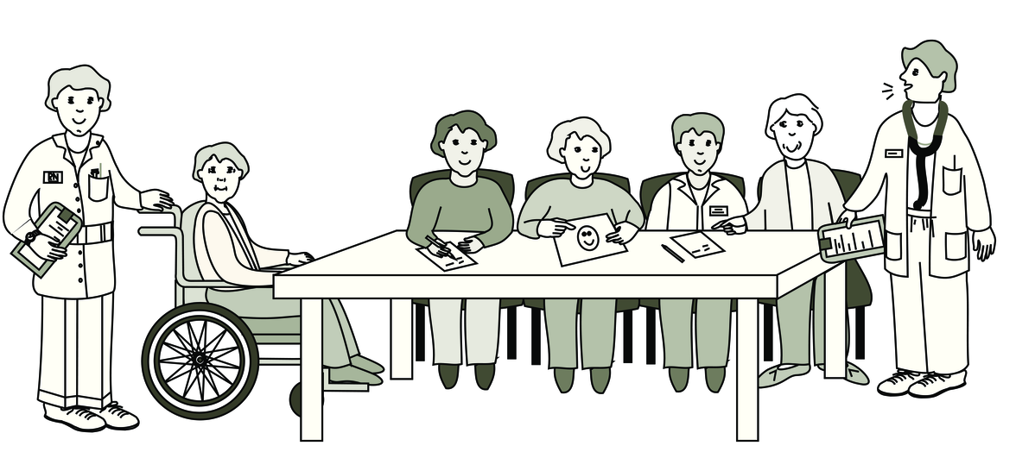


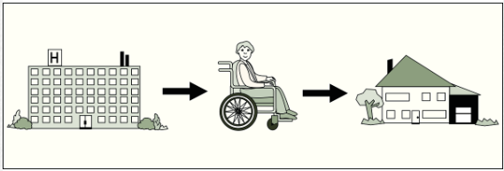

Family Meeting
Date: ________________________________
Time: ________________________________
Place:_______________________________
______________________________________
Family + supports at meeting:___________
_____________________________________________________________________________________________________________________
Images used are from ParticiPics – a free, searchable database of pictographic images developed by the Aphasia Institute, ​https://www.aphasia.ca/participics

Slide 3
Family Meeting
Meeting with rehab team to discuss:
Progress in therapy
Expectations for recovery
Next steps
  Referrals for other services
  Family training
  __________________________
Discharge from hospital
Images used are from ParticiPics – a free, searchable database of pictographic images developed by the Aphasia Institute, ​https://www.aphasia.ca/participics

Slide 4








Family Meeting
Who will be present at the meeting:
Hospitalist Doctor: __________________________
Physiatrist Doctor: __________________________
Physiotherapist: ____________________________
Occupational Therapist: ____________________
Speech-Language Pathologist: _____________
Social Worker: _____________________________
Dietitian: __________________________________
Clinical Care Lead: ________________________
___________________________________________
___________________________________________
___________________________________________

Slide 5

Family Meeting
Questions?
________________________________________________________________________________________________________________________________________________________________________________________________________________________________________________________________________________________________________________________________________________________________________________________________________________________________________________________________________________________________

Slide 6
Réunion de famille
Date: ________________________________
Heure: ________________________________
Endroit:________________________________
______________________________________
Famille + soutiens à la réunion:_________
_____________________________________________________________________________________________________________________
Images used are from ParticiPics – a free, searchable database of pictographic images developed by the Aphasia Institute, ​https://www.aphasia.ca/participics

Slide 7
Réunion de famille
Réunion avec l'équipe de rééducation pour discuter:
Progrès en thérapie
Attentes en matière de rétablissement
Prochaines étapes
  Orientations vers d'autres services
  Formation de famille
  __________________________
Congé de l'hôpital
Images used are from ParticiPics – a free, searchable database of pictographic images developed by the Aphasia Institute, ​https://www.aphasia.ca/participics

Slide 8
Réunion de famille
Qui sera présent à la réunion:
Médecin: _____________________________________________
Physiatre:_____________________________________________
Physiothérapeute (PT): ________________________________
Ergothérapeute (OT): __________________________________
Orthophoniste (SLP): __________________________________
Travailleur(euse) Sociale (SW): _________________________
Diététicien(ne) (RD): __________________________________
Responsable des soins cliniques: ______________________
______________________________________________________
______________________________________________________
______________________________________________________

Slide 9
Réunion de famille
Questions?
________________________________________________________________________________________________________________________________________________________________________________________________________________________________________________________________________________________________________________________________________________________________________________________________________________________________________________________________________________________________

