Slide 1

Medication Summary Handout
Aphasia-friendly toolkit Nov 2024
Disclaimer: These materials were created using funding from the Provincial Community Stroke Rehabilitation Initiative and crafted by Aran Oberle, Speech Language Pathologist, with input from regional rehab programs. They are not meant to replace professional expertise. Readers should seek advice from a qualified healthcare provider for any concerns. The content of this PowerPoint can be adjusted to suit the needs of healthcare professionals. Users are accountable for confirming the accuracy and suitability of the information for their unique situations.

Slide 2
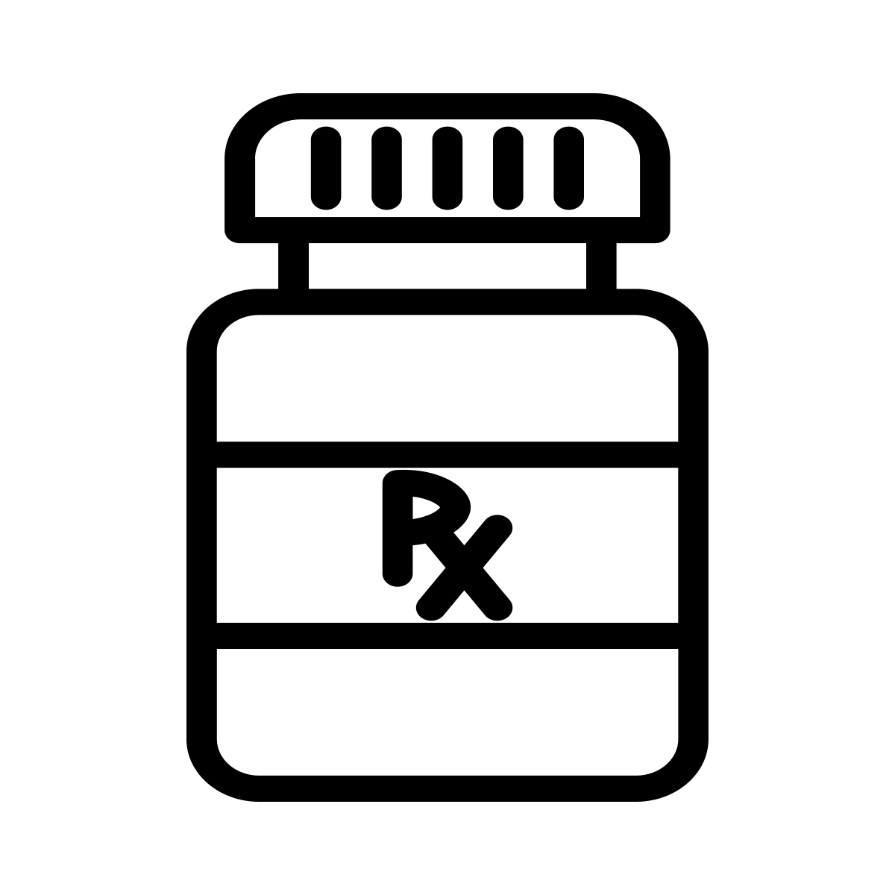

Medication Summary
*These handouts summarize key details about the medications.
They do not encompass all indications and side effects for each medication.
Information was obtained from UptoDate, Lexidrug, and RxFiles in July 2024.
Medication | English Slide # | French Slide #
Metoprolol Bisoprolol | 5 6 | 54 55
Diltiazem | 7 | 56
Amlodopine | 8 | 57
Indapamide Hydrochlorothiazide Chlorthalidone | 9 10 11 | 58 59 60
Spironolactone | 12 | 61
Ramipril Perindopril | 13 14 | 62 63
Candesartan | 15 | 64
Digoxin | 16 | 65
Atorvastatin Rosuvastatin | 17 18 | 66 67
Asa Clopidogrel Ticagrelor | 19 20 21 | 68 69 70
Apixaban Dabigatran Rivaroxaban | 22 23 24 | 71 72 73
Metformin | 25 | 74
Gliclazide | 26 | 75
Sitagliptin Lingliptin | 27 28 | 76 77
Semaglutide | 29 | 78
Empagliflozin | 30 | 79
Pantoprazole | 31 | 80
Metoclopramide Domperidone | 32 33 | 81 82
Amitryptiline | 34 | 83

Slide 3
Medication Summary
Medication | English Slide # | French Slide #
Duloxetine Venlafaxine | 35 36 | 84 85
Gabapentin Pregabalin | 37 38 | 86 87
Alendronate Risedronate | 39 40 | 88 89
Colchicine | 41 | 90
Levetiracetam (Keppra) | 42 | 91
Mirtazapine | 43 | 92
Sertraline | 44 | 93
Citalopram | 45 | 94
Escitalopram | 46 | 95
Aripiprazole | 47 | 96
Trazadone | 48 | 97
Naltrexone | 49 | 98
Varenicline | 50 | 99
Tamsulosin | 51 | 100
Botox | 52 | 101
TEMPLATE FOR NEW MEDS | 53 | 102

Slide 4
Medication Summary
Medication | English | French

Slide 5




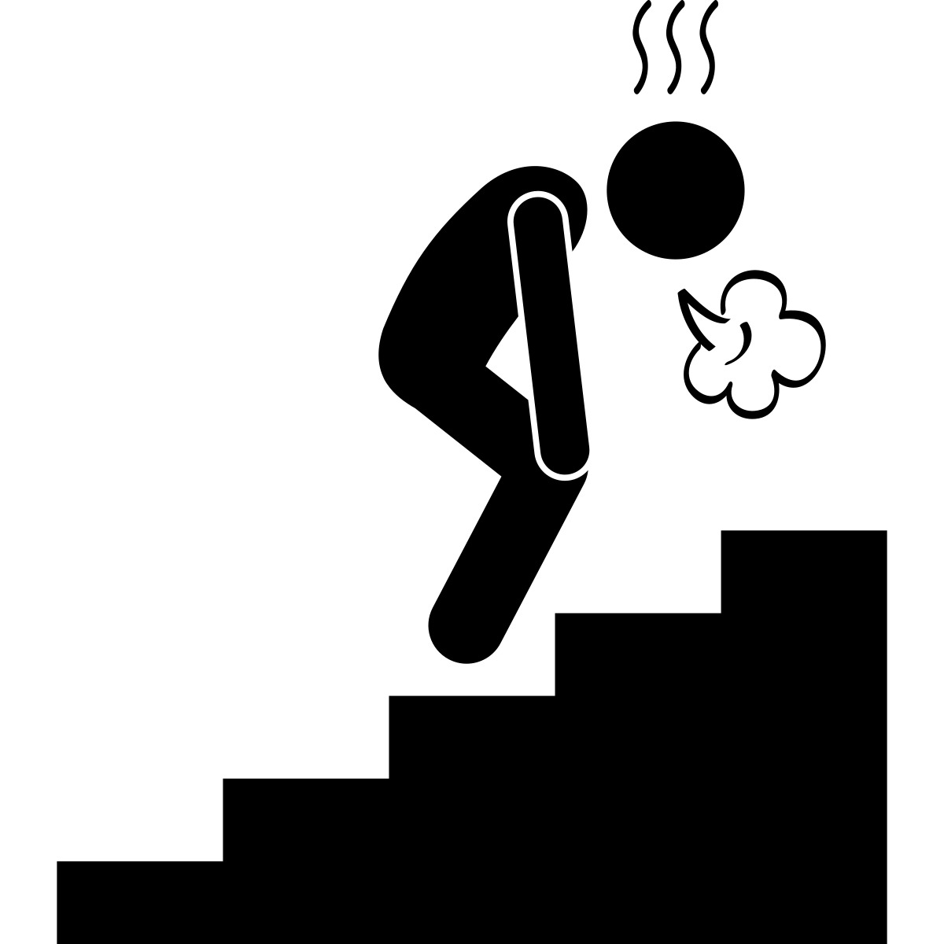



METOPROLOL
METOPROLOL BISOPROLOL DILTIAZEM
What is it for? Heart disease, Atrial Fibrillation
Possible side effect? Fatigue, vivid dreams, exercise intolerance, sexual malfunction, dizziness
For: Heart Disease, Atrial Fibrillation
Possible side effects:
    Fatigue
    Vivid dreams
    Exercise intolerance
    Dizziness
    Sexual malfunction

Slide 6
BISOPROLOL
METOPROLOL BISOPROLOL DILTIAZEM
What is it for? Heart disease, Atrial Fibrillation
Possible side effect? Fatigue, vivid dreams, exercise intolerance, sexual malfunction, dizziness
For: Heart Disease, Atrial Fibrillation
Possible side effects:
    Fatigue
    Vivid dreams
    Exercise intolerance
    Dizziness
    Sexual malfunction

Slide 7
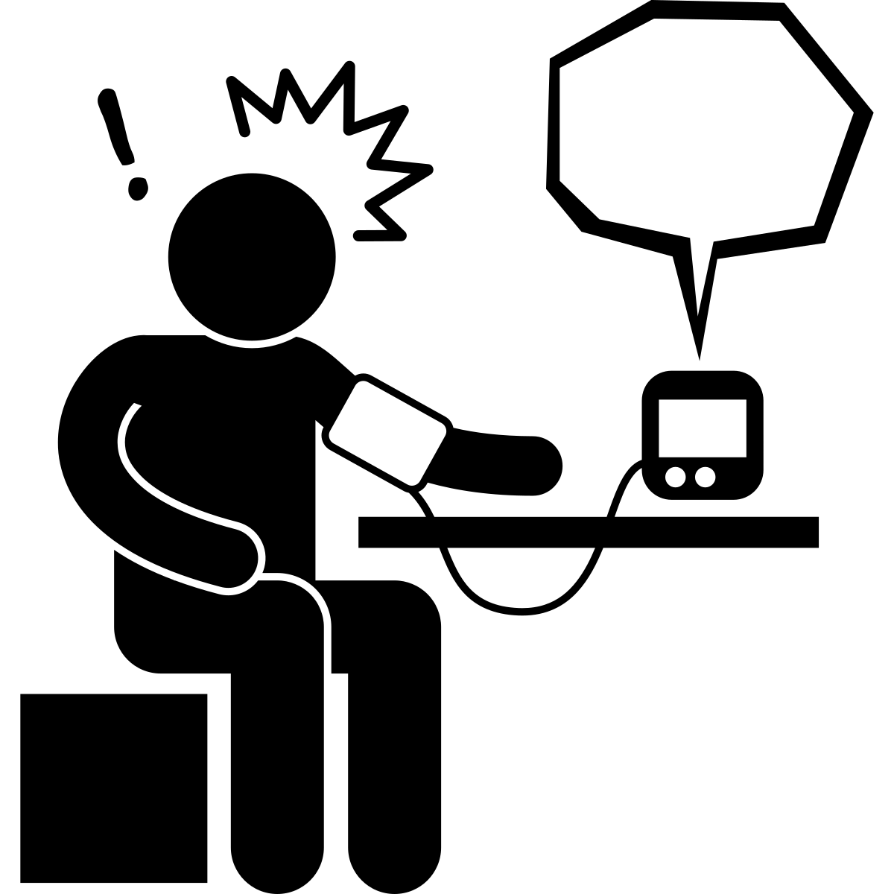


DILTIAZEM
METOPROLOL BISOPROLOL DILTIAZEM
What is it for? Heart disease, Atrial Fibrillation
Possible side effect? Fatigue, vivid dreams, exercise intolerance, sexual malfunction, dizziness
For: Atrial Fibrillation, High Blood Pressure
Possible side effects:
    Fatigue
    Leg swelling
    Rash
    Dizziness

Slide 8

AMLODIPINE
AMLODIPINE
What is it for? high blood pressure
Possible side effect? Headache, leg swelling, dizziness
For: High Blood Pressure
Possible side effects:
    Fatigue
    Leg swelling
    Dizziness

Slide 9

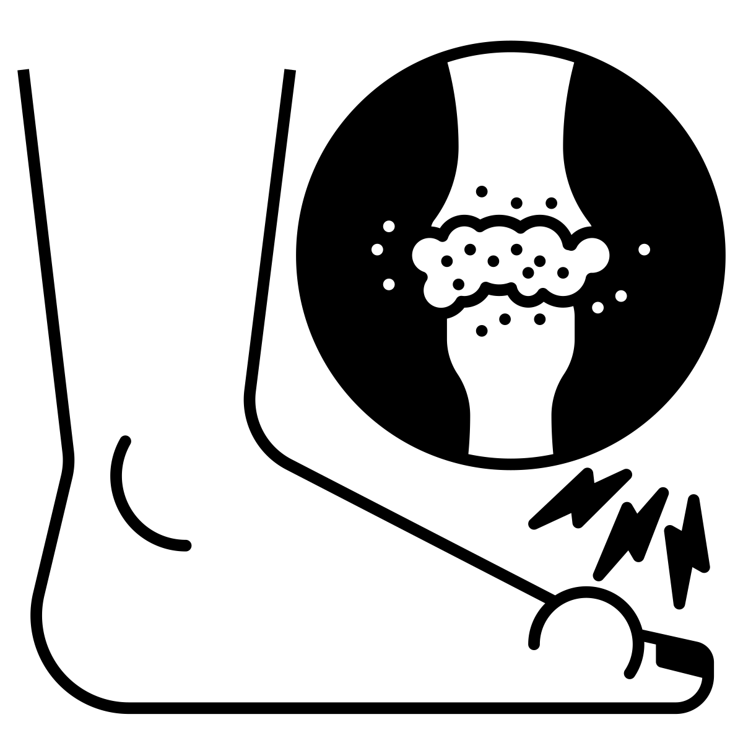
INDAPAMIDE
For: High Blood Pressure
Possible side effects:
    Dizziness
    Abnormal electrolytes
    (blood work monitored by _____________)
    Possible Gout
INDAPAMIDE HYDROCHLOROTHIAZIDE CHLORTHALIDONE
What is it for? high blood pressure
Possible side effect? Dizziness, abnormal electrolytes (blood work monitored), possible gout

Slide 10
HYDROCHLOROTHIAZIDE
For: High Blood Pressure
Possible side effects:
    Dizziness
    Abnormal electrolytes
    (blood work monitored by _____________)
    Possible Gout
INDAPAMIDE HYDROCHLOROTHIAZIDE CHLORTHALIDONE
What is it for? high blood pressure
Possible side effect? Dizziness, abnormal electrolytes (blood work monitored), possible gout

Slide 11
CHLORTHALIDONE
For: High Blood Pressure
Possible side effects:
    Dizziness
    Abnormal electrolytes
    (blood work monitored by _____________)
    Possible Gout
INDAPAMIDE HYDROCHLOROTHIAZIDE CHLORTHALIDONE
What is it for? high blood pressure
Possible side effect? Dizziness, abnormal electrolytes (blood work monitored), possible gout

Slide 12

SPIRONOLACTONE
For: High Blood Pressure, Heart Disease
Possible side effects:
    Painful breasts
    Sexual malfunction
    Abnormal electrolytes
    (blood work monitored by _____________)
SPIRONOLACTONE
What is it for? high blood pressure, Heart disease
Possible side effect? Painful breasts, al malfunction, abnormal electrolytes (blood work monitored)

Slide 13


RAMIPRIL
For: Heart Disease, Atrial Fibrillation
Possible side effects:
    Cough
    Abnormal taste
    Dizziness
    Abnormal electrolytes
    (blood work monitored by _________)
RAMIPRIL PERINDOPRIL
What is it for? Heart disease, kidney disease, high blood pressure
Possible side effect? Cough, abnormal taste, dizziness, abnormal electrolytes (blood work monitored)

Slide 14
PERINDOPRIL
For: Heart Disease, Atrial Fibrillation
Possible side effects:
    Cough
    Abnormal taste
    Dizziness
    Abnormal electrolytes
    (blood work monitored by _________)
RAMIPRIL PERINDOPRIL
What is it for? Heart disease, kidney disease, high blood pressure
Possible side effect? Cough, abnormal taste, dizziness, abnormal electrolytes (blood work monitored)

Slide 15

CANDESARTAN
For: Heart Disease, Kidney Disease,
High Blood Pressure
Possible side effects:​
    Cough​
    Abnormal taste​
    Dizziness​
    Abnormal electrolytes​
(blood work monitored by _______)

Slide 16

DIGOXIN
For: Heart Disease,
Atrial Fibrillation
Possible side effects:
    Toxicity (rare)
DIGOXIN
What is it for? Heart disease
Possible side effect? Toxicity, rare if no kidney disease and on no diuretic (water pill)

Slide 17



ATORVASTATIN
For: prevention of Heart Disease,
prevention of Stroke, Cholesterol
Possible side effects:
    Muscle problems (rare)
ATORVASTATIN ROSUVASTATIN
What is it for? Prevention of heart disease/ strokes “Cholesterol medication”
Possible side effect? Minimal. Rare (0.2%) but severe muscle side effect possible.

Slide 18
ROSUVASTATIN
For: prevention of Heart Disease,
prevention of Stroke, Cholesterol
Possible side effects:
    Muscle problems (rare)
ATORVASTATIN ROSUVASTATIN
What is it for? Prevention of heart disease/ strokes “Cholesterol medication”
Possible side effect? Minimal. Rare (0.2%) but severe muscle side effect possible.

Slide 19


ASA
For: prevention of Heart Disease,
prevention of Stroke, Blood Thinner
Possible side effects:
    Bleeding
ASA CLOPIDOGREL TICAGRELOR
What is it for? Prevention of heart disease/ strokes “blood thinner”
Possible side effect? Bleeding (stomach, less commonly brain)

Slide 20
CLOPIDOGREL
For: prevention of Heart Disease,
prevention of Stroke, Blood Thinner
Possible side effects:
    Bleeding
ASA CLOPIDOGREL TICAGRELOR
What is it for? Prevention of heart disease/ strokes “blood thinner”
Possible side effect? Bleeding (stomach, less commonly brain)

Slide 21
TICAGRELOR
For: prevention of Heart Disease,
prevention of Stroke, Blood Thinner
Possible side effects:
    Bleeding
ASA CLOPIDOGREL TICAGRELOR
What is it for? Prevention of heart disease/ strokes “blood thinner”
Possible side effect? Bleeding (stomach, less commonly brain)

Slide 22


APIXABAN
For: prevention of Stroke,
prevention of Blood Clot, Blood Thinner
Possible side effects:
    Bleeding
    Stomach upset
APIXABAN DABIGATRAN RIVAROXABAN
What is it for? Prevention of strokes due to heart disease. Prevention of venous blood clot “blood thinner”
Possible side effect? Bleeding (stomach, less commonly brain) Dabigatran: stomach upset

Slide 23
DABIGATRAN
For: prevention of Stroke,
prevention of Blood Clot, Blood Thinner
Possible side effects:
    Bleeding
    Stomach upset
APIXABAN DABIGATRAN RIVAROXABAN
What is it for? Prevention of strokes due to heart disease. Prevention of venous blood clot “blood thinner”
Possible side effect? Bleeding (stomach, less commonly brain) Dabigatran: stomach upset

Slide 24
RIVAROXABAN
For: prevention of Stroke,
prevention of Blood Clot, Blood Thinner
Possible side effects:
    Bleeding
    Stomach upset
APIXABAN DABIGATRAN RIVAROXABAN
What is it for? Prevention of strokes due to heart disease. Prevention of venous blood clot “blood thinner”
Possible side effect? Bleeding (stomach, less commonly brain) Dabigatran: stomach upset

Slide 25


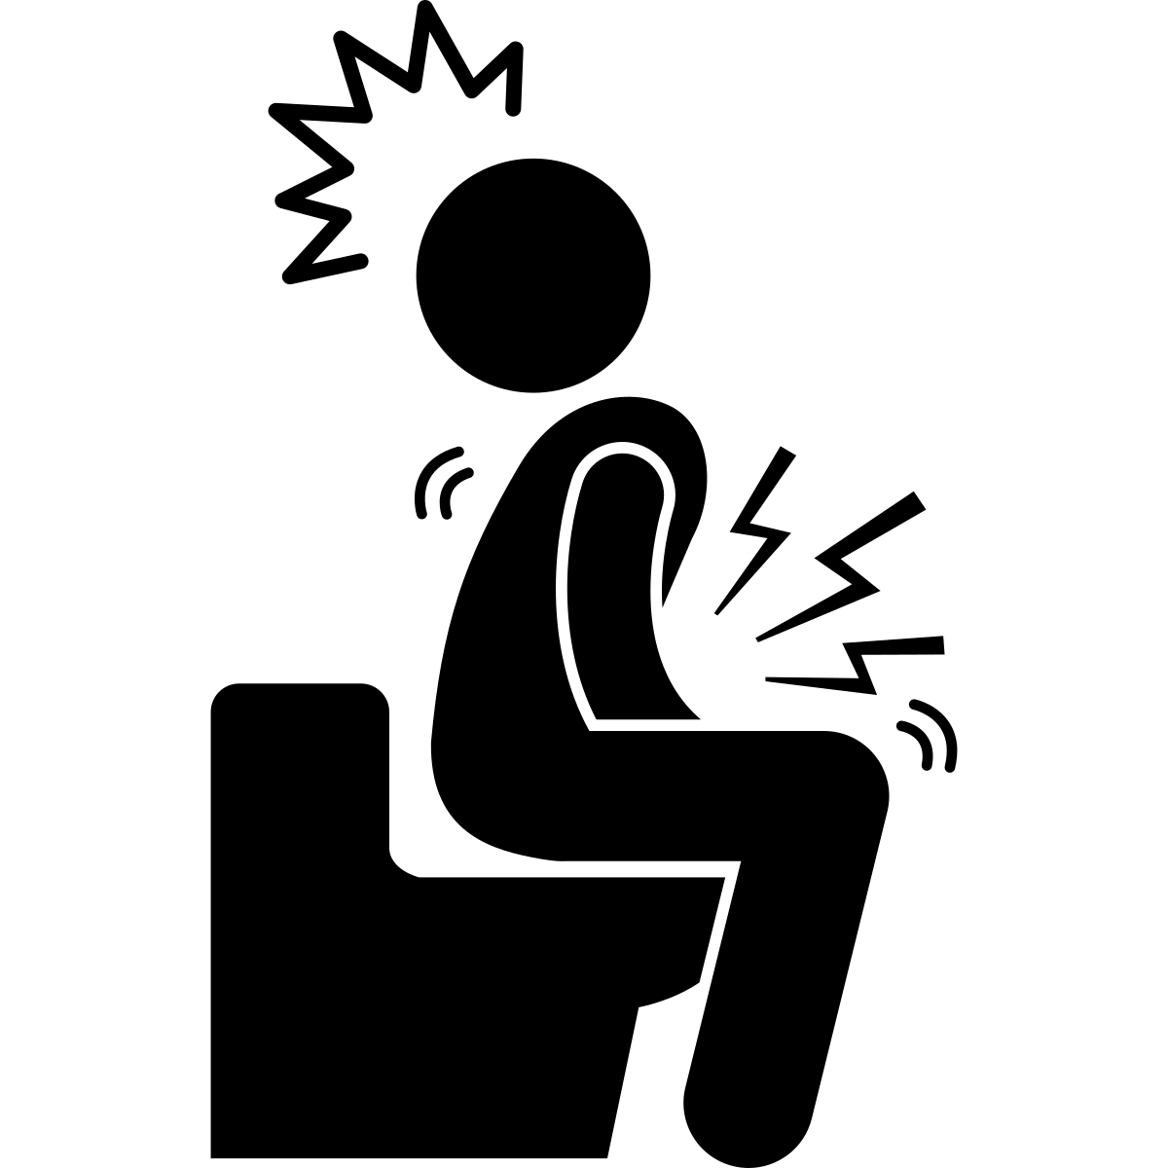
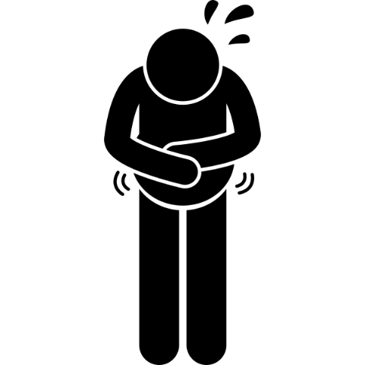
METFORMIN
For: Diabetes
Possible side effects:
    Nausea
    Diarrhea
    Stomach Pain
    ↓ B12
METFORMIN
What is it for? Diabetes
Possible side effect? Nausea, diarrhea, stomach pain

Slide 26

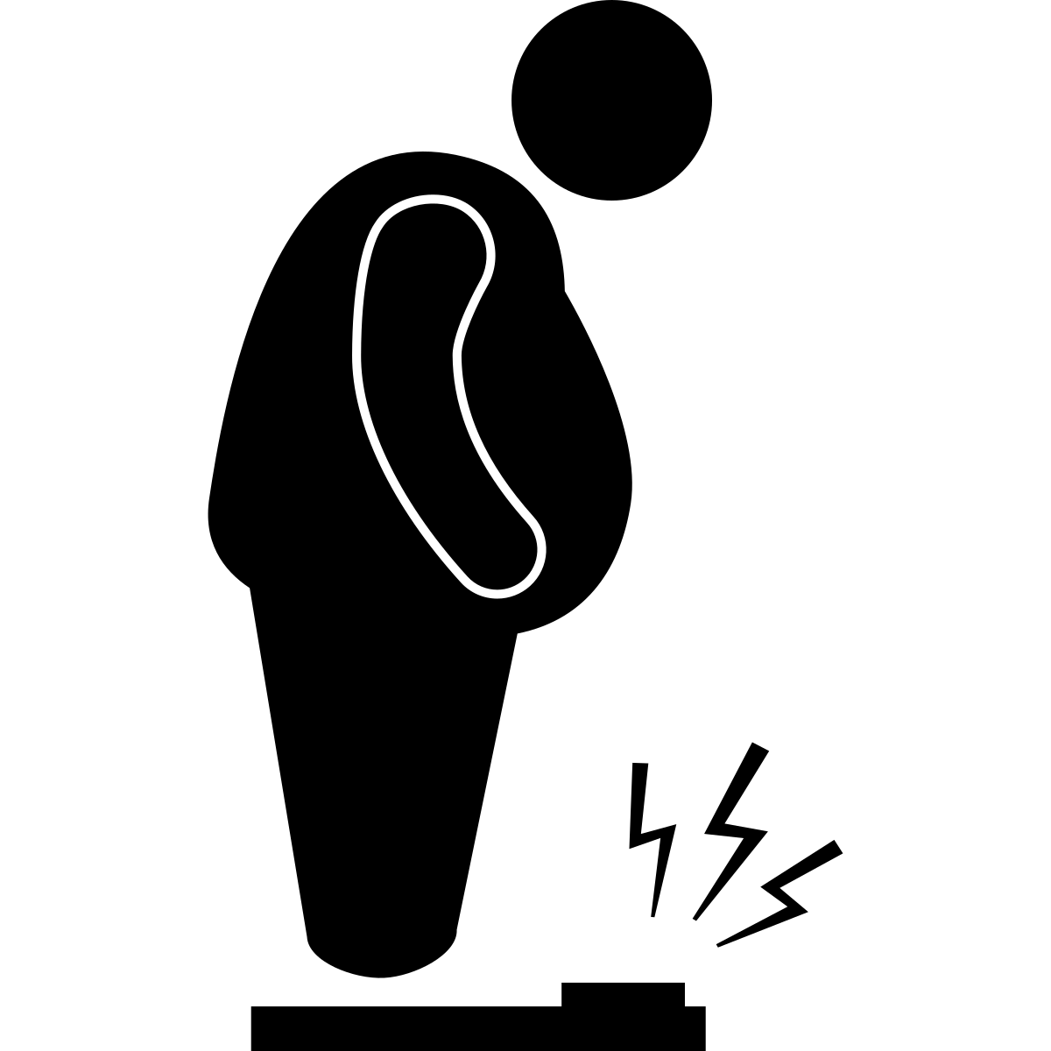

GLICLAZIDE
For: Diabetes
Possible side effects:
    Low blood sugar
    Weight gain
    Dizziness
    Headache
GLICLAZIDE
What is it for? Diabetes
Possible side effect? Hypoglycemia, weight gain

Slide 27
SITAGLIPTIN
For: Diabetes
Possible side effects:
    Low blood sugar (rare)
SITAGLIPTIN LINAGLIPTIN
What is it for? Diabetes
Possible side effect? Well tolerated, hypoglycemia rare

Slide 28
LINAGLIPTIN
For: Diabetes
Possible side effects:
    Low blood sugar (rare)
SITAGLIPTIN LINAGLIPTIN
What is it for? Diabetes
Possible side effect? Well tolerated, hypoglycemia rare

Slide 29



SEMAGLUTIDE
For: Diabetes, Heart Disease,
Kidney Disease, Weight Loss
Possible side effects:
    Stomach Pain
    No appetite
    Weight loss

Slide 30

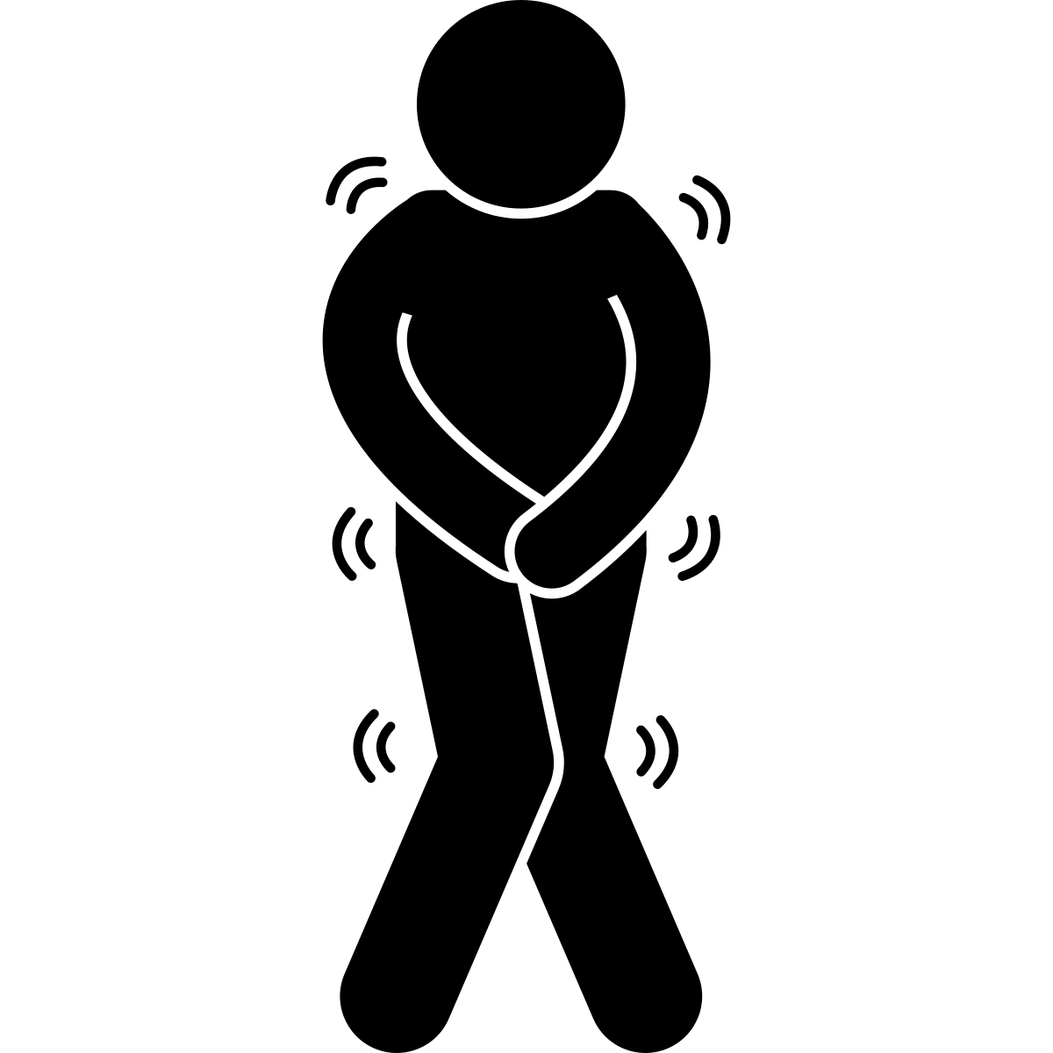

EMPAGLIFLOZIN
For: Diabetes, Heart Disease,
Kidney Disease
Possible side effects:
    Peeing often
    Dizziness
    Genital infection
    *need to eat often

Slide 31

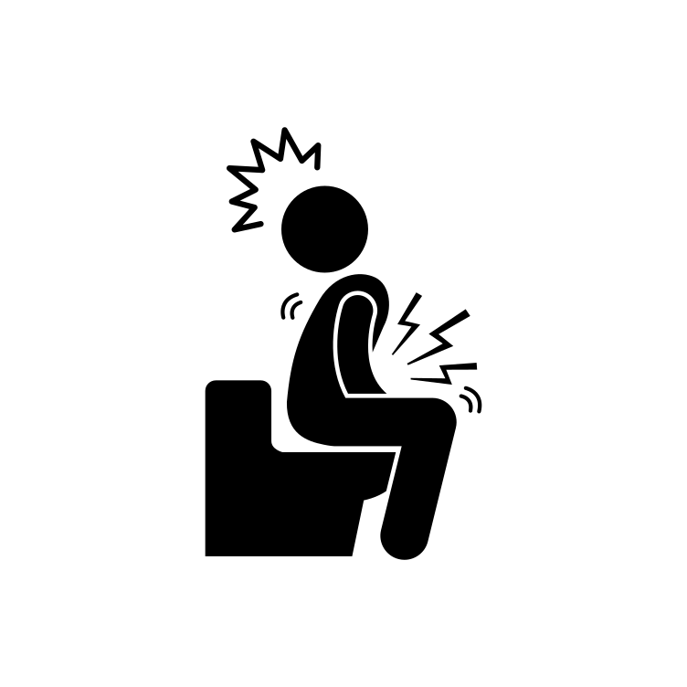
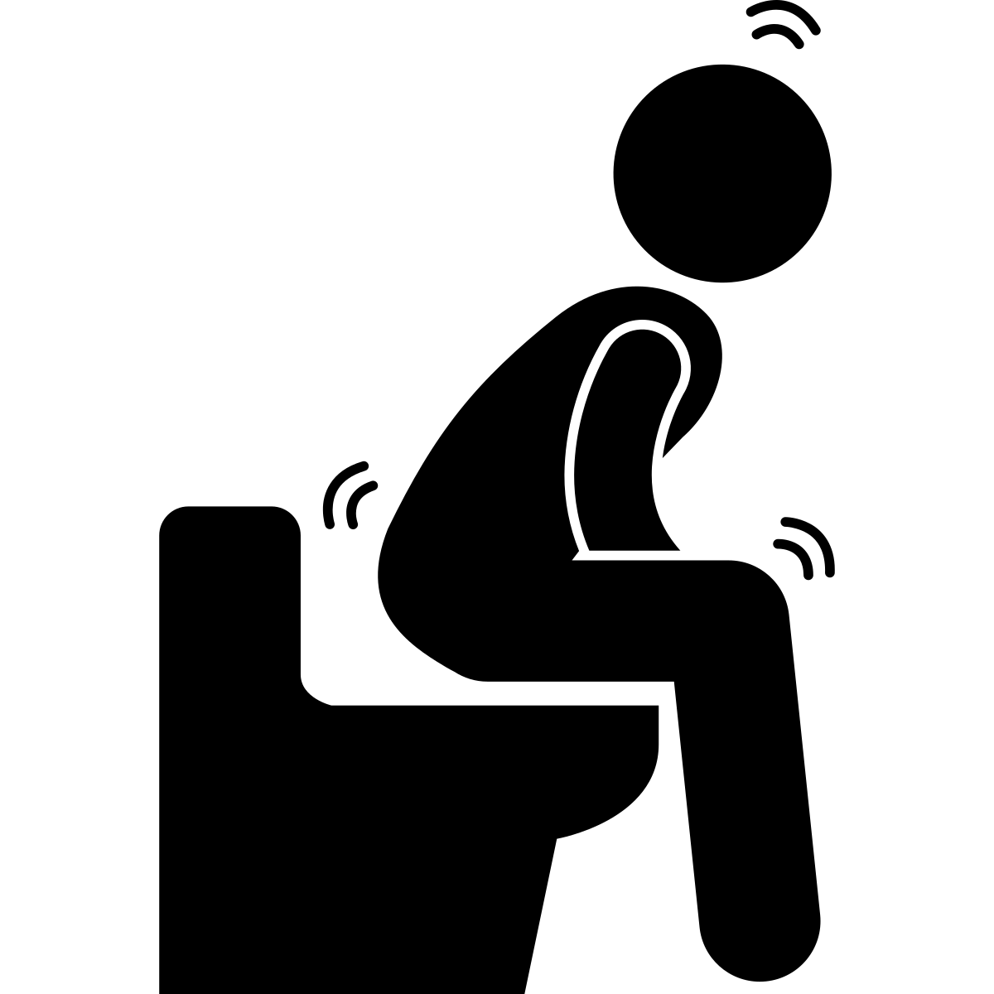
PANTOPRAZOLE
For: Stomach Pain, to Protect Stomach, Acid Reflux
Possible side effects:
    Diarrhea
    Constipation
PANTOPRAZOLE
What is it for? Stomach pain, stomach protection when on blood thinners , Acid Reflux
Possible side effect? Diarrhea, constipation

Slide 32



METOCLOPRAMIDE
For: Nausea, Discomfort after Eating
Possible side effects:
    Diarrhea
    Abnormal Movements
    Abnormal Heart Rhythm
        *small dose for 6 weeks
METOCLOPRAMIDE DOMPERIDONE
What is it for? Nausea, discomfort after eating
Possible side effect? Diarrhea, abnormal movements, abnormal heart rhythm ** use small dose for <6 weeks**

Slide 33
DOMPERIDONE
For: Nausea, Discomfort after Eating
Possible side effects:
    Diarrhea
    Abnormal Movements
    Abnormal Heart Rhythm
        *small dose for 6 weeks
METOCLOPRAMIDE DOMPERIDONE
What is it for? Nausea, discomfort after eating
Possible side effect? Diarrhea, abnormal movements, abnormal heart rhythm ** use small dose for <6 weeks**

Slide 34


AMITRYPTILINE
For: Pain, Dizziness
Possible side effects:
    Dizziness
    Dry Mouth
    Weight Gain
    Fatigue
AMITRYPTILINE
What is it for? Pain, dizziness post stroke
Possible side effect? Dizziness, dry mouth, weight gain (high doses), fatigue

Slide 35


DULOXETINE
For: Pain, Mood
Possible side effects:
    Fatigue
    Nausea
    Sweating
    Sexual dysfunction
    Bleeding
    Abnormal electrolytes
      (blood work monitored by _____________)
DULOXETINE VENLAFAXINE
What is it for? Pain, mood
Possible side effect? Fatigue, nausea, sweating, sexual dysfunction, bleeding, abnormal electrolytes (blood work monitored)

Slide 36
VENLAFAXINE
For: Pain, Mood
Possible side effects:
    Fatigue
    Nausea
    Sweating
    Sexual dysfunction
    Bleeding
    Abnormal electrolytes
      (blood work monitored by _____________)
DULOXETINE VENLAFAXINE
What is it for? Pain, mood
Possible side effect? Fatigue, nausea, sweating, sexual dysfunction, bleeding, abnormal electrolytes (blood work monitored)

Slide 37
GABAPENTIN
For: Pain, Anxiety
Possible side effects:
    Fatigue
    Weight gain
    Leg swelling
GABAPENTIN PREGABALIN
What is it for? Pain, anxiety
Possible side effect? Fatigue, weight gain (high doses), leg swelling

Slide 38
PREGABALIN
For: Pain, Anxiety
Possible side effects:
    Fatigue
    Weight gain
    Leg swelling
GABAPENTIN PREGABALIN
What is it for? Pain, anxiety
Possible side effect? Fatigue, weight gain (high doses), leg swelling

Slide 39

ALENDRONATE
For: Preventing Fractures
Possible side effects:
    Stomach pain
    Nausea
    Diarrhea
ALENDRONATE RISEDRONATE
What is it for? Preventing fractures
Possible side effect? Stomach pain, nausea, diarrhea

Slide 40
RISEDRONATE
For: Preventing Fractures
Possible side effects:
    Stomach pain
    Nausea
    Diarrhea
ALENDRONATE RISEDRONATE
What is it for? Preventing fractures
Possible side effect? Stomach pain, nausea, diarrhea

Slide 41
COLCHICINE
For: Gout
Possible side effects:
    Nausea
    Diarrhea
COLCHICINE
What is it for? Gout
Possible side effect? Nausea, diarrhea

Slide 42


LEVETIRACETAM (KEPPRA)
For: Prevention of Seizures
Possible side effects:
    Fatigue
    Headache
    Mood changes
    Dizziness
LEVETIRACETAM (KEPPRA)
What is it for? Prevention of seizures
Possible side effect? Fatigue, headache, mood changes, dizziness

Slide 43

MIRTAZAPINE
For: Mood, Depression, Anxiety
Possible side effects:
    Fatigue
    Weight gain
    Sexual dysfunction
MIRTAZAPINE
What is it for? Mood: depressed, anxious
Possible side effect? Fatigue, weight gain, sexual dysfunction

Slide 44
SERTRALINE
For: Mood, Depression, Anxiety
Possible side effects:
    Dizziness
    Diarrhea
    Sexual Dysfunction
    Fractures (rare)
    Bleeding (rare)
SERTRALINE
What is it for? Mood: depressed, anxious
Possible side effect? Dizziness, diarrhea, sexual dysfunction, rare: fractures, bleeding.

Slide 45
CITALOPRAM
For: Mood, Depression, Anxiety
Possible side effects:
    Dizziness
    Diarrhea
    Sexual Dysfunction
    Fractures (rare)
    Bleeding (rare)
SERTRALINE
What is it for? Mood: depressed, anxious
Possible side effect? Dizziness, diarrhea, sexual dysfunction, rare: fractures, bleeding.

Slide 46
ESCITALOPRAM
For: Mood, Depression, Anxiety
Possible side effects:
    Dizziness
    Diarrhea
    Sexual Dysfunction
    Fractures (rare)
    Bleeding (rare)
SERTRALINE
What is it for? Mood: depressed, anxious
Possible side effect? Dizziness, diarrhea, sexual dysfunction, rare: fractures, bleeding.

Slide 47

ARIPIPRAZOLE
For: Mood, Depression, Anxiety
Possible side effects:
    Fatigue
    Restlessness
    Weight Gain

Slide 48


TRAZADONE
For: Sleep
Possible side effects:
    Dizziness
    Falling
    Headache
    Bleeding
TRAZADONE
What is it for? Sleep
Possible side effect? Dizziness, fall, headache

Slide 49




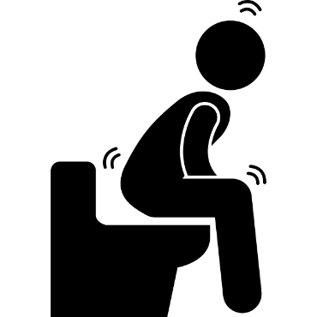
NALTREXONE
For: Decreasing/Stop Alcohol
Possible side effects:
    Nausea
    Vomissements
    Vertiges
    Diarrh
    Depressed mood (rare)

Slide 50

VARENICLINE
For: Stopping Smoking
Possible side effects:
    Nausea
    Vivid Dreams
    Mood Changes (rare)
VARENICLINE
What is it for? Stop Smoking
Possible side effect? Nausea, vivid dreams, rare: mood changes

Slide 51
TAMSULOSIN
For: Bladder Control
Possible side effects:
    Dizziness
    Sexual dysfunction
TAMSULOSIN
What is it for? Bladder control
Possible side effect? Dizziness , sexual dysfunction

Slide 52



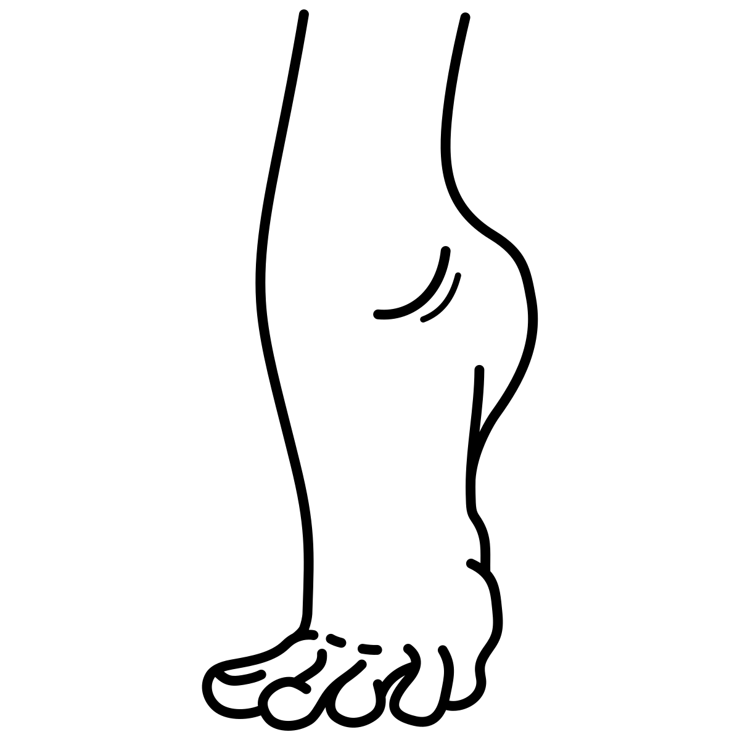







BOTOX
For: Spasticity
Possible side effects:
    Irritation
    Pain
    Swelling / Bruising
    Difficulty breathing /swallowing /talking
    Difficulty urinating
    Can spread to other parts of body

Slide 53
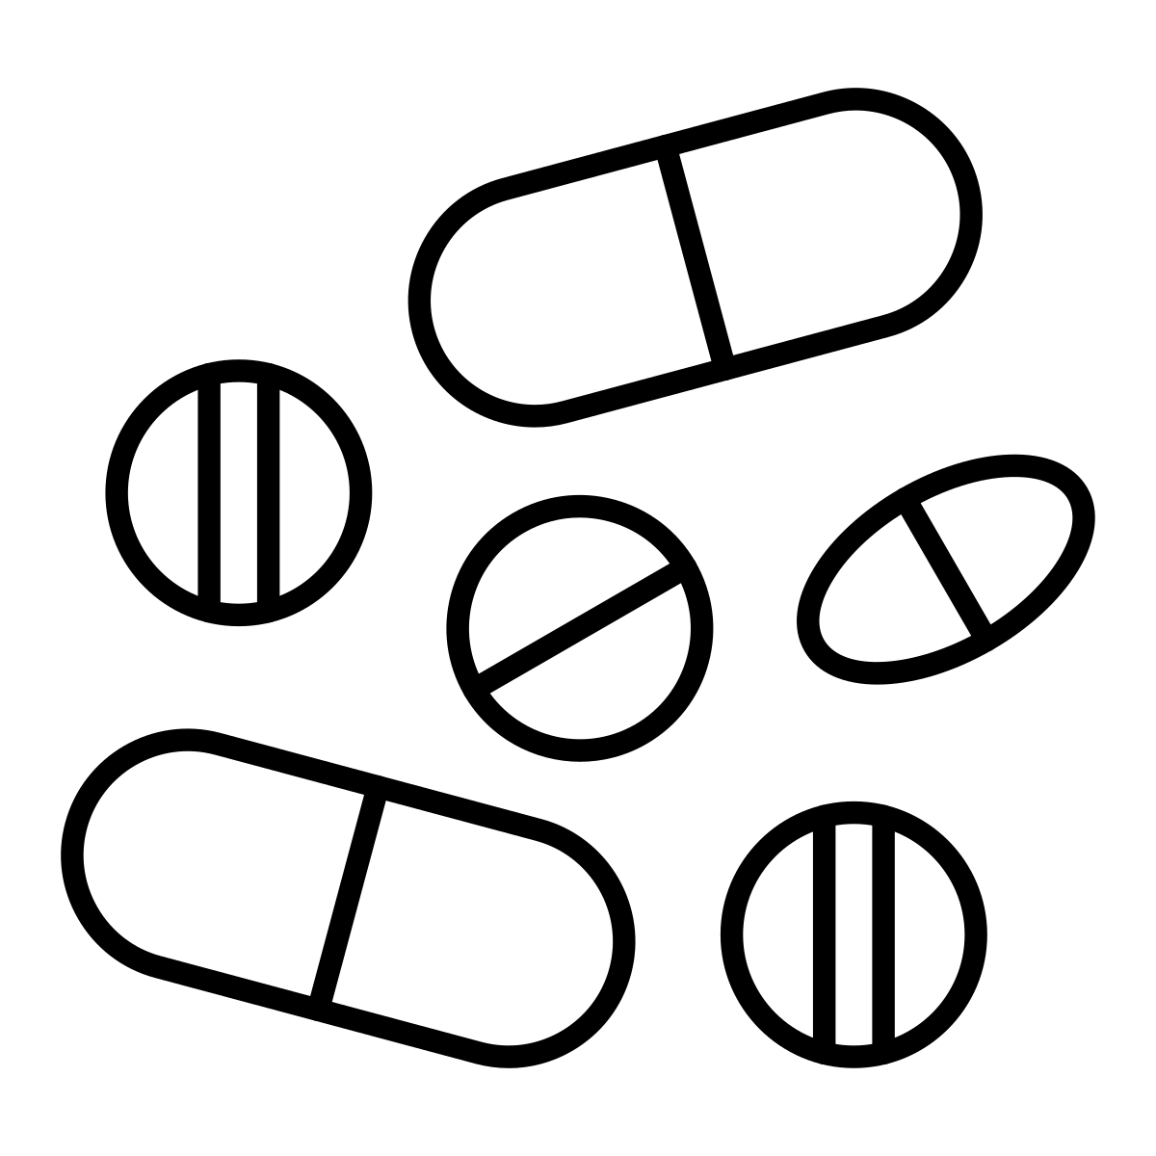


Medication
For: Medical Condition
Possible side effects:
    Option 1
    Option 2
    Option 3

Slide 54
METOPROLOL
Pour: Maladies Cardiaques, Fibrillation Auriculaire
Effets secondaires possibles:
    Fatigue
    Rêves intenses
    Intolérance à l'exercice
    Vertiges
    Dysfonctionnement sexuel
    àâçèéê
​

Slide 55
BISOPROLOL
Pour: Maladies Cardiaques, Fibrillation Auriculaire
Effets secondaires possibles:
    Fatigue
    Rêves intenses
    Intolérance à l'exercice
    Vertiges
    Dysfonctionnement sexuel
    àâçèéê

Slide 56
DILTIAZEM
Pour: Maladies Cardiaques, Fibrillation Auriculaire
Effets secondaires possibles:
    Fatigue
    Gonflement des jambes
    Rougeurs
    Vertiges

Slide 57
AMLODIPINE
Pour: l'Hypertension Artérielle
Effets secondaires possibles:
    Fatigue
    Gonflement des jambes
    Vertiges
    àâçèéê

Slide 58
INDAPAMIDE
Pour: l'Hypertension Artérielle
Effets secondaires possibles:
    Vertiges
    Électrolytes anormaux
    (contrôle des analyses de sang par __________)
    Goutte possible
INDAPAMIDE HYDROCHLOROTHIAZIDE CHLORTHALIDONE
What is it for? high blood pressure
Possible side effect? Dizziness, abnormal electrolytes (blood work monitored), possible gout
    àâçèéê

Slide 59
HYDROCHLOROTHIAZIDE
Pour: l'Hypertension Artérielle
Effets secondaires possibles:
    Vertiges
    Électrolytes anormaux
    (contrôle des analyses de sang par __________)
    Goutte possible
INDAPAMIDE HYDROCHLOROTHIAZIDE CHLORTHALIDONE
What is it for? high blood pressure
Possible side effect? Dizziness, abnormal electrolytes (blood work monitored), possible gout
    àâçèéê

Slide 60
CHLORTHALIDONE
Pour: l'Hypertension Artérielle
Effets secondaires possibles:
    Vertiges
    Électrolytes anormaux
    (contrôle des analyses de sang par __________)
    Goutte possible
INDAPAMIDE HYDROCHLOROTHIAZIDE CHLORTHALIDONE
What is it for? high blood pressure
Possible side effect? Dizziness, abnormal electrolytes (blood work monitored), possible gout
    àâçèéê

Slide 61
SPIRONOLACTONE
Pour: Hypertension Artérielle,
Maladies Cardiaques
Effets secondaires possibles:
    Seins douloureux
    Dysfonctionnement sexuel
    Électrolytes anormaux
    (contrôle des analyses de sang par __________)
    àâçèéê
SPIRONOLACTONE
What is it for? high blood pressure, Heart disease
Possible side effect? Painful breasts, al malfunction, abnormal electrolytes (blood work monitored)

Slide 62
RAMIPRIL
Pour: Maladies Cardiaques,
Fibrillation Auriculaire
Effets secondaires possibles:
    Toux
    Goût anormal
    Vertiges
    Électrolytes anormaux
    (contrôle des analyses de sang par __________)
    àâçèéê
RAMIPRIL PERINDOPRIL
What is it for? Heart disease, kidney disease, high blood pressure
Possible side effect? Cough, abnormal taste, dizziness, abnormal electrolytes (blood work monitored)

Slide 63
PERINDOPRIL
Pour: Maladies Cardiaques,
Fibrillation Auriculaire
Effets secondaires possibles:
    Toux
    Goût anormal
    Vertiges
    Électrolytes anormaux
    (contrôle des analyses de sang par __________)
    àâçèéê
RAMIPRIL PERINDOPRIL
What is it for? Heart disease, kidney disease, high blood pressure
Possible side effect? Cough, abnormal taste, dizziness, abnormal electrolytes (blood work monitored)

Slide 64
CANDESARTAN
Pour: Maladies Cardiaques,
Maladies Rénales, l'Hypertension Artérielle
Effets secondaires possibles:
    Toux
    Goût anormal
    Vertiges
    Électrolytes anormaux
    (contrôle des analyses de sang par __________ )
    àâçèéê

Slide 65
DIGOXIN
Pour: Maladies Cardiaques,
Fibrillation Auriculaire
Effets secondaires possibles:
    Toxicité (rare)
    àâçèéê
DIGOXIN
What is it for? Heart disease
Possible side effect? Toxicity, rare if no kidney disease and on no diuretic (water pill)

Slide 66
ATORVASTATIN
Pour: prévention des Maladies Cardiaques,
prévention des AVC, Cholestérol
Effets secondaires possibles:
      Problèmes musculaires (rare)
    àâçèéê
ATORVASTATIN ROSUVASTATIN
What is it for? Prevention of heart disease/ strokes “Cholesterol medication”
Possible side effect? Minimal. Rare (0.2%) but severe muscle side effect possible.

Slide 67
ROSUVASTATIN
Pour: prévention des Maladies Cardiaques,
prévention des AVC, Cholestérol
Effets secondaires possibles:
      Problèmes musculaires (rare)
    àâçèéê
ATORVASTATIN ROSUVASTATIN
What is it for? Prevention of heart disease/ strokes “Cholesterol medication”
Possible side effect? Minimal. Rare (0.2%) but severe muscle side effect possible.

Slide 68
ASA
Pour: prévention des Maladies Cardiaques,
prévention des AVC, Anticoagulants
Effets secondaires possibles:
    Saignement
    àâçèéê
ASA CLOPIDOGREL TICAGRELOR
What is it for? Prevention of heart disease/ strokes “blood thinner”
Possible side effect? Bleeding (stomach, less commonly brain)

Slide 69
CLOPIDOGREL
Pour: prévention des Maladies Cardiaques,
prévention des AVC, Anticoagulants
Effets secondaires possibles:
    Saignement
    àâçèéê
ASA CLOPIDOGREL TICAGRELOR
What is it for? Prevention of heart disease/ strokes “blood thinner”
Possible side effect? Bleeding (stomach, less commonly brain)

Slide 70
TICAGRELOR
Pour: prévention des Maladies Cardiaques,
prévention des AVC, Anticoagulants
Effets secondaires possibles:
    Saignement
    àâçèéê
ASA CLOPIDOGREL TICAGRELOR
What is it for? Prevention of heart disease/ strokes “blood thinner”
Possible side effect? Bleeding (stomach, less commonly brain)

Slide 71
APIXABAN
Pour: prévention des AVC,
prévention des caillots sanguins,
Anticoagulants
Effets secondaires possibles:
    Saignement
    Troubles de l'estomac
    àâçèéê
APIXABAN DABIGATRAN RIVAROXABAN
What is it for? Prevention of strokes due to heart disease. Prevention of venous blood clot “blood thinner”
Possible side effect? Bleeding (stomach, less commonly brain) Dabigatran: stomach upset

Slide 72
DABIGATRAN
Pour: prévention des AVC,
prévention des caillots sanguins,
Anticoagulants
Effets secondaires possibles:
    Saignement
    Troubles de l'estomac
    àâçèéê
APIXABAN DABIGATRAN RIVAROXABAN
What is it for? Prevention of strokes due to heart disease. Prevention of venous blood clot “blood thinner”
Possible side effect? Bleeding (stomach, less commonly brain) Dabigatran: stomach upset

Slide 73
RIVAROXABAN
Pour: prévention des AVC,
prévention des caillots sanguins,
Anticoagulants
Effets secondaires possibles:
    Saignement
    Troubles de l'estomac
    àâçèéê
APIXABAN DABIGATRAN RIVAROXABAN
What is it for? Prevention of strokes due to heart disease. Prevention of venous blood clot “blood thinner”
Possible side effect? Bleeding (stomach, less commonly brain) Dabigatran: stomach upset

Slide 74
METFORMIN
Pour: Diabète
Effets secondaires possibles:
    Nausées
    Diarrhée
    Douleurs d'estomac
    ↓ B12
    àâçèéê
METFORMIN
What is it for? Diabetes
Possible side effect? Nausea, diarrhea, stomach pain

Slide 75
GLICLAZIDE
Pour: Diabète
Effets secondaires possibles:
    Faible niveau de sucre dans le sang
    Prise de poids
    Vertiges
    Maux de tête
    àâçèéê
GLICLAZIDE
What is it for? Diabetes
Possible side effect? Hypoglycemia, weight gain

Slide 76
SITAGLIPTIN
Pour: Diabète
Effets secondaires possibles:
    Faible niveau de sucre dans le sang (rare)
    àâçèéê
SITAGLIPTIN LINAGLIPTIN
What is it for? Diabetes
Possible side effect? Well tolerated, hypoglycemia rare

Slide 77
LINAGLIPTIN
Pour: Diabète
Effets secondaires possibles:
    Faible niveau de sucre dans le sang (rare)
    àâçèéê
SITAGLIPTIN LINAGLIPTIN
What is it for? Diabetes
Possible side effect? Well tolerated, hypoglycemia rare

Slide 78
SEMAGLUTIDE
Pour: Diabète, Maladies Cardiaques,
Maladie Rénale, Perte de Poids
Effets secondaires possibles:
    Douleurs d'estomac
    Manque d'appétit
    Perte de poids
    àâçèéê

Slide 79
EMPAGLIFLOZIN
Pour: Diabète,
Maladies Cardiaques, Maladies Rénale
Effets secondaires possibles:
    Pipi fréquent
    Vertiges
    Infection génitale
    *besoin de manger souvent
    àâçèéê

Slide 80
PANTOPRAZOLE
    àâçèéê
Pour: Douleurs d'Estomac,
Protéger l'Estomac, Reflux
Effets secondaires possibles:
    Diarrhée
    Constipation
PANTOPRAZOLE
What is it for? Stomach pain, stomach protection when on blood thinners , Acid Reflux
Possible side effect? Diarrhea, constipation

Slide 81
METOCLOPRAMIDE
Pour: Nausées,
Malaise Après les Repas
Effets secondaires possibles:
    Diarrhée
    Mouvements anormaux
    Rhythme cardiaque anormal
        *petite dose pendant 6 semaines
    àâçèéê
METOCLOPRAMIDE DOMPERIDONE
What is it for? Nausea, discomfort after eating
Possible side effect? Diarrhea, abnormal movements, abnormal heart rhythm ** use small dose for <6 weeks**

Slide 82
DOMPERIDONE
Pour: Nausées,
Malaise Après les Repas
Effets secondaires possibles:
    Diarrhée
    Mouvements anormaux
    Rhythme cardiaque anormal
        *petite dose pendant 6 semaines
    àâçèéê
METOCLOPRAMIDE DOMPERIDONE
What is it for? Nausea, discomfort after eating
Possible side effect? Diarrhea, abnormal movements, abnormal heart rhythm ** use small dose for <6 weeks**

Slide 83
AMITRYPTILINE
Pour: Douleur, Vertiges
Effets secondaires possibles:
    Vertiges
    Bouche sèche
    Prise de poids
    Fatigue
    àâçèéê
AMITRYPTILINE
What is it for? Pain, dizziness post stroke
Possible side effect? Dizziness, dry mouth, weight gain (high doses), fatigue

Slide 84
Pour: Douleur, Humeur
Effets secondaires possibles:
    Fatigue
    Nausées
    Transpiration
    Dysfonction sexuelle
    Saignement
    Électrolytes anormaux
    (contrôle des analyses de sang par __________)
DULOXETINE
    àâçèéê
DULOXETINE VENLAFAXINE
What is it for? Pain, mood
Possible side effect? Fatigue, nausea, sweating, sexual dysfunction, bleeding, abnormal electrolytes (blood work monitored)

Slide 85
Pour: Douleur, Humeur
Effets secondaires possibles:
    Fatigue
    Nausées
    Transpiration
    Dysfonction sexuelle
    Saignement
    Électrolytes anormaux
    (contrôle des analyses de sang par __________)
VENLAFAXINE
    àâçèéê
DULOXETINE VENLAFAXINE
What is it for? Pain, mood
Possible side effect? Fatigue, nausea, sweating, sexual dysfunction, bleeding, abnormal electrolytes (blood work monitored)

Slide 86
GABAPENTIN
Pour: Douleur, Anxiété
Effets secondaires possibles:
    Fatigue
    Prise de poids
    Gonflement des jambes
    àâçèéê
GABAPENTIN PREGABALIN
What is it for? Pain, anxiety
Possible side effect? Fatigue, weight gain (high doses), leg swelling

Slide 87
PREGABALIN
Pour: Douleur, Anxiété
Effets secondaires possibles:
    Fatigue
    Prise de poids
    Gonflement des jambes
    àâçèéê
GABAPENTIN PREGABALIN
What is it for? Pain, anxiety
Possible side effect? Fatigue, weight gain (high doses), leg swelling

Slide 88
ALENDRONATE
Pour: Prévention des Fractures
Effets secondaires possibles:
    Douleurs d'estomac
    Nausées
    Diarrhée
    àâçèéê
ALENDRONATE RISEDRONATE
What is it for? Preventing fractures
Possible side effect? Stomach pain, nausea, diarrhea

Slide 89
RISEDRONATE
Pour: Prévention des Fractures
Effets secondaires possibles:
    Douleurs d'estomac
    Nausées
    Diarrhée
    àâçèéê
ALENDRONATE RISEDRONATE
What is it for? Preventing fractures
Possible side effect? Stomach pain, nausea, diarrhea

Slide 90
COLCHICINE
Pour: Goutte
Effets secondaires possibles:
    Nausées
    Diarrhée
    àâçèéê
COLCHICINE
What is it for? Gout
Possible side effect? Nausea, diarrhea

Slide 91
LEVETIRACETAM (KEPPRA)
Pour: Prévention des Crises
Effets secondaires possibles:
    Fatigue
    Maux de tête
    Changements d'humeur
    Vertiges
    àâçèéê
LEVETIRACETAM (KEPPRA)
What is it for? Prevention of seizures
Possible side effect? Fatigue, headache, mood changes, dizziness

Slide 92
MIRTAZAPINE
Pour: Humeur, Dépression,
Anxiété
Effets secondaires possibles:
    Fatigue
    Prise de poids
    Dysfonction sexuelle
    àâçèéê
MIRTAZAPINE
What is it for? Mood: depressed, anxious
Possible side effect? Fatigue, weight gain, sexual dysfunction

Slide 93
SERTRALINE
Pour: Humeur, Dépression, Anxiété
Effets secondaires possibles:
    Vertiges
    Diarrhée
    Dysfonction sexuelle
    Fractures (rare)
    Saignement (rare)
    àâçèéê
SERTRALINE
What is it for? Mood: depressed, anxious
Possible side effect? Dizziness, diarrhea, sexual dysfunction, rare: fractures, bleeding.

Slide 94
CITALOPRAM
Pour: Humeur, Dépression, Anxiété
Effets secondaires possibles:
    Vertiges
    Diarrhée
    Dysfonction sexuelle
    Fractures (rare)
    Saignement (rare)
    àâçèéê
SERTRALINE
What is it for? Mood: depressed, anxious
Possible side effect? Dizziness, diarrhea, sexual dysfunction, rare: fractures, bleeding.

Slide 95
ESCITALOPRAM
Pour: Humeur, Dépression, Anxiété
Effets secondaires possibles:
    Vertiges
    Diarrhée
    Dysfonction sexuelle
    Fractures (rare)
    Saignement (rare)
    àâçèéê
SERTRALINE
What is it for? Mood: depressed, anxious
Possible side effect? Dizziness, diarrhea, sexual dysfunction, rare: fractures, bleeding.

Slide 96
ARIPIPRAZOLE
Pour: Humeur, Dépression,
Anxiété
Effets secondaires possibles:
    Fatigue
    Agitation
    Prise de poids
    àâçèéê

Slide 97
TRAZADONE
Pour: Dormir
Effets secondaires possibles:
    Vertiges
    Chutes
    Maux de tête
    Saignements
    àâçèéê
TRAZADONE
What is it for? Sleep
Possible side effect? Dizziness, fall, headache

Slide 98
NALTREXONE
    àâçèéê
Pour: Diminution/Arrêt de l'Alcool
Effets secondaires possibles:
    Nausées
    Vertiges
    Vomiting
    Diarrhée
    Humeur Déprimée (rare)
NALTREXONE
What is it for? Decrease / stop alcohol
Possible side effect? Nausea, headache, rare: depressed mood

Slide 99
VARENICLINE
Pour: Arrêt du Tabac
Effets secondaires possibles:
    Nausées
    Rêves intenses
    Changements d'humeur (rare)
    àâçèéê
VARENICLINE
What is it for? Stop Smoking
Possible side effect? Nausea, vivid dreams, rare: mood changes

Slide 100
TAMSULOSIN
Pour: Contrôle de la Vessie
Effets secondaires possibles:
    Vertiges
    Dysfonction sexuelle
    àâçèéê
TAMSULOSIN
What is it for? Bladder control
Possible side effect? Dizziness

Slide 101
BOTOX
Pour: Spasticité
Effets secondaires possibles:
    Irritation
    Douleur
    Gonflement / Contusion
    Difficulté à respirer / à avaler /à parler
    Difficulté à uriner
    Peut se propager à d'autres parties du corps

Slide 102
Médicament
Pour: Condition Médicale
Effets secondaires possibles:
    Option 1
    Option 2
    Option 3
    àâçèéê

Slide 103

Medication
    àâçèéê

Slide 104
Medication
    àâçèéê

Slide 105
Medication
    àâçèéê

