Slide 1


OT
Gym Activity Choice
Aphasia-friendly toolkit March 2024
Disclaimer: These materials were created using funding from the Provincial Community Stroke Rehabilitation Initiative and crafted by Aran Oberle, Speech Language Pathologist, with input from regional rehab programs. They are not meant to replace professional expertise. Readers should seek advice from a qualified healthcare provider for any concerns. The content of this PowerPoint can be adjusted to suit the needs of healthcare professionals. Users are accountable for confirming the accuracy and suitability of the information for their unique situations.

Slide 2

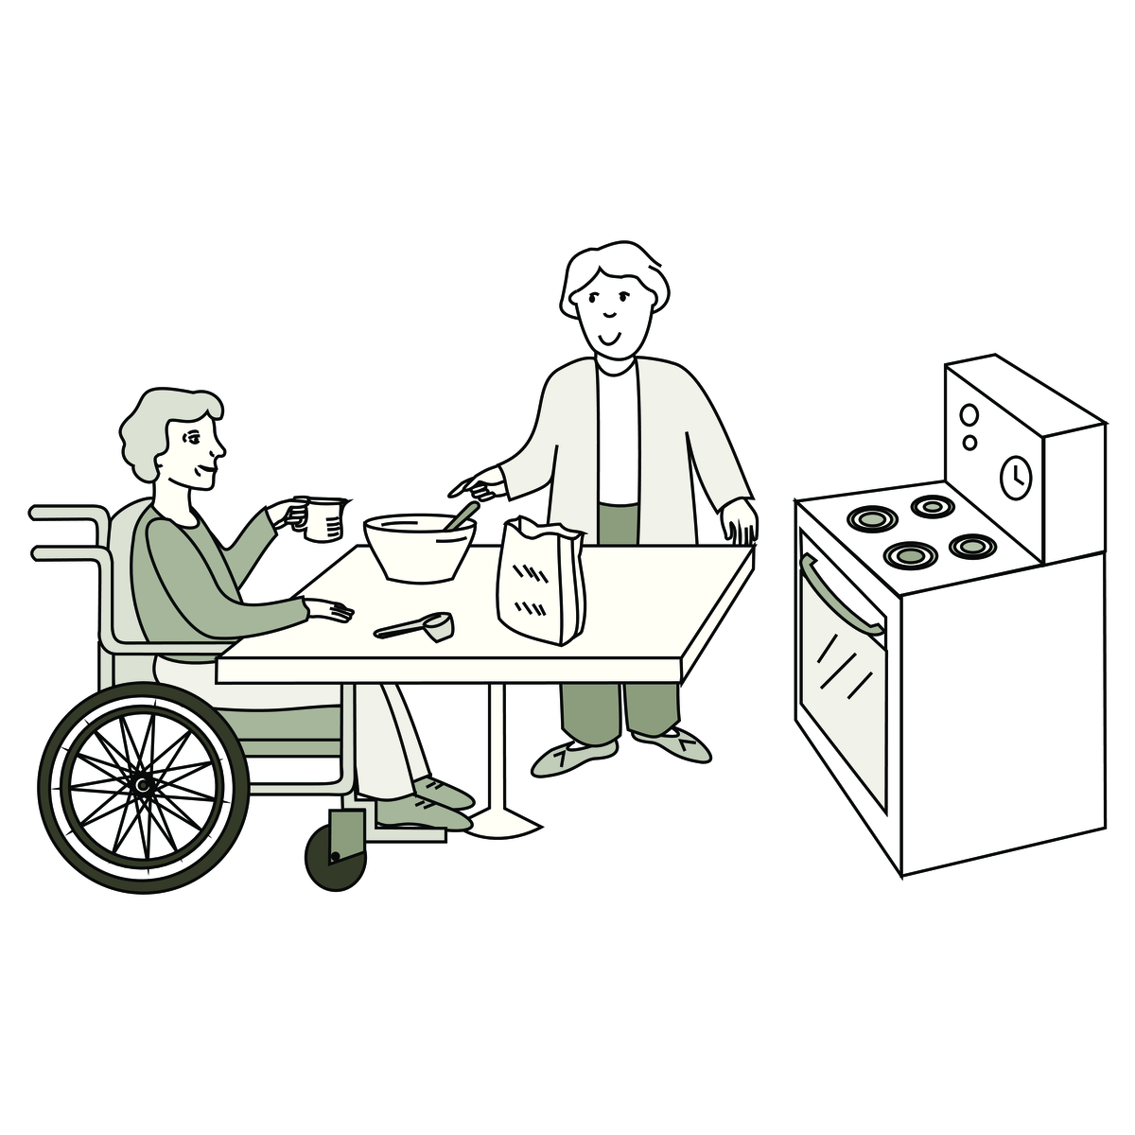
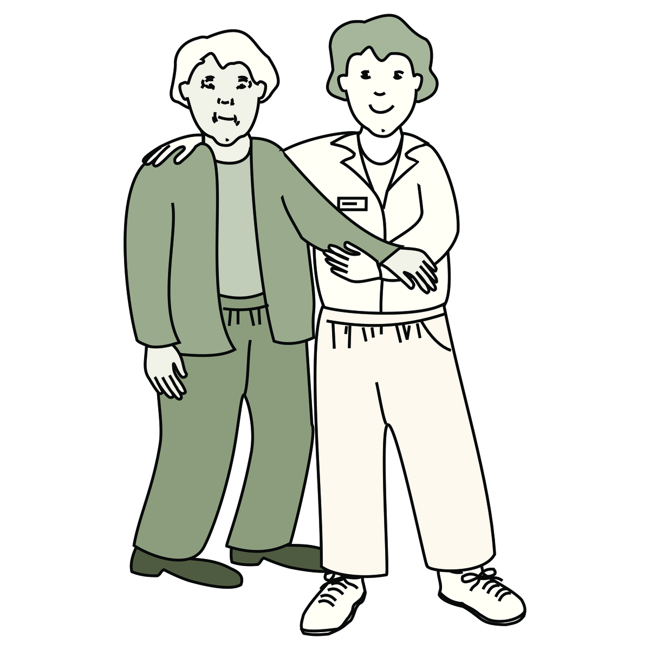
Occupational therapy
with
Occupational Therapist (OT)
Rehabilitation Assistant (RA)
Images used are from ParticiPics – a free, searchable database of pictographic images developed by the Aphasia Institute,
https://www.aphasia.ca/participics

Slide 3
Ergothérapie
avec
Ergothérapeute (OT)
Assistant de réadaptation (RA)
Images used are from ParticiPics – a free, searchable database of pictographic images developed by the Aphasia Institute,
https://www.aphasia.ca/participics

Slide 4

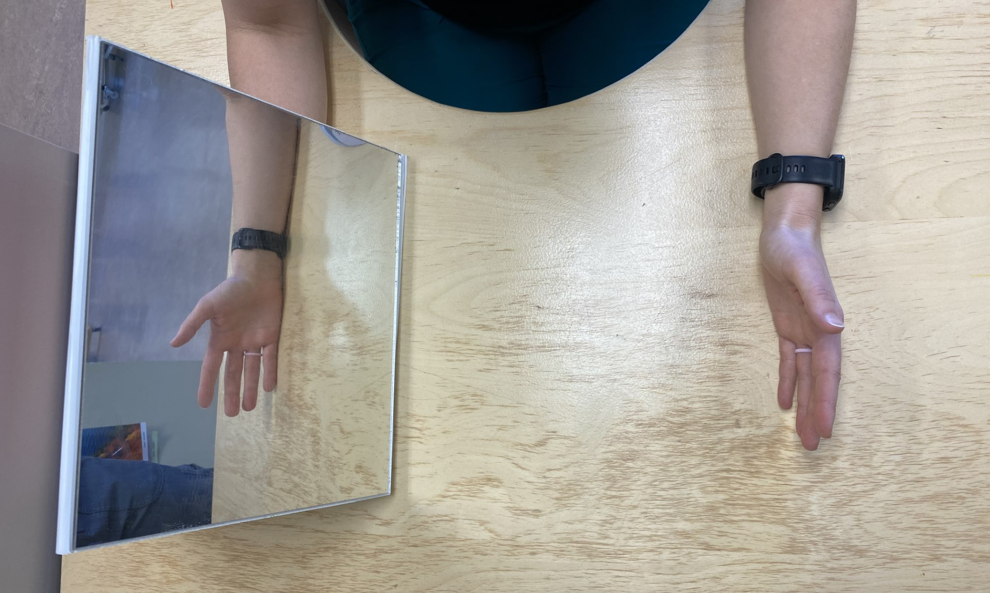

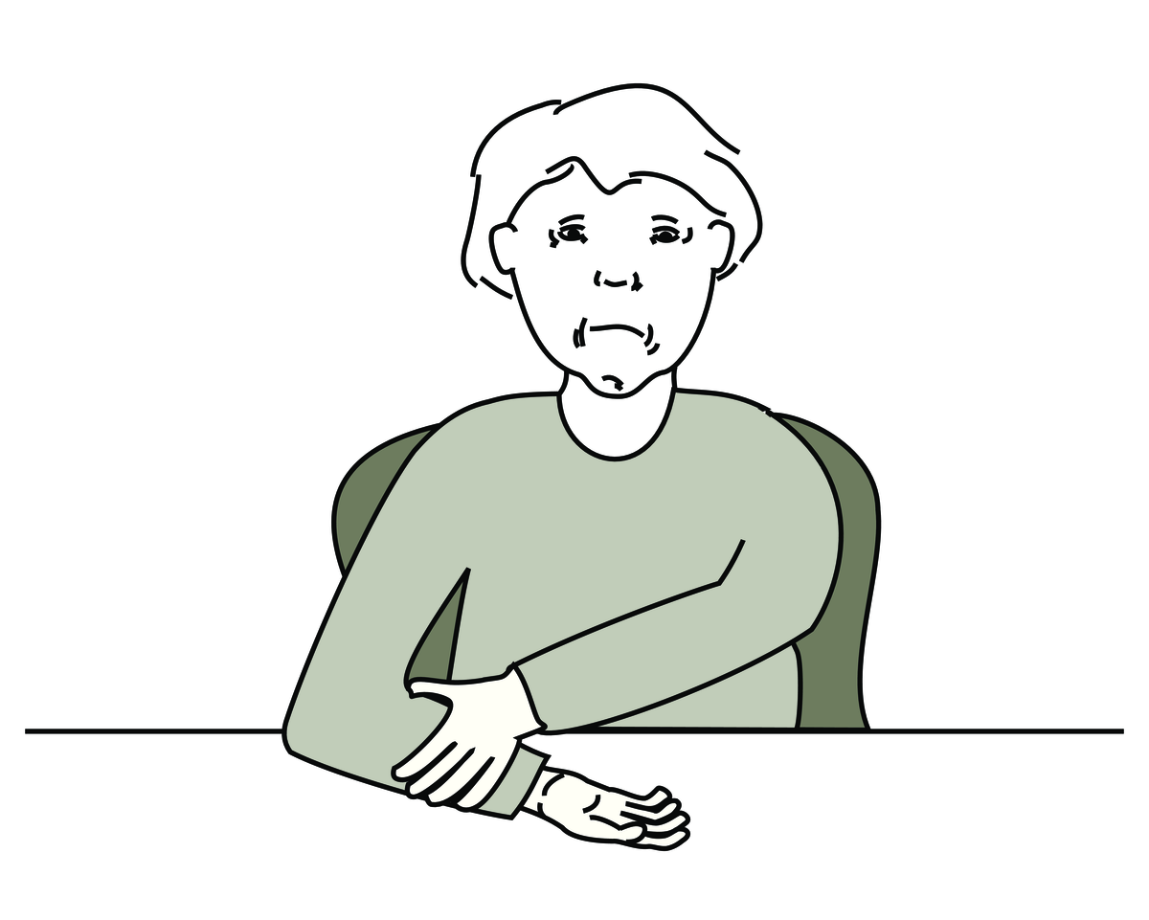


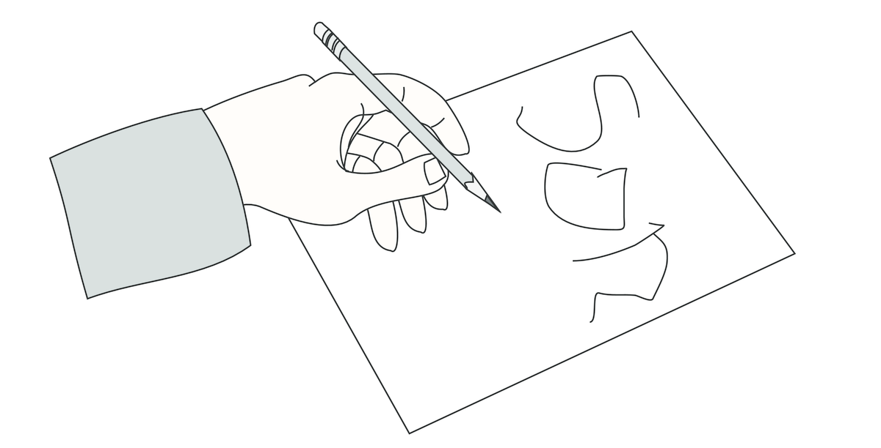
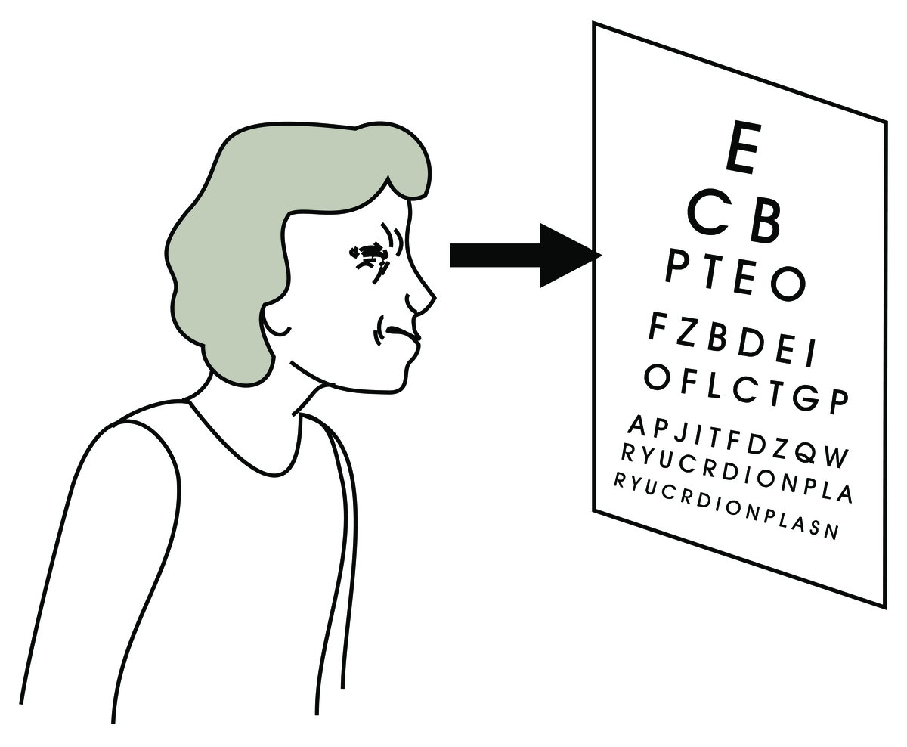
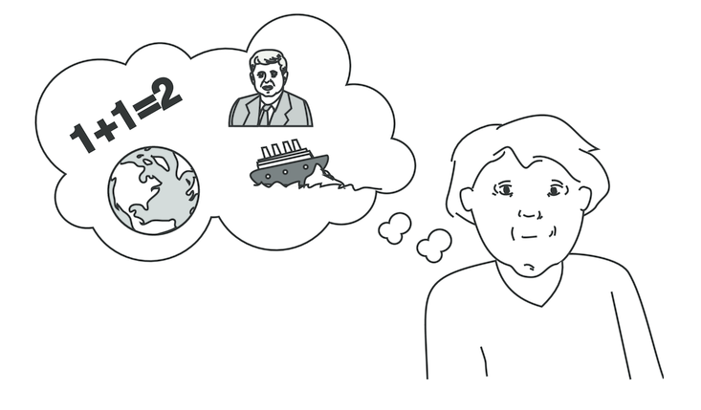
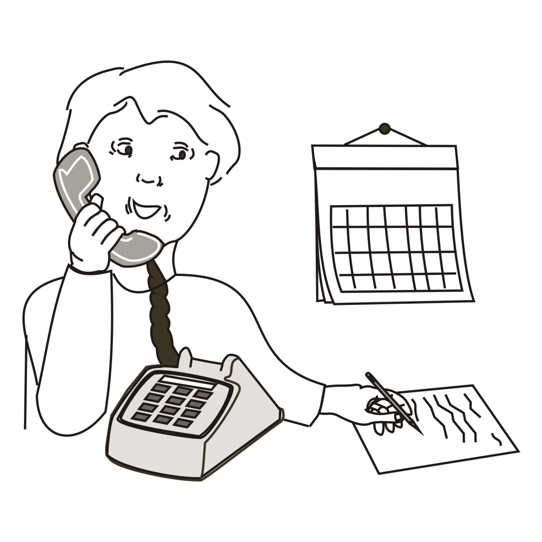
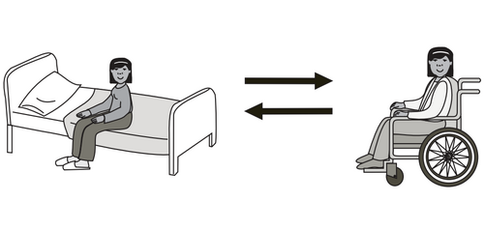
Occupational Therapy Activities
Arm bike
Mirror box
Arm exercises
Hand exercises
Vision
Cognition
Telephone
Transfers
Images used are from ParticiPics – a free, searchable database of pictographic images developed by the Aphasia Institute,
https://www.aphasia.ca/participics

Slide 5
Activitiés en ergothérapie
Vélo à bras
Boîte à miroir
Exercices pour bras
Exercices pour mains
Vision
Cognition
Téléphone
Transferts
Images used are from ParticiPics – a free, searchable database of pictographic images developed by the Aphasia Institute,
https://www.aphasia.ca/participics

Slide 6
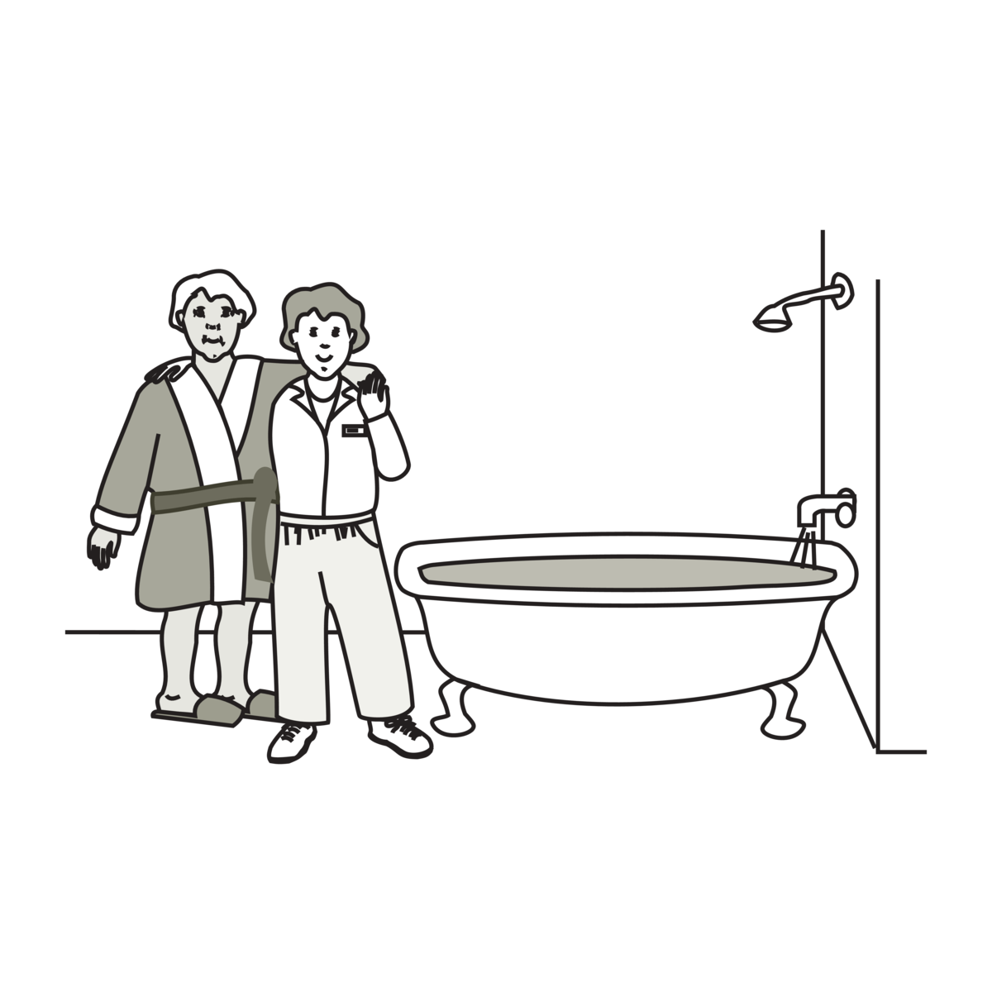
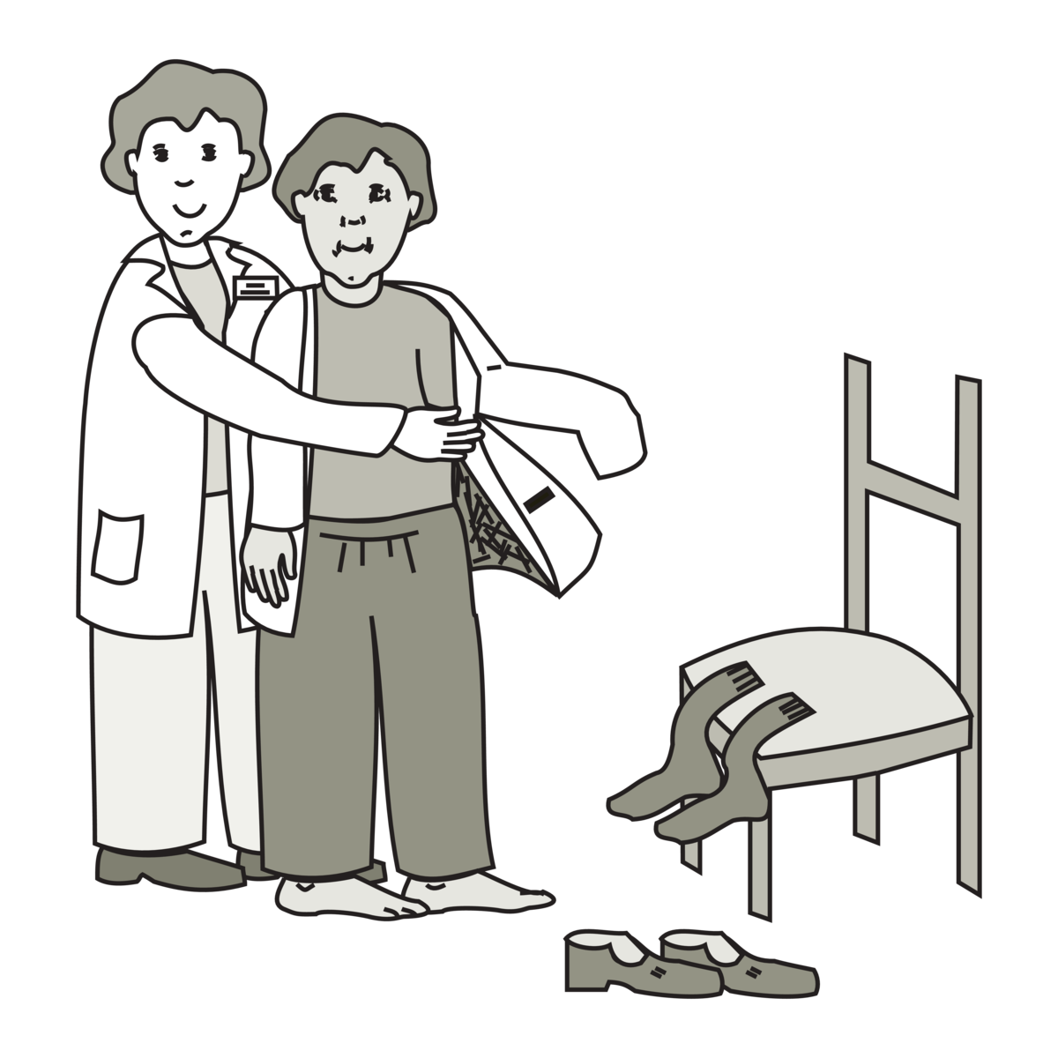
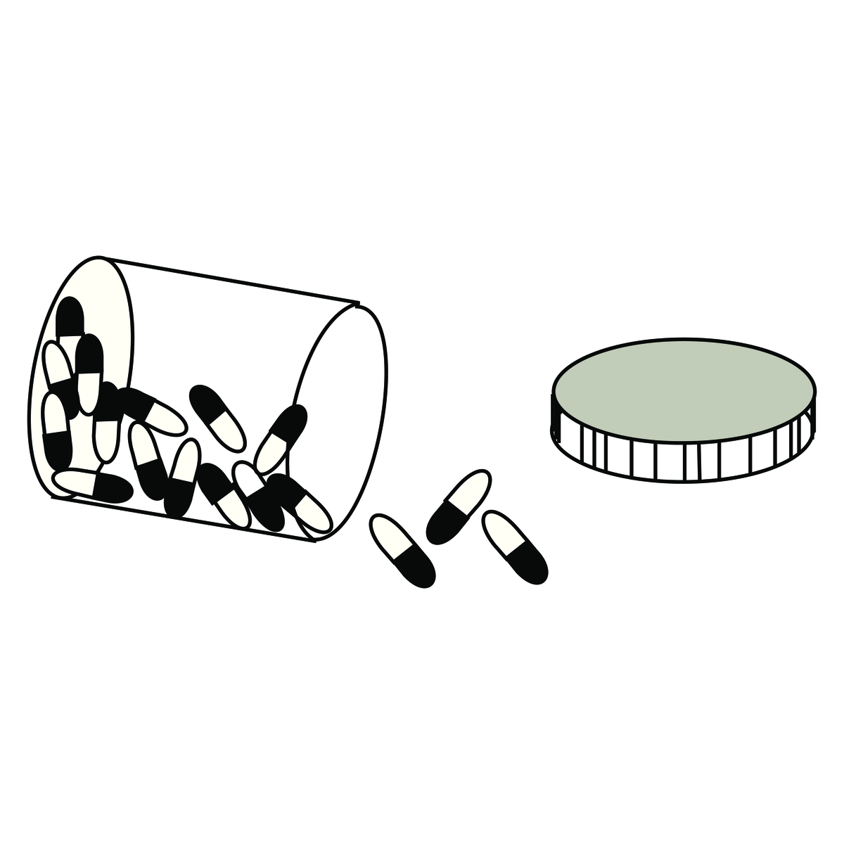
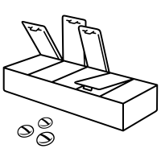
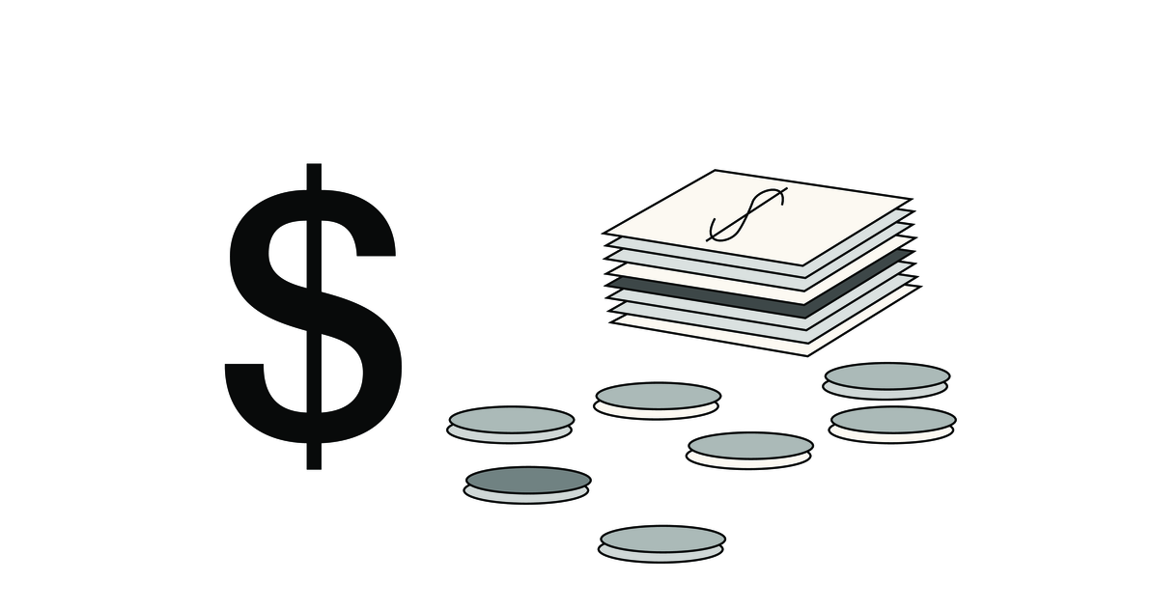
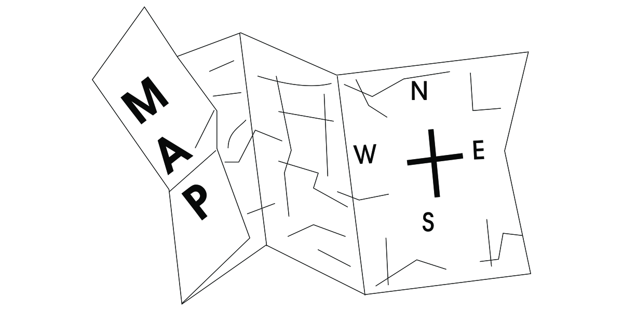
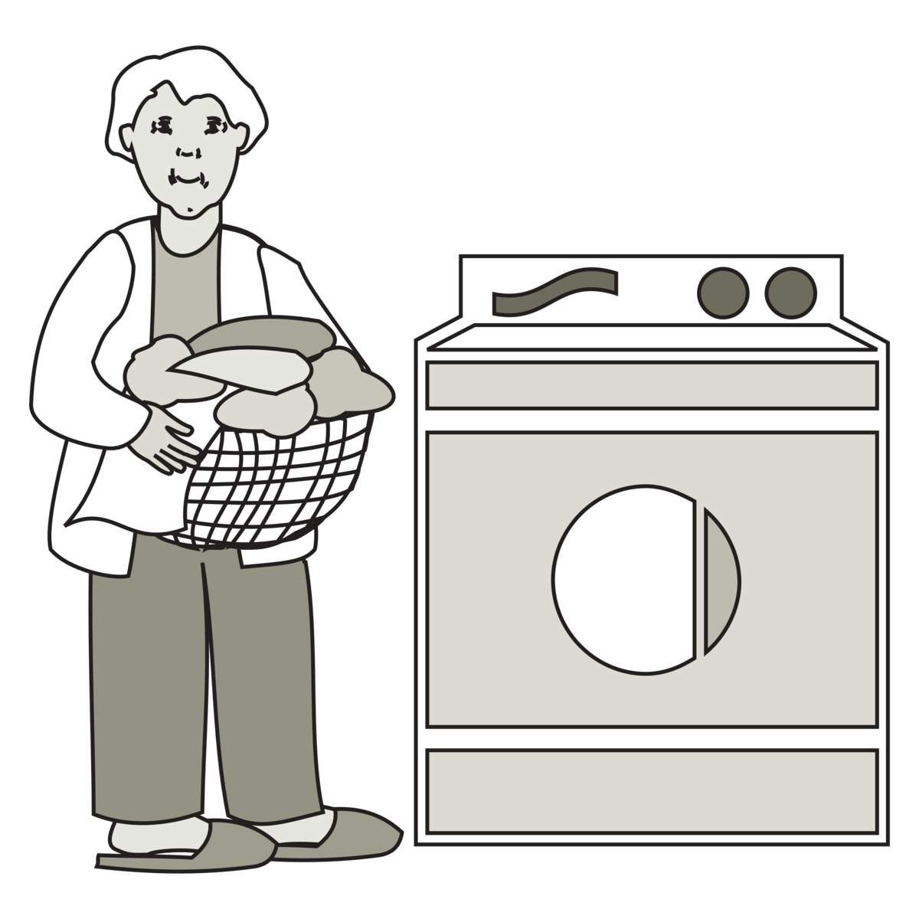
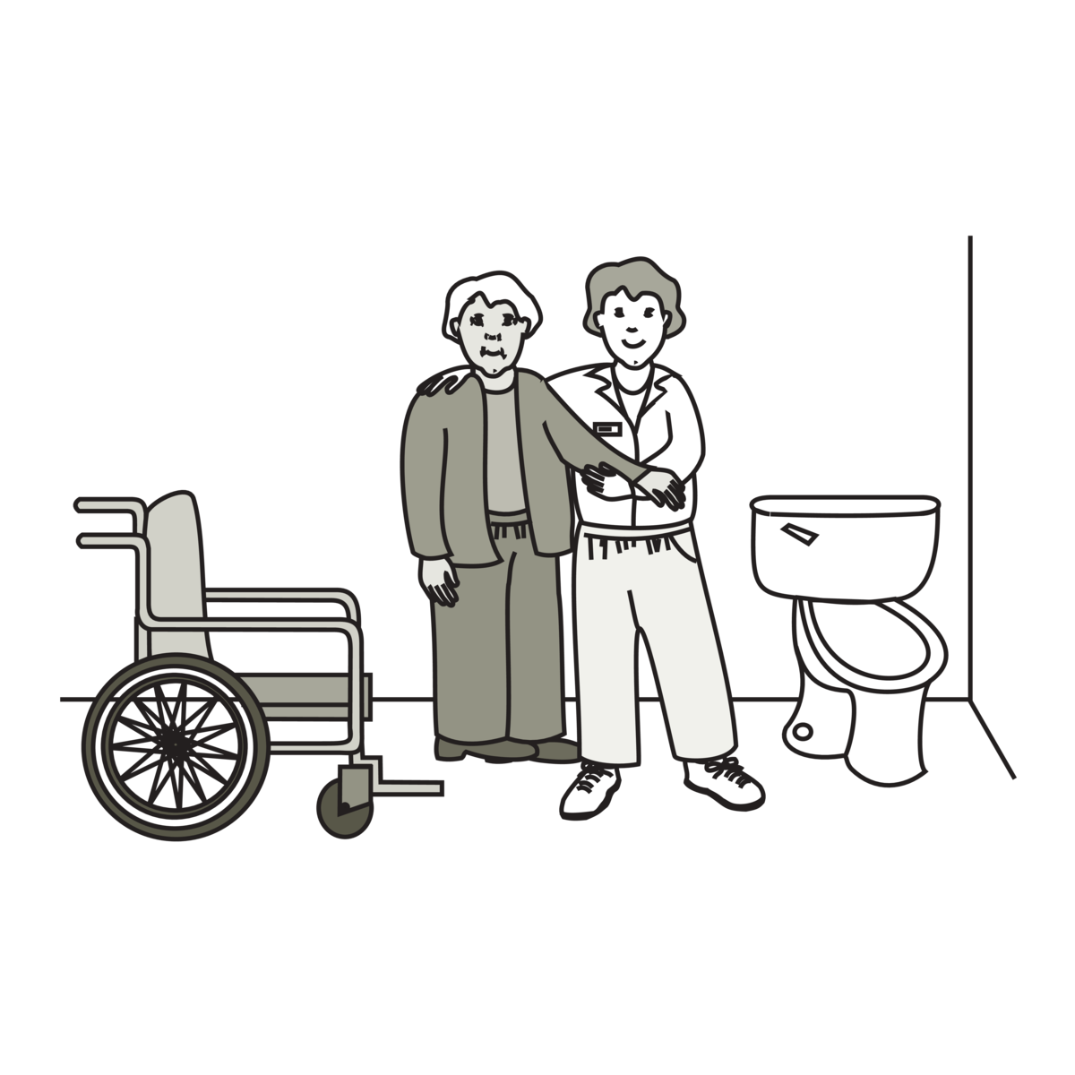
Occupational Therapy Activities
Cooking
Bathing
Dressing
Medications
Money
Orientation
Laundry
Toileting
Images used are from ParticiPics – a free, searchable database of pictographic images developed by the Aphasia Institute,
https://www.aphasia.ca/participics

Slide 7
Activitiés en ergothérapie
Cuisine
Bain
S'habiller
Medicaments
Argent
Orientation
Lessive
Hygiène
Images used are from ParticiPics – a free, searchable database of pictographic images developed by the Aphasia Institute,
https://www.aphasia.ca/participics

