Slide 1
SLP
Scope Domains Signs
Aphasia-friendly toolkit March 2024
Disclaimer: These materials were created using funding from the Provincial Community Stroke Rehabilitation Initiative and crafted by Aran Oberle, Speech Language Pathologist, with input from regional rehab programs. They are not meant to replace professional expertise. Readers should seek advice from a qualified healthcare provider for any concerns. The content of this PowerPoint can be adjusted to suit the needs of healthcare professionals. Users are accountable for confirming the accuracy and suitability of the information for their unique situations.

Slide 2
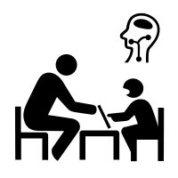
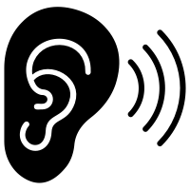
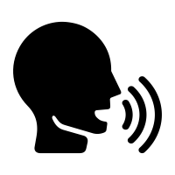
SPEECH – LANGUAGE
PATHOLOGY
- Articulation
- Dysphagia
- Phonology
- Language
- Cognition
- Aphasia
- Fluency
- Voice
- AAC

Slide 3
ORTHOPHONIE
- Suppléance
- Articulation
- Phonologie
- Dysphagie
- Cognition
- Langage
- Aphasie
- Fluidité
- Voix

