Slide 1
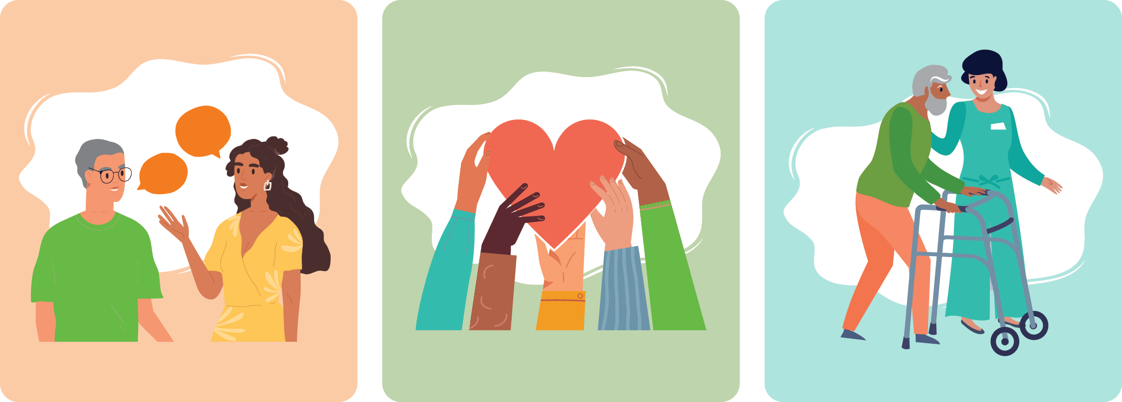
Smart Tips for Stroke Care:
A healthcare provider’s guide to caring for
a person with stroke

Slide 2
About Smart Tips for Stroke Care:
Smart Tips for Stroke Care was intended/created for Personal Support Workers (PSW) working in long-term care in Ontario. However, anyone interested in stroke care can benefit from using the resource, including PSWs in the community, family members, etc.
The goal of the Smart Tips resource is to highlight common changes due to stroke and strategies for managing these changes. Each Smart Tips topic may be used individually or as part of a series. The Smart Tips can be printed freely as a full document or individually according to staff and organizational needs. Click here to access the Smart Tips for Stroke Care booklet (available in English and French).
For additional information please contact your regional Stroke Network.

Slide 3
About this slide deck:
This slide deck was created as a teaching tool to accompany the Smart Tips resource.
This slide deck is intended to be delivered by an educator or healthcare professional with expertise in stroke care. The slides can be tailored to the audience, and additional content can be found in the notes below each slide. We have created slides with extra detail in addition to the original Smart Tips resource. These slides are identified in the notes section, and are optional.
You are free to modify the content to suit your audience, however we ask that you do not remove the Disclaimer slide, nor the acknowledgements at the end.

Slide 4
Disclaimer
The information contained in these Smart Tips is for general information purposes only and is intended to support your organizational policies/procedures. The Regional Stroke Networks of Ontario assume no responsibility for errors or omissions in the contents
The Smart Tips slide deck offers information designed for educational purposes and are not intended to replace professional medical advice, diagnosis, or treatment. Please consult with a physician or other appropriate health care providers regarding medical or health related diagnoses or treatment options
Smart Tips for Stroke Care (2023) was created by members of the Regional Stroke Networks of Ontario. This material may be shared without permission from the authors, without changes to content, and with the source credited.

Slide 5
Table of Contents
Introduction to Stroke
Hemiplegic Arm and Hand
Bowel and Bladder Function After Stroke
Eating and Swallowing After Stroke
Communication After Stroke: Aphasia
Depression After Stroke
Fatigue After Stroke
Cognition After Stroke
Vision and Perception After Stroke
Behaviour After Stroke
Mobility After Stroke
Transfers After Stroke
Positioning in Bed After Stroke
Positioning in a Chair/Wheelchair After Stroke
Meaningful Activity After Stroke

Slide 6
TOPIC:
Introduction
to Stroke

Slide 7
Introduction to Stroke
Did you know?
Stroke is the 3rd leading cause of death and a leading cause of disability in Canada
60% of persons with stroke will have a long-term impairment that can affect participation in everyday activities
1 in 5 persons living in Long Term Care have had a stroke
Stroke recovery can be a lifelong process
Notes:
Did you know?
Stroke is the 3rd leading cause of death and a leading cause of disability in Canada
60% of persons with stroke will have a long-term impairment that can affect participation in everyday activities
1 in 5 persons living in Long Term Care have had a stroke
Stroke recovery can be a lifelong process

Slide 8
Introduction to Stroke
How does the brain work?
The brain is divided into 2 halves called hemispheres
The left hemisphere controls the right side of the body and the right hemisphere controls the left side of the body
The location of the stroke determines what functions are affected
Notes:
How does the brain work?
The brain is divided into 2 halves called hemispheres. In general, the left hemisphere controls the right side of the body and the right hemisphere controls the left side of the body. The location of the stroke determines what functions are affected. For example, a stroke on the left side of the brain can cause the right arm or leg to be weak.

Slide 9
Introduction to Stroke
What is a stroke?
A stroke is sudden and occurs when the blood supply to part of your brain is interrupted causing brain cells to die
Notes:
What is a stroke?
A stroke is sudden and occurs when the blood supply to part of your brain is interrupted causing brain cells to die.

Slide 10
Introduction to Stroke
Ischemic
Blood supply in the brain is blocked by blood clots and/or buildup of plaque in the blood vessels
More than 75% of strokes
Hemorrhagic
A blood vessel in the brain leaks or ruptures
Less than 25% of strokes
Notes:
Ischemic - Blood supply in the brain is blocked by blood clots and/or buildup of plaque in the blood vessels. More than 75% of strokes are ischemic.
Hemorrhagic - A blood vessel in the brain leaks or ruptures. Less than 25% of strokes are hemorrhagic.

Slide 11
Introduction to Stroke
What is a TIA?
Transient Ischemic Attack
Sometimes called a “mini-stroke”
Caused by a short-term lack of blood flow to the brain
May cause stroke symptoms that last minutes to hours
An important warning sign that a more serious stroke may occur soon
Must be treated as a MEDICAL EMERGENCY
911 should be called immediately
Notes:
Sometimes called a “mini-stroke”, a Transient Ischemic Attack (TIA) is caused by a short-term lack of blood flow to the brain. This may cause stroke symptoms that last minutes to hours.
TIA is an important warning sign that a more serious stroke may occur soon. TIAs must be treated as a MEDICAL EMERGENCY and 911 should be called immediately.

Slide 12
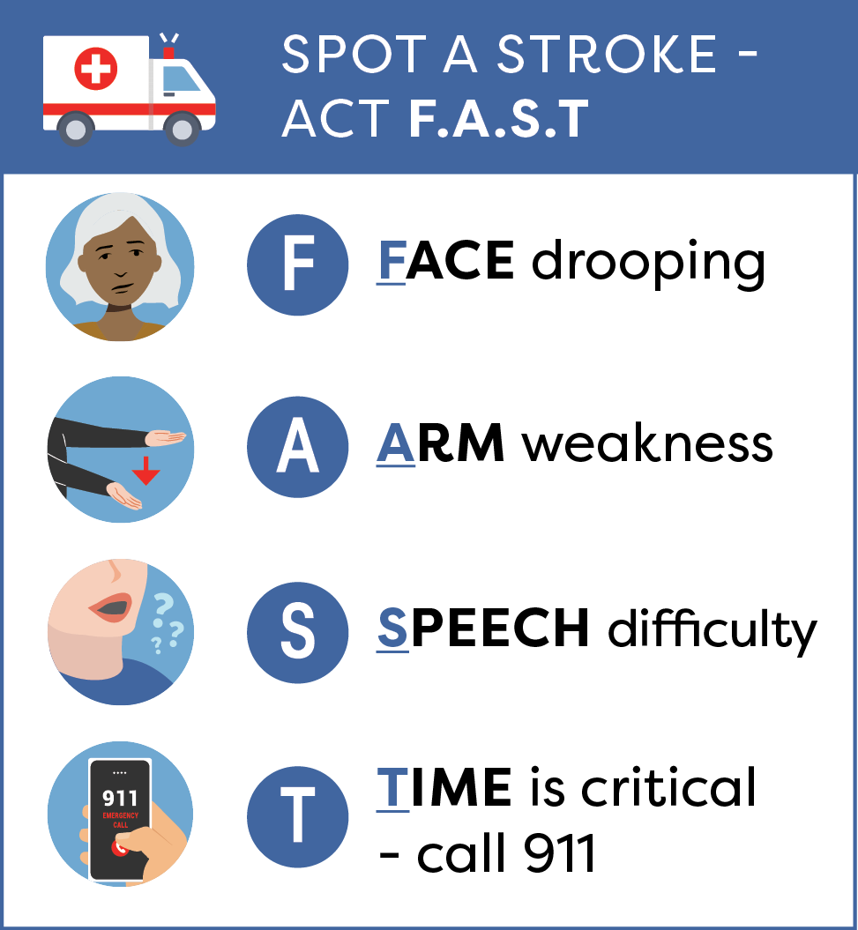
Introduction to Stroke
Signs and Symptoms of Stroke
Recognize the signs of stroke; act quickly!
FAST is a good way to recognize and remember these signs and symptoms
Sudden onset of other symptoms may also be indicative of stroke, including:
loss of balance/coordination
changes in vision
sudden severe headache
numbness in one half of the body
Notes:
Learn to recognize the signs of stroke and act quickly!
While FAST is a good way to recognize and remember these signs and symptoms, the sudden onset of other symptoms may also be indicative of stroke:
loss of balance/coordination
changes in vision
sudden severe headache
numbness in one half of the body

Slide 13
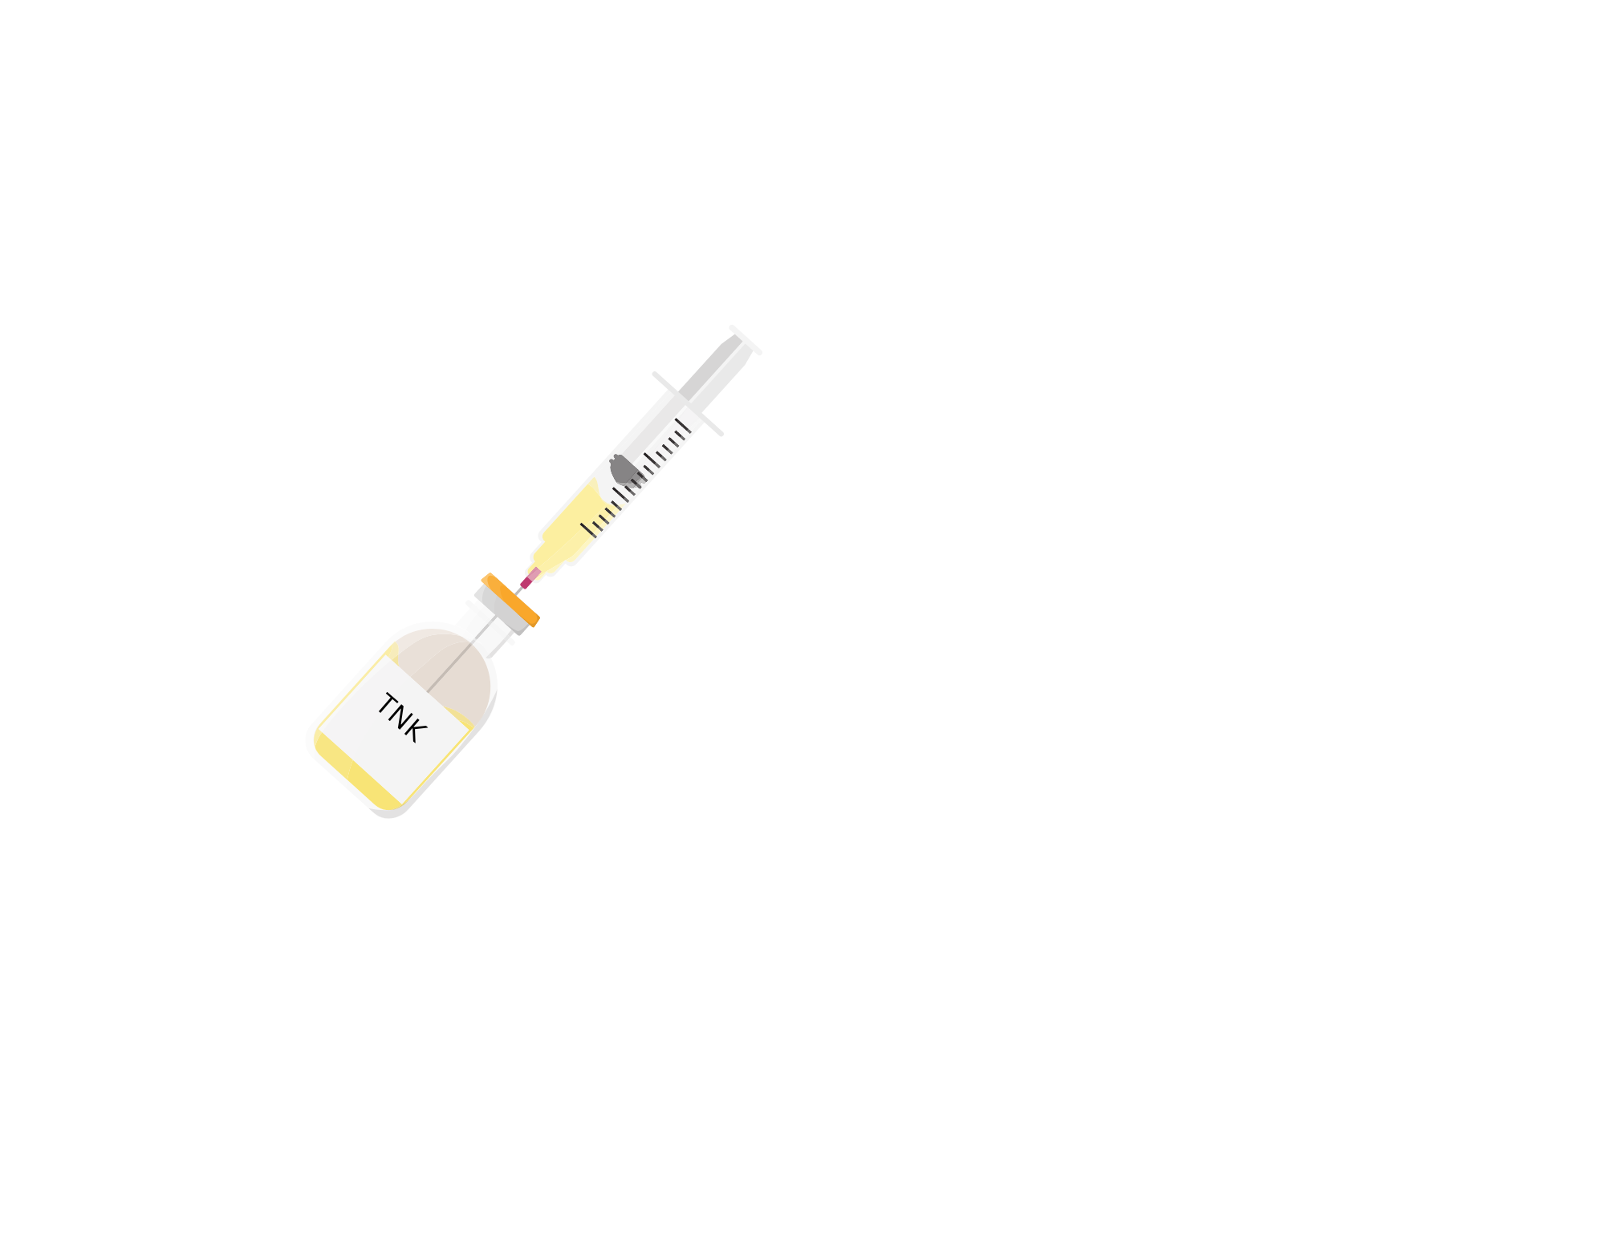
Introduction to Stroke
Early Interventions- Thrombolysis
Some people with ischemic stroke are eligible for a clot-busting drug
The drug aims to dissolve the clot and return the blood supply to the brain
It must be given quickly after the onset of stroke symptoms for eligible people (up to 4.5 hours)
Examples of clot-busting drugs are TNK and tPA
Notes:
Slide optional – It contains additional detail not found in the Introduction section of the Smart Tips for Stroke Care guide.
Some people with ischemic stroke are eligible for a clot-busting drug. The drug aims to dissolve the clot and return the blood supply to the brain. It can be given up to 4.5 hours after the onset of stroke symptoms for eligible people
Some examples of clot-busting drugs are TNK and TPA

Slide 14
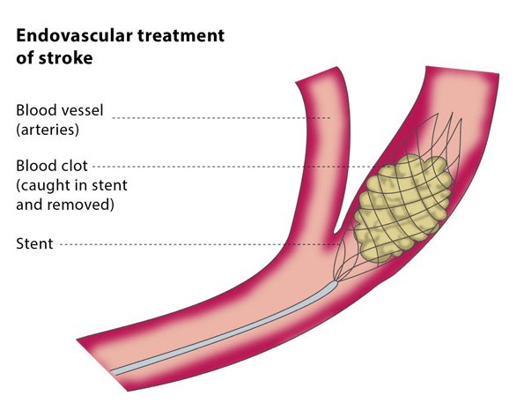
Introduction to Stroke
Early Interventions- Thrombectomy
Endovascular Therapy (EVT or thrombectomy) involves the mechanical removal of a blood clot within a large artery of the brain
Can be performed up to 24 hours after the onset of symptoms in select patients
Notes:
Slide optional - It contains additional detail not found in the Introduction section of the Smart Tips for Stroke Care guide.
Endovascular Therapy (EVT or thrombectomy) for the treatment of ischemic stroke, involves the mechanical removal of a blood clot within a large vessel (artery) of the brain. It can be performed up to 24 hours after the onset of symptoms in select patients.

Slide 15
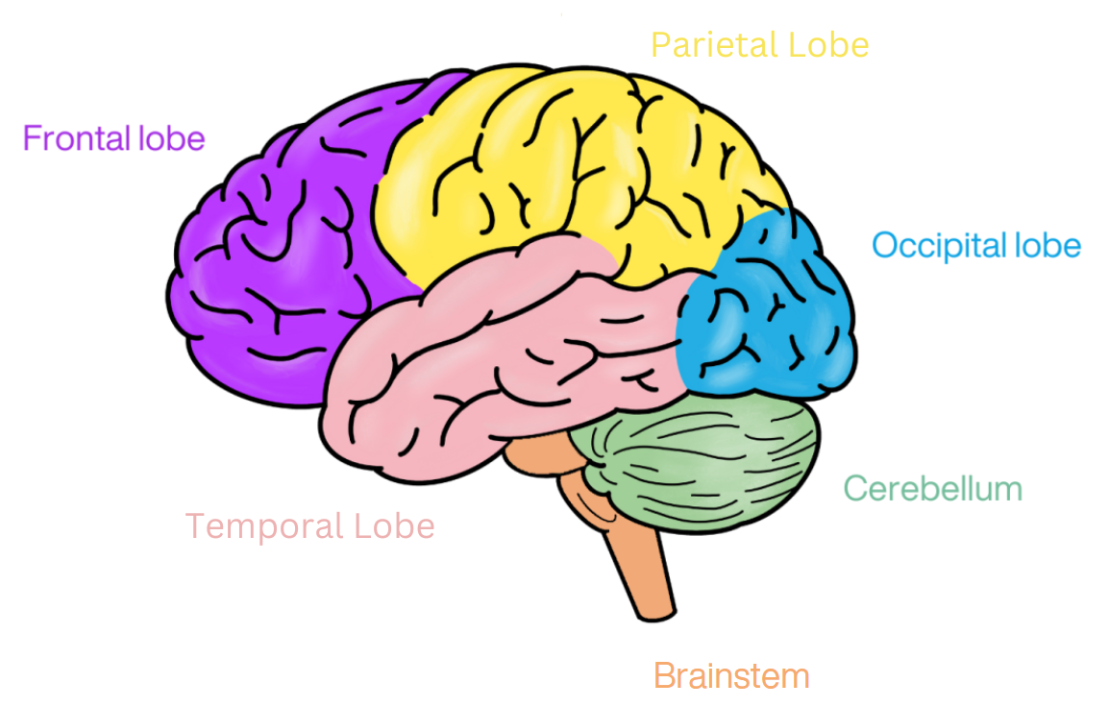
Introduction to Stroke
Parts of the Brain
Notes:
Slide optional – It contains additional detail not found in the Introduction section of the Smart Tips for Stroke Care guide.

Slide 16
Introduction to Stroke
Frontal Lobe
Memory
Temporal Lobe
Memory
Parietal Lobe
Sensory processing (e.g. taste, pain)
Occipital Lobe
Cerebellum
Brainstem
Distance and depth perception
Balance
Heart rate
Planning
Thinking
Organizing
Emotions
Movement
Understand words
Body awareness
Language
Spatial awareness
Emotions
Visual recognition
Senses (especially sight and sound)
Object/face recognition
Memory formation
Colour
Movement
Coordination
Blood pressure
Sleep
Breathing
Reflexes
Functions of the Brain
Notes:
Slide optional – It contains additional detail not found in the Introduction section of the Smart Tips for Stroke Care guide.
This list of functions is not exhaustive

Slide 17
Introduction to Stroke
Common effects of Stroke
Every stroke is different; changes may include:
One-sided weakness/paralysis
Loss of balance/coordination
Bladder/bowel problems
Swallowing problems
Fatigue
Trouble communicating
Notes:
Every stroke is different. Depending on what part of the brain is damaged by the stroke, the person may experience physical, cognitive, perceptual and emotional changes which may include:
Common effects of Stroke…
One-sided weakness/paralysis
Loss of balance/coordination
Bladder/bowel problems
Swallowing problems
Fatigue
Trouble communicating
Loss of sensation (how you perceive touch, temperature, etc.)

Slide 18
Introduction to Stroke
Common effects of Stroke continued…
Loss of sensation (how you perceive touch, temperature, etc.)
Difficulty paying attention to one side of the body or environment
Vision changes
Changes in thinking and/ or memory
Changes in personality or behaviour
Changes in emotions or mood (e.g. unexpected emotional responses)
Notes:
Difficulty paying attention to one side of the body or environment
Vision changes
Changes in thinking and/ or memory
Changes in personality or behaviour
Changes in emotions or mood (e.g. unexpected emotional responses)

Slide 19
Introduction to Stroke
Risk Factors for Stroke
Non-Modifiable Risk Factors
Age: Increased risk after 55 years of age
Gender: After menopause, women have a higher risk than men
Genetic factors: Parent or sibling had a stroke before age 65
Ethnicity: Increased risk for people of African, South Asian, Indigenous heritage
Prior stroke or TIA
Notes:
Slide optional – It contains additional detail not found in the Introduction section of the Smart Tips for Stroke Care guide.
Non-modifiable risk factors:
Age: Increased risk after 55 years of age
Gender: After menopause women have a higher risk than men
Genetic factors: Parent or sibling had a stroke before age 65
Ethnicity: Increased risk for people of African, South Asian, Indigenous heritage
Prior stroke or TIA

Slide 20
Introduction to Stroke
Risk Factors for Stroke
Lifestyle
Diet
Smoking
Obesity
Sedentary lifestyle
Excess alcohol intake
Recreational drug use
Stress
Notes:
Slide optional – It contains additional detail not found in the Introduction section of the Smart Tips for Stroke Care guide.
Diet (Salt intake, “Heart healthy”)
Smoking
Obesity
Sedentary lifestyle
Excess alcohol intake
Recreational drug use
Stress (not managing stress)

Slide 21
Introduction to Stroke
Risk Factors for Stroke
Disease or Medications
Disease or medications
High blood pressure
Diabetes
High cholesterol
Heart disease / arrhythmias
Coagulation disorders
Vascular disease
Sleep apnea
Taking birth control or hormone replacement
Notes:
Slide optional – It contains additional detail not found in the Introduction section of the Smart Tips for Stroke Care guide.
High blood pressure
Diabetes
High cholesterol
Heart disease / arrhythmias
Coagulation disorders
Vascular disease
Sleep apnea
Taking birth control or hormone replacement

Slide 22
Introduction to Stroke
Understanding the effects of stroke will help you to provide better care and support to the person with stroke and their family.
Recovery after a stroke is possible.
It begins immediately after the stroke and continues throughout one’s life.
Smart Tips for Stroke Care (2023) was created by members of the Regional Stroke Networks of Ontario. This material may be shared without permission from the authors, without changes and with source credited.
Notes:
Understanding the effects of stroke will help you to provide better care and support to the person with stroke and their family. Please refer to the other SMART TIPS for Stroke Care topics for more information.

Slide 23
TOPIC:
The Hemiplegic Arm and Hand After Stroke

Slide 24
The Hemiplegic Arm and Hand
After Stroke
A stroke can cause weakness (hemiplegia) on the affected side.
This can impact the ability to:
move the arm and hand
carry out functional tasks
protect the arm from injury
Careful handling and care of the arm and hand can reduce pain and prevent complications.
Notes:
A stroke can cause weakness (hemiplegia) on the affected side.
This can impact the ability to move the arm and hand, carry out functional tasks or protect the arm from injury.
Careful handling and care of the arm and hand can reduce pain and prevent complications.
This is important because once it starts, pain in the arm and/or hand can become chronic and difficult to treat.

Slide 25
The Hemiplegic Arm and Hand
After Stroke
What you should know:
The shoulder is made up of small muscles and ligaments which support the joint
>50% persons with hemiplegia will experience pain in their affected arm and/or hand
Swelling in the hand is likely to develop if not well supported
Notes:
The shoulder is made up of small muscles and ligaments which support the joint. Many important nerves and blood vessels pass through it, making the shoulder, arm and hand vulnerable to injury
Anatomy-
Shoulder socket is very shallow- this allows it to be the most mobile joint in the body, But this also makes it the least stable as it is supported only by muscles and ligaments-
Effects of a stroke can reduce the strength and tone of the muscles supporting the shoulder joint.
As a result, gravity can drag the head of the humerus down, overstretching the weakened muscles.
More than half of persons with hemiplegia will experience pain in their affected arm and/or hand. Pain may occur more frequently in persons who are dependent on others for transfers.
The hand is likely to develop swelling if not well supported. Elevation and loosening/ removal of restricting items would be helpful to reduce this if observed- seek additional advice if this is a new problem

Slide 26
The Hemiplegic Arm and Hand
After Stroke
What you should know:
Pain can interfere with mood, sleep, day to day activities, and overall quality of life
Altered sensation can make a person with stroke unaware of the position of their arm and can increase risk of injury
The affected arm and hand can have altered muscle tone (low or high)
Notes:
Pain can interfere with mood, sleep, day to day activities, and overall quality of life
A stroke can also cause altered sensation and perception (neglect) of the arm. As a result, a person with stroke can be unaware of the position of their arm. This can increase risk of injury. For example the arm could hang over the side of the wheelchair, injuring the shoulder as well as risking fingers getting caught in the wheel
Following a stroke the arm and hand can have altered muscle tone. Both high tone and low tone limbs can cause pain

Slide 27
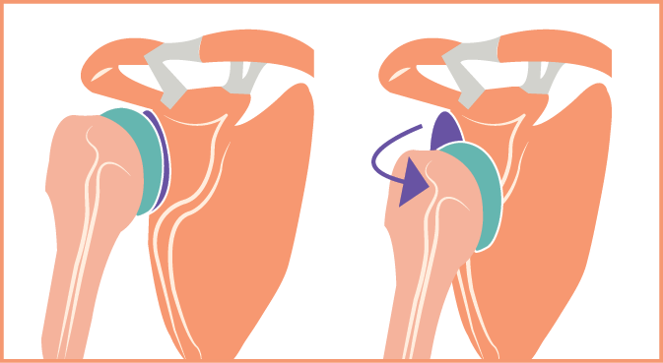
The Hemiplegic Arm and Hand
After Stroke
A low tone limb will feel limp and heavy.
A low tone hemiplegic arm is at risk of overstretching or tearing weakened muscles.
This may cause a partial dislocation (subluxation) which is not correctable.
Notes:
A low tone limb will feel limp and heavy. A low tone hemiplegic arm is at risk of overstretching or tearing weakened muscles. This may cause a partial dislocation (subluxation of the shoulder), which is not correctable.
Effects of a stroke can reduce the strength and tone of the muscles supporting the shallow shoulder joint.
As a result, gravity can drag the head of the humerus down, overstretching the weakened muscles.

Slide 28
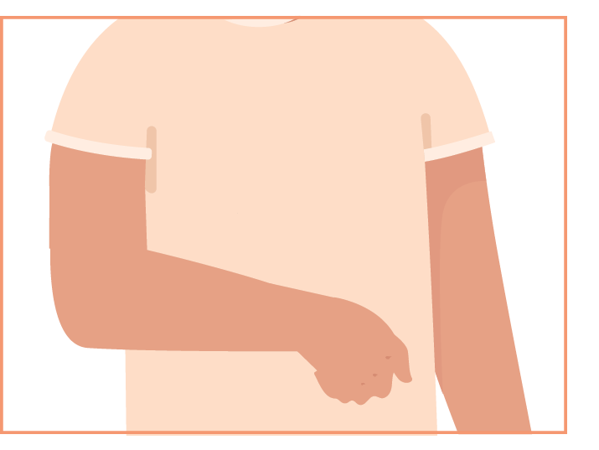
The Hemiplegic Arm and Hand
After Stroke
A high tone limb will feel stiff and tight. It can be very difficult to move the arm or hand, and to provide care.
This can contribute to:
Skin breakdown (underarm, hand)
Difficulty in assisting with hygiene and dressing
Limited range of motion (contractures)
Shoulder pain
Move the limb carefully and slowly - do not force movement!
Notes:
A high tone limb will feel stiff and tight. High muscle tone can pull the arm toward the chest wall, with a bent wrist and clenched hand. It can be very difficult to move the arm or hand, and to provide care. This can contribute to:
Skin breakdown (underarm, hand)
Difficulty in assisting with hygiene and dressing
Limited range of motion (contractures)
Shoulder pain
With high tone UE, move carefully, slowly, do not force movement. If care is becoming increasingly difficult, seek the advice of a therapist

Slide 29
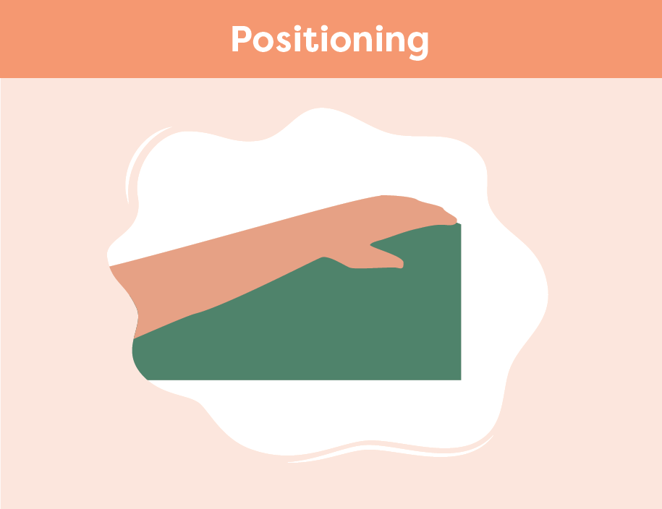
The Hemiplegic Arm and Hand
After Stroke
Smart Tips:
Be gentle when moving the arm or hand. Avoid pulling on the limb
Ensure the affected arm and hand are always supported. Try to:
ensure the elbow and forearm are placed away from the body
keep the wrist straight or slightly extended
place the hand palm down with fingers open as much as possible
Notes:
Smart Tips – Always follow the care plan!
These strategies pertain to positioning of the hemiplegic arm:
Be gentle when moving the arm or hand. Avoid pulling on the limb
Ensure the affected arm and hand are always supported using pillows or other equipment when recommended in the care plan
In every position, ensure the elbow and forearm are placed away from the body. Keep the wrist straight or slightly extended and place the hand palm down with fingers open as much as possible
See Smart Tips for Positioning in Chair/Wheelchair After Stroke and Positioning in Bed After Stroke

Slide 30
The Hemiplegic Arm and Hand
After Stroke
Goal: 30 degrees of wrist extension, 30 degrees of flexion through digits
Consider use of splints/ rolls
Careful positioning can help with reducing the high tone (spasticity), and maintain joint ROM
Notes:
This slide is optional- offers additional information pertaining to previous slide. It contains additional detail not found in the Hemiplegic Arm & Hand section of the Smart Tips for Stroke Care guide.
Smart Tips – Always follow the care plan!
The goal is to maintain 30 degrees of wrist extension, 30 degrees of flexion through digits, consider use of splints/ rolls to maintain this position
Careful positioning can help with reducing the high tone (spasticity), and maintain joint ROM
It is important to consider the position and alignment of all the joints of the UE when looking at any one joint that is limited
See Smart Tips for Positioning in Chair/Wheelchair After Stroke and Positioning in Bed After Stroke

Slide 31
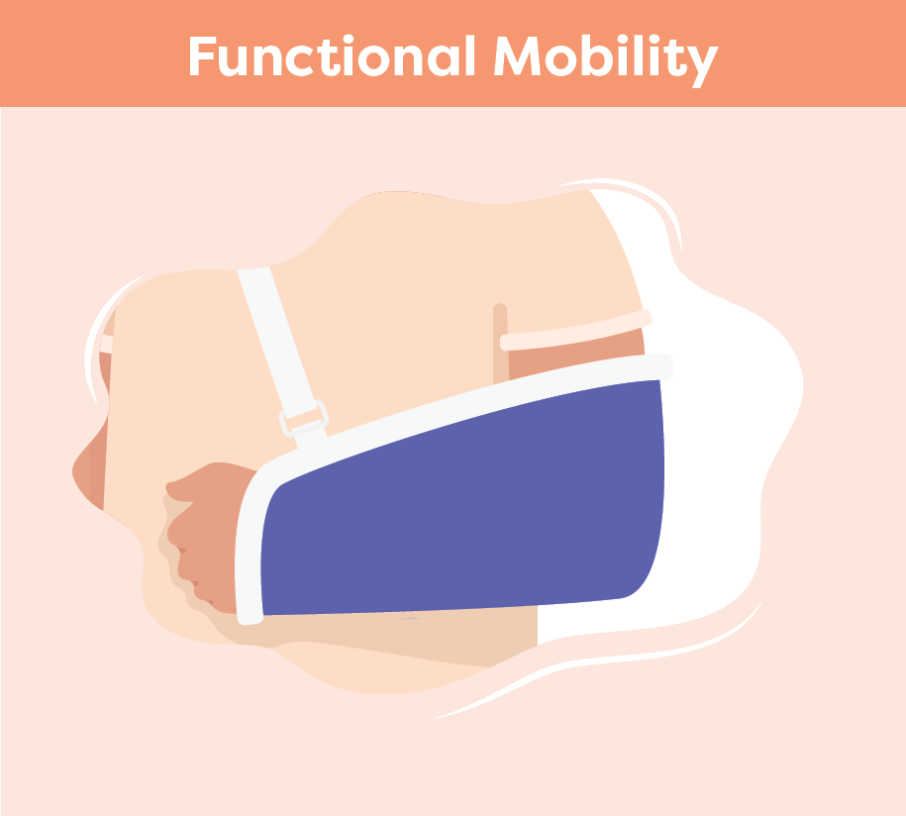
The Hemiplegic Arm and Hand
After Stroke
Never pull on the person’s affected arm or lift from the underarm
Encourage participation
When using a lifting device, ensure the affected arm is positioned inside the lift sling and in front of the body
Support the arm when the person is standing, transferring or ambulating
Use a sling if recommended by a therapist
Notes:
These strategies pertain to supporting the hemiplegic arm during functional mobility
Never pull on the person’s affected arm or lift from the underarm. Encourage the person to participate as much as they safely can. (See Smart Tips for Stroke Care - Mobility after Stroke and Transfers after Stroke)
When using a lifting device (e.g. floor lift, ceiling lift) ensure the affected arm is positioned inside the lift sling, and supported in front of the body
Ensure the arm is supported when the person is standing, transferring or ambulating
If recommended by a therapist, apply an arm sling to support the weight of their hemiplegic arm during mobility activities

Slide 32
The Hemiplegic Arm and Hand
After Stroke
Always support the hemiplegic arm
Move the arm and hand slowly and gently
Monitor clenched hand for hygiene and skin health
Do not raise the arm above shoulder level unless the person can do so themselves
Dressing rule for stroke: hemiplegic arm should be “first on; last off”
Notes:
These strategies pertain to activities of daily living (ADL’s)
Be careful to always support the hemiplegic arm
Move the arm and hand slowly and gently. This is especially important during tasks like bathing and dressing
Monitor persons with high tone that have a clenched hand for hygiene and skin health.
Look for finger nails digging in the palm (may need trimming), and cleanliness between the fingers
Do not raise the arm above shoulder level unless the person can do so themselves. If asked “Why not”?
Shoulder movement is complex and involves more than just the shoulder joint
The scapula (shoulder blade) has to move for the arm to move, especially as you move beyond 90 degrees of abduction and flexion. So, if the scapula is stuck (against the bed, high tone) and you move too far, you can cause injury
Never do exercises with the UE unless recommended by a therapist.
Dressing rule for stroke: hemiplegic arm should be “first on; last off”

Slide 33
The Hemiplegic Arm and Hand
After Stroke
Seek extra support
All team members have a role to play in caring for the affected arm and hand
Occupational Therapists and Physiotherapists are skilled in hemiplegia
Smart Tips for Stroke Care (2023) was created by members of the Regional Stroke Networks of Ontario. This material may be shared without permission from the authors, without changes and with source credited.
Notes:
All team members have a role to play in caring for the affected arm and hand
Occupational Therapists and Physiotherapists are experts in hemiplegia. It may be helpful to involve them in the person’s care

Slide 34
TOPIC:
Bowel and Bladder Function After Stroke

Slide 35
Bowel and Bladder
After Stroke
Bowel and bladder incontinence are common after stroke
Can be a result of damage to the part of the brain that controls bowel and bladder function
Many factors (e.g. mobility) can increase bowel and bladder issues
People with bowel and bladder issues may:
require frequent trips to the bathroom
not make it to the bathroom in time
have issues with urinary tract infections
Notes:
Bowel and bladder incontinence (loss of control or poor control) are common after a stroke
Incontinence can be a result of damage to the part of the brain that controls bowel and bladder function
Many factors, such as a person’s ability to move, think and communicate, can increase bowel and bladder issues. As well, things such as equipment, room layout, medication and co-morbidities can also add to the issue
People with bowel and bladder issues may require frequent trips to the bathroom, may not make it to the bathroom in time and/or have issues with urinary tract infections

Slide 36
Bowel and Bladder
After Stroke
What you should know:
> 45% of persons with stroke in LTC experience incontinence
Bowel incontinence is less common than bladder incontinence
Women have higher rates of incontinence after stroke than men
Incontinence after stroke is associated with poor outcomes
Incontinence can lead to:
skin breakdown
infections
pain
falls
dehydration
Notes:
More than 45% of persons with stroke living in LTC experience bladder or bowel incontinence
Bowel incontinence is less common than bladder incontinence
Women have higher rates of incontinence after stroke than men
Incontinence after stroke is associated with poor outcomes including slower recovery, prolonged hospitalization, and low quality of life
Issues that can result from incontinence include skin breakdown, skin and bladder infections, dehydration, pain and falls

Slide 37
Bowel and Bladder
After Stroke
What you should know:
Incontinence may lead to isolation and issues with depression
Reducing incontinence can improve quality of life and self-esteem
Increased awareness of incontinence can help to reduce stigma
Notes:
Persons with stroke who have incontinence may also isolate more and have issues with depression
Reducing occurrences of incontinence can greatly improve quality of life and self-esteem
Increased awareness and knowledge of bowel and bladder incontinence among health care providers can help to reduce stigma and encourage individuals faced with these conditions to seek help

Slide 38
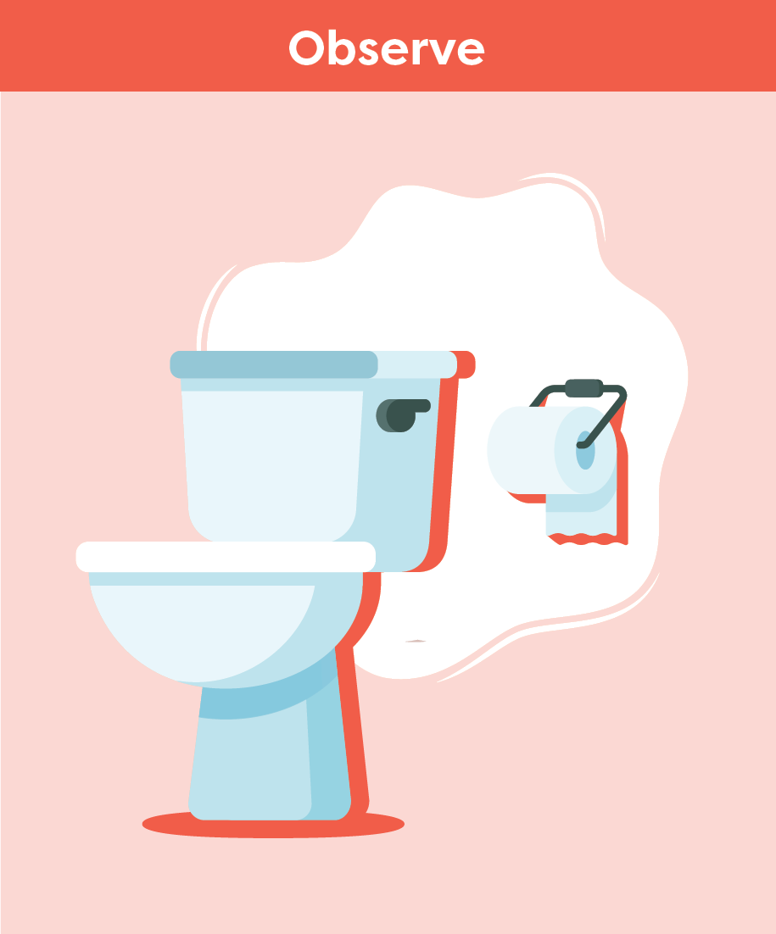
Bowel and Bladder
After Stroke
Smart Tips:
Assess factors that impact incontinence
Get to know the person and how they indicate their need to go to the bathroom
For language/communication barriers, use pointing/gestures or pictures
Monitor bowel and bladder patterns, diet and fluid intake
Notes:
Smart Tips – Always follow the care plan! This section pertains to observation.
Assess factors that could impact incontinence such as room layout, and/or visual, mobility and thinking deficits
Get to know the person with stroke and how they indicate their need to go to the bathroom. Can they ask? Do they need assistance? Are they agitated, restless or roaming? This could be a sign they need to use the bathroom
If language or communication is a barrier, encourage the person or provider/family to use pointing/gestures or pictures to indicate needs
Monitor bowel and bladder patterns, diet and fluid intake. For example, is the person refusing fluids because of fear of being incontinent

Slide 39
Bowel and Bladder
After Stroke
Recognize signs of incontinence, such as:
frequent urination
soiled/wet clothes or linens
strong odour
urine/feces on bathroom floors
toilet paper as padding inside the underwear
increased usage of incontinence products
Notes:
Smart Tips – Always follow the care plan! This section pertains to observation
Recognize signs of incontinence, such as frequent urination, soiled/wet clothes or linens, strong odour, urine/feces on bathroom floors, toilet paper as padding inside the underwear and/or increased usage of incontinence products

Slide 40
Bowel and Bladder
After Stroke
Closely watch for signs of urinary tract infection:
strong odour
minimal urine output
increased urgency
discomfort when urinating
blood in urine
lower abdominal/back pain/pressure
increased confusion/agitation
increased fatigue
fever
Notes:
Smart Tips – Always follow the care plan! This section pertains to observation.
Closely watch for possible signs of urinary tract infection, including strong odour, minimal urine output, increased urgency, discomfort when urinating, blood in urine, lower abdominal/back pain/pressure, increased confusion/agitation, increased fatigue and fever

Slide 41
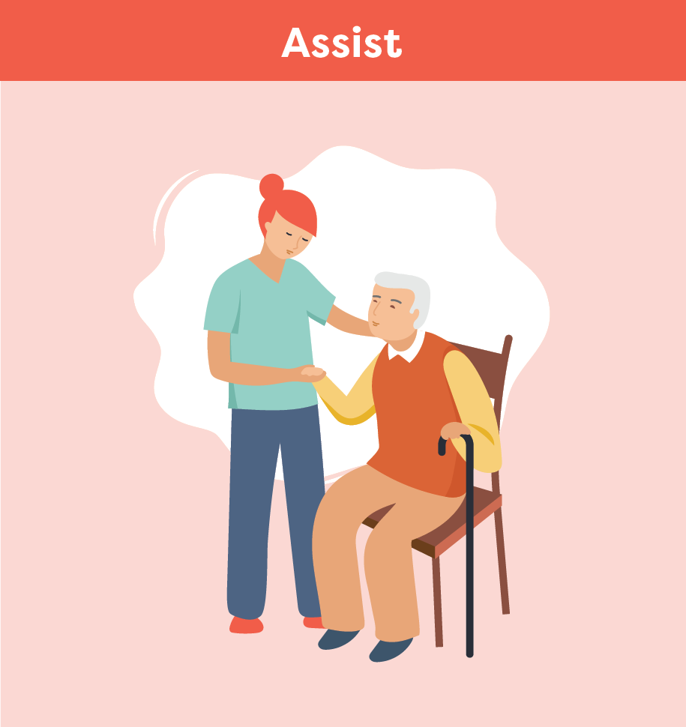
Bowel and Bladder
After Stroke
Set up the room for easy and safe access to the bathroom
Apply strategies from the care plan:
Encourage use of commode/urinal
Toileting 30 minutes after a meal
Regular toileting throughout day
Limit caffeine intake
Offering decaf coffee or herbal teas
Notes:
Smart Tips – Always follow the care plan! This section pertains to how you might assist the person:
Set up the room for easy and safe access to the bathroom
Always follow the care plan. For example, encourage use of a commode or urinal, toileting for a bowel movement 30 minutes after a meal, regular toileting throughout the day, limiting caffeine intake to 1-2 cups earlier in the day, offering decaf coffee or herbal teas

Slide 42
Bowel and Bladder
After Stroke
Encourage water intake, especially morning and early afternoon
Educate the person and their family
Provide emotional support and reassurance
Notes:
Smart Tips – Always follow the care plan! This section pertains to how you might assist the person:
Encourage water intake to meet daily fluid goals. Fluids can also be added to the diet through soups, yogurt, jello, ice cream, popsicles, watery fruit such as watermelon or grapes. If possible, arrange to have most fluid intake in the morning and early afternoon, less in the evening and prior to bedtime
Educate the person with stroke and their family on incontinence after stroke and encourage them to use the strategies put in place
Provide emotional support and reassurance to people experiencing incontinence

Slide 43
Bowel and Bladder
After Stroke
Seek extra support
Persons with incontinence should be assessed by a trained professional
When you notice signs of incontinence or a possible urinary tract infection, report it immediately
Smart Tips for Stroke Care (2023) was created by members of the Regional Stroke Networks of Ontario. This material may be shared without permission from the authors, without changes and with source credited.
Notes:
Persons with stroke should be assessed by a trained professional such as the nurse, nurse practitioner or physician to determine cause of incontinence and to develop a personalized care plan
You are the eyes and ears for the team. When you notice signs of incontinence or a possible urinary tract infection, report it immediately

Slide 44
TOPIC:
Eating and Swallowing After Stroke

Slide 45
Eating and Swallowing
After Stroke
Dysphagia:
Means trouble swallowing
Results from damage to the brain
May require changes to food textures and liquids for safety
Notes:
Dysphagia means trouble swallowing and can result from damage to the brain such as a stroke.
When a person has dysphagia, they may need changes to their food textures and liquids to ensure that they can safely eat and drink.

Slide 46
Eating and Swallowing
After Stroke
What you should know:
Up to 65% of people will have dysphagia
Pneumonia can occur when food or liquids “go down the wrong way”
Oral care should be done before and after meals and at bedtime
Poor intake can lead to weight loss and dehydration
Social isolation can occur for many people living with dysphagia
Notes:
Up to 65% of people will have dysphagia following a stroke
Pneumonia can occur when food or liquids “go down the wrong way” (known as aspiration pneumonia)
Oral care before and after meals and at bedtime can help reduce risk of aspiration pneumonia
Fear of choking and/or a change in food texture or thickened fluids can result in poor intake. This can lead to weight loss and dehydration
Social isolation can occur for many people living with dysphagia. It is important to include them in social activities and be sure they can join with safe food and beverage options

Slide 47
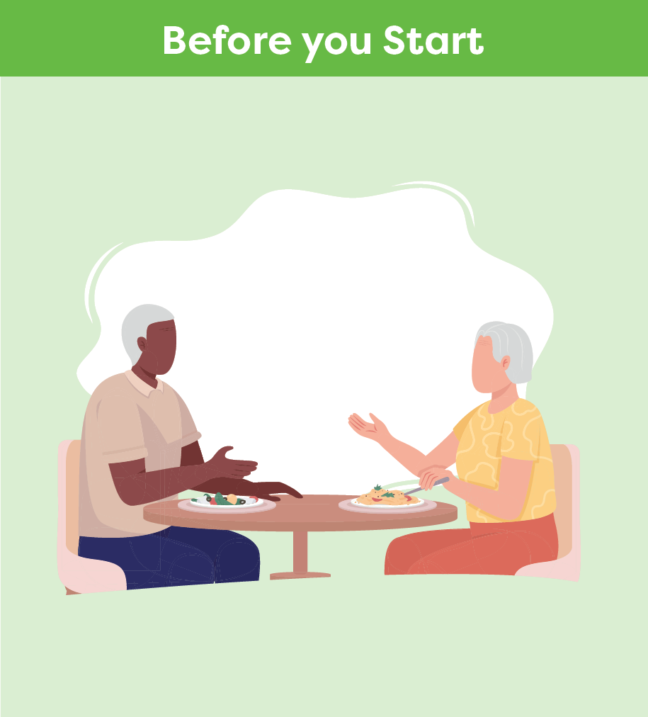
Eating and Swallowing
After Stroke
Smart Tips:
Perform hand hygiene
Ensure the person is alert
Use assistive devices as needed
Ensure dentures are in place and fit well
Notes:
Smart Tips – Always follow the care plan! This section pertains to steps you should take before you start helping a person with stroke eat
Perform hand hygiene
Ensure the person is alert
Follow the suggestions by therapy staff for use of assistive devices as needed (controlled sip cups, built-up utensil handles, plate guard, anti-slip mat, etc.)
Ensure dentures are in place and fit well

Slide 48
Eating and Swallowing
After Stroke
Place yourself face to face and at eye level or sit on the person’s unaffected side
Check that the person is upright for the meal
Ask for help if you are not sure a food is right for the person
Notes:
Smart Tips – Always follow the care plan! This section pertains to steps you should take before you start helping a person with stroke eat
Place yourself face to face and at eye level with the person. If unable to do so, sit on the person’s unaffected side
Check that the person is upright for the meal (unless otherwise noted in the care plan)
Ask for help if you are not sure a food is right for the person. Check the care plan for safe options (e.g. popsicles, ice cream and/or milkshakes may not be okay for everyone)

Slide 49
Eating and Swallowing
After Stroke
Watch for signs of trouble swallowing:
Pocketing of food or pills
Taking a long time to eat
Drooling or spitting out food
Shortness of breath after meals
A wet or gurgly voice
Throat-clearing
Coughing or choking
Person reporting issues
Notes:
Smart Tips – Always follow the care plan! This section pertains to things you should look or listen for while a person is eating
Pocketing of food or pills in the mouth or cheeks and under tongue
Taking a long time to eat
Drooling or spitting out food
Shortness of breath after meals
A wet or gurgly voice
Throat-clearing
Coughing or choking
The person reporting that something is sticking in their throat, their throat feels tight or they describe signs of heartburn

Slide 50
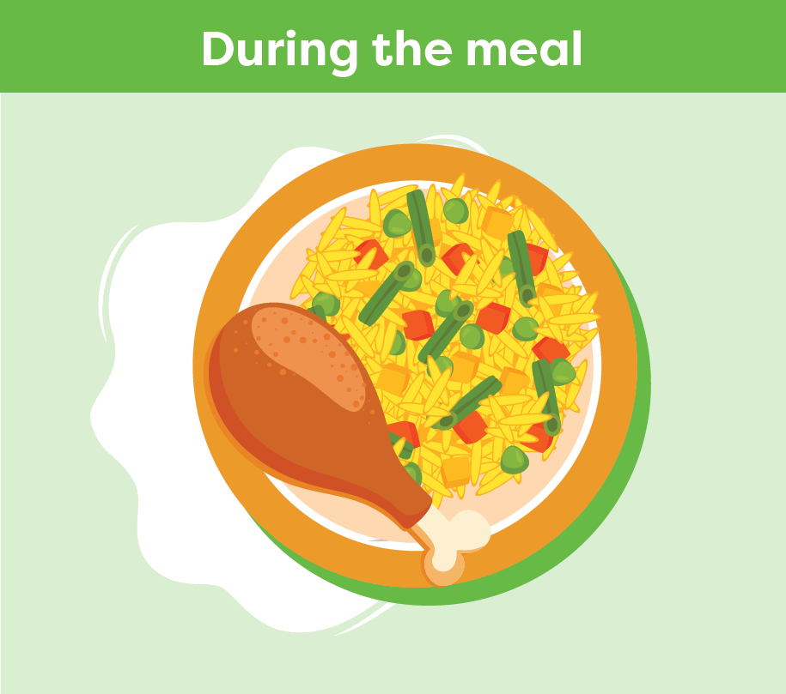
Eating and Swallowing
After Stroke
Be patient and avoid rushing
Avoid talking when the person is eating
Decrease distractions
Eat slowly
Encourage to feed themself when able
Confirm the mouth is clear
Let the person know what food they are being offered
Be positive!
Notes:
Smart Tips – Always follow the care plan! This section pertains to ways you can support a person during the meal
Be patient and avoid rushing the meal
Avoid talking when the person is eating
Decrease distractions
Support the person to eat slowly and feed themself when able
Confirm the mouth is clear before offering more food and again after the meal
Food can look different when the texture has changed. Be sure to let the person know what they are being offered
Be positive! This can have a big impact on how much the person will eat and their pleasure of mealtime

Slide 51
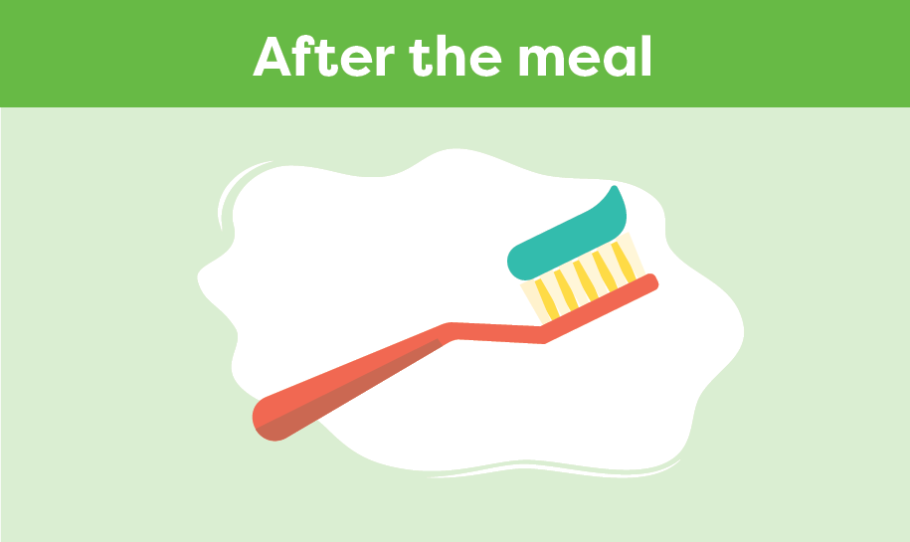
Eating and Swallowing
After Stroke
Keep upright for 30 minutes after eating
Check for pocketing of food
Encourage good oral care
Use a soft toothbrush
Notes:
Smart Tips – Always follow the care plan! This section pertains to things that you should do after a person eats.
Keep the person seated upright for 30 minutes after eating
Check for pocketing of food
Encourage good oral care. Provide help when needed with brushing teeth/dentures before and after meals
Use a soft toothbrush and avoid relying on oral swabs when assisting with oral care

Slide 52
Eating and Swallowing
After Stroke
Seek extra support
Swallowing can change over time. If you see any changes, report this to the team immediately
Registered Dietitians and Speech Language Pathologists are skilled in eating and swallowing
Smart Tips for Stroke Care (2023) was created by members of the Regional Stroke Networks of Ontario. This material may be shared without permission from the authors, without changes and with source credited.
Notes:
Careful monitoring is vital because swallowing can change over time and affect a person’s ability to eat and drink safely. If you see any changes in a person’s eating or swallowing, report this to the team immediately
Registered Dietitians and Speech Language Pathologists are skilled in eating and swallowing. It may be helpful to involve them in the person’s care

Slide 53
TOPIC:
Communication After Stroke: Aphasia

Slide 54
Communication
After Stroke: Aphasia
Communication problems are common after a stroke
Aphasia is a common communication impairment and can affect a person’s ability to:
speak
read
write
understand what others say
Notes:
Communication problems are common after a stroke. Aphasia is a common communication impairment. It can affect a person’s ability to speak, read, write, and understand what others say.

Slide 55
Communication
After Stroke: Aphasia
What you should know:
1 in 3 people with stroke will have aphasia
Aphasia impacts a person’s ability to use language
Aphasia does NOT impact intelligence
Communicating with someone with aphasia can take time and effort
Aphasia can lead to frustration, social isolation and depression
Better communication can improve care and quality of life
Notes:
1 in 3 people who have had a stroke will have aphasia
Aphasia impacts a person’s ability to use language. It does NOT impact their intelligence. They may know more than they can say
Communicating with someone with aphasia can take time and effort for both you and the person with aphasia. It gets easier with practice
Aphasia can lead to frustration, social isolation and depression
Better communication can improve care and quality of life for the person with aphasia

Slide 56
Communication
After Stroke: Aphasia
A person may have one or both of the following types of aphasia:
Receptive Aphasia - trouble taking messages IN; difficulty understanding what is heard or read
Expressive Aphasia - trouble getting messages OUT; difficulty speaking or writing
Notes:
A person may have one or both of the following types of aphasia:
Receptive Aphasia - trouble taking messages IN; difficulty understanding what is heard or read
Expressive Aphasia - trouble getting messages OUT; difficulty speaking or writing

Slide 57
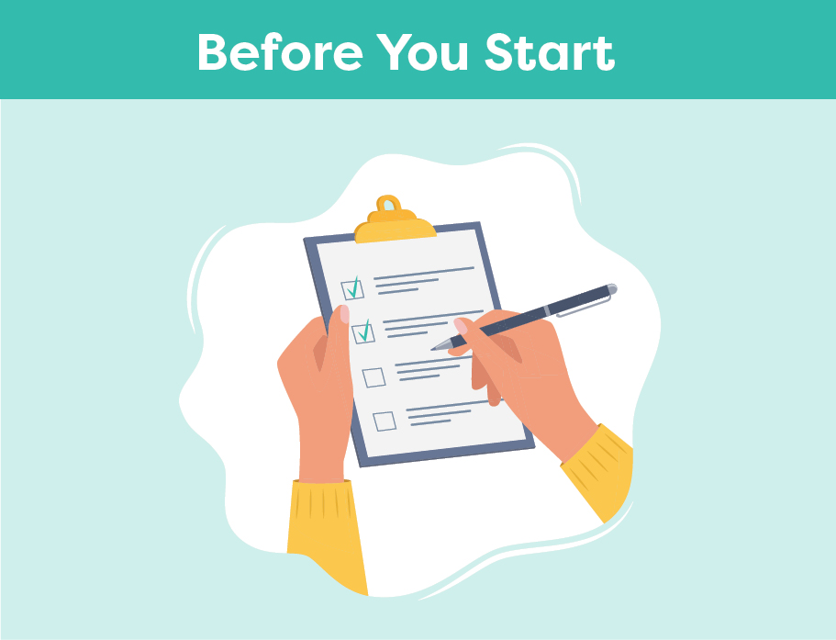
Communication
After Stroke: Aphasia
Smart Tips:
Ensure adequate lighting
Reduce noise and distractions
Ensure hearing aids, glasses and/or dentures are in use
Position yourself face to face at eye level
Plan for extra time and be patient
Notes:
Smart Tips – Always follow the care plan! This section pertains to actions to take before you start
Ensure adequate lighting
Reduce noise and distractions
Ensure the person’s hearing aids and glasses and/or dentures are in place if needed
Position yourself face to face and at eye level with the person
Plan extra time for your interaction and be patient

Slide 58
Communication
After Stroke: Aphasia
Make sure the topic of conversation is very clear
Speak in short simple sentences
Ask YES/NO questions
Offer choice
Notes:
Smart Tips – Always follow the care plan! This section pertains to how to keep it simple
Make sure you both know the topic and be very clear when the topic changes
Speak in short simple sentences
Ask YES/NO questions
Offer choice: “Do you want A or B, or neither?”

Slide 59
Communication
After Stroke: Aphasia
Speak slowly and clearly
Use a normal tone and volume
Acknowledge competence “I know you know”
Include the person with aphasia in conversations
Avoid interrupting
Notes:
Smart Tips – Always follow the care plan! This section pertains to being respectful when communicating
Speak slowly and clearly in a normal tone and volume
Acknowledge competence “I know you know”
Include the person with aphasia in conversations - do not speak for them
Avoid interrupting, allow them time to finish their sentence

Slide 60
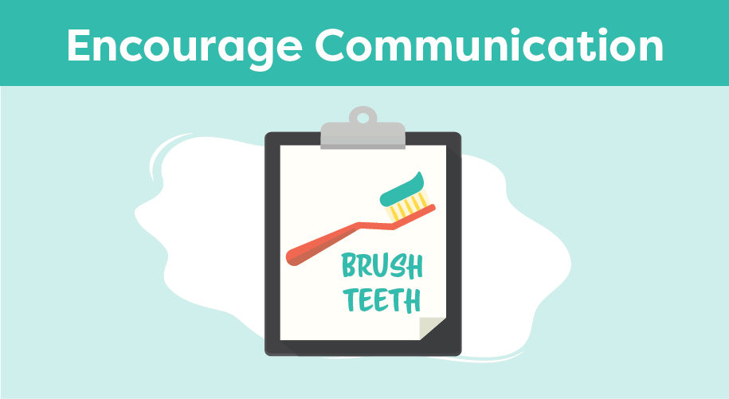
Communication
After Stroke: Aphasia
Use gestures
Write down key words
Have them point to words or pictures
Notes:
Smart Tips – Always follow the care plan. This section pertains to encouraging communication
Use gestures
Write down key words during your interaction
Have them point to words or pictures; use a communication board

Slide 61
Communication
After Stroke: Aphasia
Repeat what you think the person said
Pay attention to body language and facial expressions
Acknowledge frustration
Offer to try again later
Notes:
Smart Tips – Always follow the care plan! This section pertains to confirming the message
Repeat what you think the person said to verify what you understood
Pay attention to body language and facial expressions
Acknowledge frustration, it’s okay to admit that you don’t understand
Offer to try again later

Slide 62
Communication
After Stroke: Aphasia
Seek extra support
Speech Language Pathologists are skilled in communication
For more information about Aphasia, please visit the Aphasia Institute https://www.aphasia.ca/
Smart Tips for Stroke Care (2023) was created by members of the Regional Stroke Networks of Ontario. This material may be shared without permission from the authors, without changes and with source credited.
Notes:
Speech Language Pathologists are the experts in communication. It may be helpful to involve them in the person’s care
For more information about Aphasia, please visit the Aphasia Institute https://www.aphasia.ca/

Slide 63
TOPIC:
Depression After Stroke

Slide 64
Depression After Stroke
1 in 3 people will experience depression after stroke
Is a mood disorder that can occur following an injury to the brain
Can affect how an individual thinks, feels or behaves
Does not go away on its own and requires treatment
Notes:
1 in 3 people who have had a stroke will experience depression
Depression is a mood disorder that can occur following an injury to the brain
Depression can affect how an individual thinks, feels or behaves and it can influence daily life functioning
It is normal to feel sad after a stroke, but this feeling typically goes away in time. Depression does not go away on its own and requires treatment.

Slide 65
Depression After Stroke
What you should know:
Early recognition is key!
Risk is greatest in the first 3-6 months
Signs of depression can be mistaken for the effects of stroke or aging
Signs of depression can also be overlooked or missed when a person has difficulty speaking or thinking
Depression is treatable with medications and/or counselling
Can affect a person’s quality of life and ability to enjoy activities
Risk of depression increases at times of change
Notes:
The risk of depression is greatest in the first 3-6 months after a stroke, but a person can develop depression years later
Signs of depression can be mistaken for the effects of stroke or aging
Signs of depression can also be overlooked or missed when a person has difficulty speaking or thinking
Early recognition is key. Depression is treatable. The most common treatments for depression are medications and counselling. The person may need to try several medications before finding one that works best. Medications may take several weeks to work before you notice a change (e.g 6-8 weeks).
If not treated, depression can affect a person’s ability to enjoy activities, participate in their own care and interact with family and friends. Depression can impact quality of life
Risk of depression increases at times of change, so a person should be monitored when moving into a new setting such as a long-term care home

Slide 66
Depression After Stroke
Smart Tips:
Look for Signs of Depression:
Feeling hopeless, helpless or worthless
Feeling sad, anxious, irritable or angry
Loss of interest and withdrawal
Appetite, weight and sleep pattern changes
Headaches, chronic pain, digestive problems
Notes:
Smart Tips – Always follow the care plan! This section pertains to recognizing the signs of depression
Look for Signs of Depression:
Feeling hopeless, helpless or worthless
Feeling sad, anxious, irritable or angry
Loss of interest and withdrawal
Appetite, weight and sleep pattern changes
Headaches, chronic pain, digestive problems
Other considerations include negativity, feeling gloomy and dark, feeling of living in a fog, slow movements.

Slide 67
Depression After Stroke
Look for Signs of Depression:
Fatigue/lack of energy
Memory, concentration problems, confusion and slow thoughts
Difficulty making decisions
Thoughts of death, dying or suicide
Notes:
Smart Tips – Always follow the care plan!
Look for Signs of Depression:
Fatigue/lack of energy
Memory, concentration problems, confusion and slow thoughts
Difficulty making decisions
Thoughts of death, dying or suicide
Other considerations include negativity, feeling gloomy and dark, feeling of living in a fog, slow movements.

Slide 68
Depression After Stroke
Consistent routine
Help the person plan and structure
Encourage participation in activities of interest
Encourage the person to share their feelings
Listen actively and offer support
Always be hopeful
Notes:
This section pertains to encouragement and support
Add structure to the day by keeping a consistent routine
Help the person plan and structure their day. If necessary, break larger tasks into smaller ones.
Encourage the person to participate in activities they enjoy. Promote self-care.
Find activities that can make the person feel better, such as exercise, social activities, listening to music, or reading
Encourage the person to share their feelings
Listen actively and offer support. Don’t be judgmental.
Always be hopeful when working with a person with depression

Slide 69
Depression After Stroke
Educate the person and their family about depression
Remind them that depression is a medical illness
Learn how to communicate with people who have aphasia
Notes:
This section pertains to education about depression
Educate the person and their family about depression and the impact that stroke can have on mood. Remind them that depression is a medical illness.
Learn how to communicate with people who have aphasia
See Smart Tips for Stroke Care - Communication After Stroke: Aphasia

Slide 70
Depression After Stroke
Seek extra support
Look for signs and symptoms of depression and report any differences in mood to your team
Refer to a health care provider with the ability to assess and treat depression
Get help immediately if a person is talking about death, dying or suicide
Smart Tips for Stroke Care (2023) was created by members of the Regional Stroke Networks of Ontario. This material may be shared without permission from the authors, without changes and with source credited.
Notes:
Look for signs and symptoms of depression and report any differences in mood to your team
All people showing signs and symptoms of depression should be referred to a health care provider with the ability to assess and treat depression. Some examples of health care providers that can help include the social worker, physician and nurse practitioner.
Ensure that you get help immediately if a person is talking about death, dying or suicide

Slide 71
TOPIC:
Fatigue After Stroke

Slide 72
Fatigue After Stroke
Fatigue is a feeling of tiredness or lack of energy
One of the most common effects of stroke
Signs are not always obvious
Has a significant impact on everyday life
Notes:
Fatigue is a feeling of tiredness or lack of energy and is one of the most common effects of stroke.
The signs of fatigue are not always obvious but it can have a significant impact on the person’s ability to function day to day and participate in activities.

Slide 73
Fatigue After Stroke
What you should know:
Fatigue after stroke:
Can affect up to half of persons with stroke
Often starts in the first few weeks; can happen at any point
Is different from typical tiredness
Does not always improve with rest
May affect a person’s quality of life and relationships
Can be mistaken for depression
Notes:
Fatigue after stroke:
Can affect up to half of persons with stroke but is manageable when using a team approach
Often starts in the first few weeks after a stroke but can happen at any point
Is different from the typical tiredness that everyone feels from time to time. After a stroke, even tasks like moving, thinking, talking – can take more effort than it did before
Is not necessarily related to activity, does not always improve with rest and the person may constantly feel exhausted
May affect a person’s quality of life and relationships, as family and friends may not understand how genuinely exhausted the person is
Can be mistaken for depression. However, it is important to know that fatigue and depression are different, and each problem needs to be recognized and managed separately

Slide 74
Fatigue After Stroke
Intensity of fatigue does not seem to be related to type or severity of stroke
Factors that can impact fatigue:
Noisy or busy environments
Complex activities such as social events, bingo, etc.
Poor sleep or breathing problems while asleep (e.g. sleep apnea)
Poor nutrition
Pain
Some medications
Other medical conditions (e.g. thyroid problems)
Notes:
The intensity of fatigue does not seem to be related to the type or severity of the stroke. A person with a very mild stroke can experience fatigue
Other factors can have an impact on fatigue after stroke. These include:
Noisy or busy environments
Complex activities such as social events, bingo, etc.
Poor sleep or breathing problems while asleep (e.g. sleep apnea)
Poor nutrition
Pain
Some medications
Other medical conditions (e.g. thyroid problems)

Slide 75
Fatigue After Stroke
Smart Tips:
Encourage communication about level of fatigue
Encourage any participation, even if only partially or for a short time
Notes:
Smart Tips – Always follow the care plan! This section pertains to encouragement & support.
Encourage good communication by asking the person about their level of fatigue before, during and after an activity
Encourage participation in activities the person enjoys, even if only partially or for a short time

Slide 76
Fatigue After Stroke
Adequate sleep
Nutrition
Exercise
Notes:
This section pertains to Promoting Healthy Habits.
Adequate sleep (keep a regular sleep schedule)
Nutrition (e.g. eat a healthy diet, drink enough water and avoid alcohol)
Exercise (even small amounts can help improve fatigue over time)

Slide 77
Fatigue After Stroke
Complete important activities first
Do tasks in a way that uses less energy
Organize the environment
Plan activities for when the person will have the most energy
Balance periods of activity and rest
Plan extra time
Notes:
This section pertains to planning ahead.
Have the person identify which activities are the most important to them, and plan to complete those activities first
Help the person to do tasks in a way that uses less energy, such as sitting when possible
Organize the environment to make tasks easier, such as having the necessary items close by
Plan activities for when the person will have the most energy. Balance periods of activity with periods of rest. Plan extra time to accomplish a task

Slide 78
Fatigue After Stroke
Do not push the person to do too much if they are having a ‘better day’
Everyone’s level of fatigue will be different
Fatigue can be unpredictable
Notes:
This pertains to planning ahead.
Do not push the person to do too much if they are having a ‘better day’. This may leave them exhausted for the next day or two
Recognize that everyone’s level of fatigue will be different and that fatigue can be unpredictable

Slide 79
Fatigue After Stroke
Highlight their successes in using strategies to manage their fatigue
Focus on what they can do
Notes:
This pertains to celebrating success.
Observe the person’s progress over time and highlight the success they have had in using strategies to manage their fatigue
Remind them of what they can do instead of focusing on what they cannot do

Slide 80
Fatigue After Stroke
Seek extra support
Occupational Therapists and Physiotherapists can help with strategies
Tell the team if you notice a change
Seek medical advice for any conditions that may be contributing to fatigue
Smart Tips for Stroke Care (2023) was created by members of the Regional Stroke Networks of Ontario. This material may be shared without permission from the authors, without changes and with source credited.
Notes:
Occupational Therapists and Physiotherapists can help with strategies to manage fatigue. It may be helpful to involve them in a person’s care
Tell the team if you notice a change in a person’s fatigue level and seek medical advice for any conditions that may be contributing to fatigue

Slide 81
TOPIC:
Cognition
After Stroke

Slide 82
Cognition After Stroke
Cognition refers to how a person thinks and understands and can include:
Attention
Orientation
Memory
Insight
Impulse control
Cognitive changes can occur due to damage to the brain
As many as 2/3 of persons with stroke experience cognitive changes
Notes:
Cognition refers to how a person thinks and understands.
Cognition includes attention, orientation, memory, insight, impulse control, planning, problem-solving and decision-making.
Cognitive changes can occur due to damage to the brain after a stroke.
Mood, anxiety, fatigue, sleep, pain and medications are common factors that can also affect cognition after a stroke.
As many as two-thirds of persons with stroke experience cognitive changes.

Slide 83
Cognition After Stroke
What you should know:
Changes to cognition are less visible than physical changes
Cognitive changes can affect safety and quality of life.
People may:
have difficulty remembering recent or past event
be easily distracted and need more time to think things through
have difficulty recognizing their limitations and abilities
act quickly without thinking
Notes:
What you should know:
Changes to cognition are less visible than physical changes but can be just as or more significant
Individual impacts of cognitive changes vary from person to person
Cognitive changes can affect safety and quality of life. People with cognitive changes may:
have difficulty remembering recent or past event (e.g. not remembering to call for assistance before getting up)
not always be aware of who they are, where they are and/or the date and time
be easily distracted (e.g. wandering off topic or task in conversation or requiring repetition of instructions)
need more time to think things through and respond
have difficulty recognizing their limitations and abilities
act quickly without thinking (i.e. impulsive)
Have difficulty starting a task or getting stuck mid-task
Have difficulty being aware of how much time has gone by

Slide 84
Cognition After Stroke
Cognitive changes can cause distress, impact mood, lead to frustration and affect daily activities
Persons with cognitive changes function better with a structured routine that includes tasks that are meaningful to them
Notes:
What you should know continued…
The above changes can cause distress, impact mood, lead to frustration and affect daily activities
Persons with cognitive changes function better with a structured routine that includes tasks that are meaningful to them

Slide 85
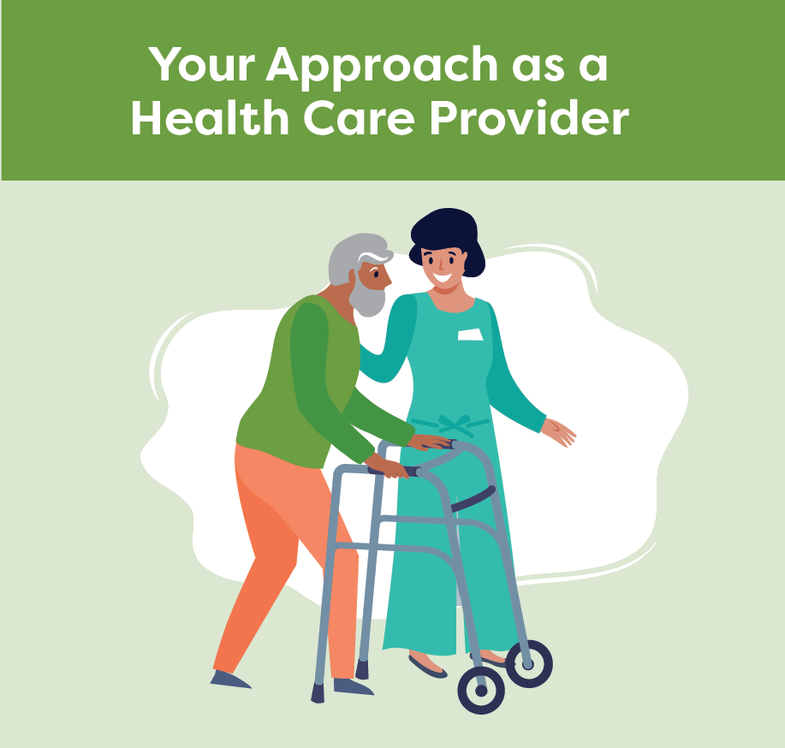
Cognition After Stroke
Smart Tips:
Be patient
Speak slowly and clearly
Provide extra time
Make eye contact
Help the person establish a routine
Confirm that the person understands
Include the family in care
Notes:
Smart Tips – Always follow the care plan! This section pertains to how you can modify your approach
Be patient
Speak slowly and clearly. Use communication tools as needed. (See Smart Tips for Stroke Care – Communication After Stroke: Aphasia)
Provide extra time to allow the person to understand and respond
Make eye contact to help the person remain engaged in the task
Collaborate with the person to establish a consistent routine
Confirm that the person understands what you are asking of them
Include the family in care

Slide 86
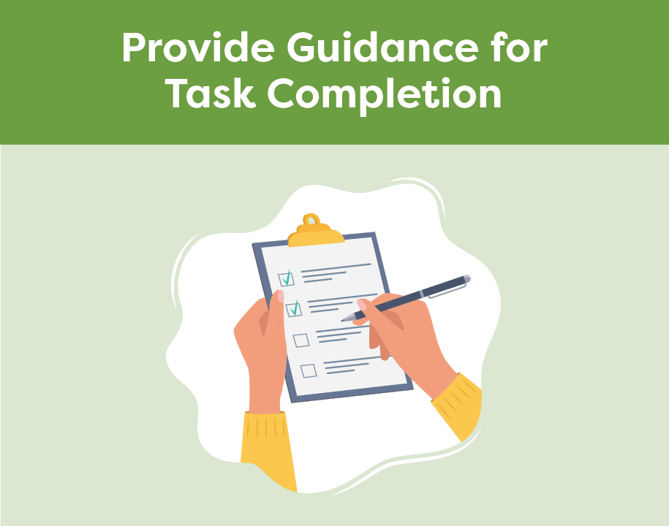
Cognition After Stroke
Give short and simple instructions
Help the person start the task
Focus on one activity at a time
Encourage the person to slow down
Repeat information and redirect
Notes:
This section pertains to providing guidance for task completion
Give short and simple instructions, one instruction at a time
Encourage or help the person to start the task
Break down the task into parts and focus on one activity at a time
Encourage the person to slow down
Repeat information and redirect as needed

Slide 87
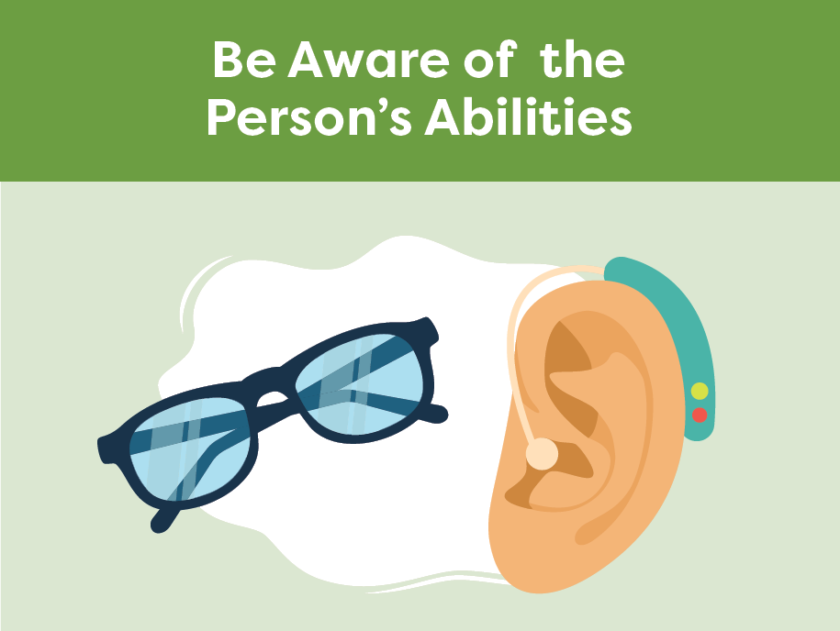
Cognition After Stroke
Get to know the person and their abilities
Gently remind the person of their current abilities and limitations
Make sure the person is ready to participate
Supervise as necessary
Notes:
This section pertains to being aware of the persons abilities
Get to know the person. Remember that they may not understand and appreciate their own abilities and limitations
Provide gentle reminders to the person of their current abilities since the stroke
Make sure the person is ready to participate (e.g. toileting completed, pain controlled, glasses and hearing aids in place)
Supervise as necessary

Slide 88
Cognition After Stroke
Minimize noise and distractions
Encourage the use of aids
Post reminders to promote safety
Help make the environment safe
Help personalize their room
Use labels/signs to help organize
Notes:
This section pertains to setting up the environment for success
Minimize noise and distractions (e.g. TV and radio)
Encourage the use of aids (e.g. calendars, journal, white board, daily plan)
Post reminders to promote safety (e.g. call for help, use your walker)
Help make the environment as safe as possible (e.g. call bell in place, mobility device nearby)
Help personalize their room (e.g. photos, familiar items)
Use labels and signs to help organize and locate items (e.g. picture of socks on drawer)

Slide 89
Cognition After Stroke
Seek extra support
Cognition should be monitored to understand the person’s abilities and develop a personalized care plan
If you notice a sudden change in cognition, report it to your team immediately
Occupational Therapists are skilled in cognition
Smart Tips for Stroke Care (2023) was created by members of the Regional Stroke Networks of Ontario. This material may be shared without permission from the authors, without changes and with source credited.
Notes:
Cognition should be monitored after stroke to understand the person’s abilities and develop a personalized care plan. You are the eyes and ears for the team
If you notice a sudden change in cognition, report it to your team immediately
Occupational Therapists have expertise in cognition. It may be helpful to involve them in the person’s care

Slide 90
TOPIC:
Vision and Perception After Stroke

Slide 91
Vision and Perception After Stroke
Our brain collects information through all five senses
Perception is how our brain interprets information to understand our surroundings
Changes in vision and perception can lead to loss of independence, safety risks and emotional distress
Notes:
Our brain collects information through our five senses including: vision, smell, hearing, touch and taste.
Vision is our most dominant sense.
Perception is how our brain interprets information from our senses to understand our surroundings.
Changes in vision and perception can occur after a stroke and can lead to loss of independence, safety risks and emotional distress

Slide 92
Vision and Perception After Stroke
What you should know:
When someone has changes to vision and perception it may:
not be obvious
be easy to overestimate the person’s abilities
impact mood and cause frustration
lead to serious safety risks
Notes:
What you should know:
When someone has changes to vision and perception:
It may not be obvious
It can be easy to overestimate the person’s abilities and difficult to understand why the person is struggling with activities
It can have an impact on mood and cause frustration
It can lead to serious safety risks (e.g. falls)

Slide 93
VISION | Common Changes | What is it | Practical Example | Smart Tips
 | Blurry vision | Lack of vision clarity or sharpness | The person may: have difficulty reading have difficulty finding objects (e.g. white call bell on white sheets or white plate on white table) | Use large print Create contrast where possible (e.g. use coloured tape on the call bell or dark placemat under white plate)
 | Double vision (diplopia) | Seeing two images of a single object | The person may: have difficulty finding objects on a cluttered table | Reduce amount of items and space them out on bedside table
 | Visual field loss | Most common - lack of vision in one half of each eye (hemianopsia) | The person may: not see hazards in their environment causing them to bump into objects | Tell the person to scan using the ‘Lighthouse Strategy’ (i.e. imagining the eyes as beams of light sweeping side to side)
Notes:
The content of this slide is displayed over next 3 slides, one row of the chart per slide. You as the facilitator may choose to speak to this slide or to display the 3 following slides one at a time as you instruct.

Slide 94
VISION | Common Changes | What is it | Practical Example | Smart Tips
 | Blurry vision | Lack of vision clarity or sharpness | The person may: have difficulty reading have difficulty finding objects (e.g. white call bell on white sheets or white plate on white table) | Use large print Create contrast where possible (e.g. use coloured tape on the call bell or dark placemat under white plate)
 | Double vision (diplopia) | Seeing two images of a single object | The person may: have difficulty finding objects on a cluttered table | Reduce amount of items and space them out on bedside table
 | Visual field loss | Most common - lack of vision in one half of each eye (hemianopsia) | The person may: not see hazards in their environment causing them to bump into objects | Tell the person to scan using the ‘Lighthouse Strategy’ (i.e. imagining the eyes as beams of light sweeping side to side)
Notes:
Additional strategies listed in slides 12 and 13

Slide 95
VISION | Common Changes | What is it | Practical Example | Smart Tips
 | Blurry vision | Lack of vision clarity or sharpness | The person may: have difficulty reading have difficulty finding objects (e.g. white call bell on white sheets or white plate on white table) | Use large print Create contrast where possible (e.g. use coloured tape on the call bell or dark placemat under white plate)
 | Double vision (diplopia) | Seeing two images of a single object | The person may: have difficulty finding objects on a cluttered table | Reduce amount of items and space them out on bedside table
 | Visual field loss | Most common - lack of vision in one half of each eye (hemianopsia) | The person may: not see hazards in their environment causing them to bump into objects | Tell the person to scan using the ‘Lighthouse Strategy’ (i.e. imagining the eyes as beams of light sweeping side to side)

Slide 96
VISION | Common Changes | What is it | Practical Example | Smart Tips
 | Blurry vision | Lack of vision clarity or sharpness | The person may: have difficulty reading have difficulty finding objects (e.g. white call bell on white sheets or white plate on white table) | Use large print Create contrast where possible (e.g. use coloured tape on the call bell or dark placemat under white plate)
 | Double vision (diplopia) | Seeing two images of a single object | The person may: have difficulty finding objects on a cluttered table | Reduce amount of items and space them out on bedside table
 | Visual field loss | Most common - lack of vision in one half of each eye (hemianopsia) | The person may: not see hazards in their environment causing them to bump into objects | Tell the person to scan using the ‘Lighthouse Strategy’ (i.e. imagining the eyes as beams of light sweeping side to side)

Slide 97
PERCEPTION | Common Changes | What is it | Practical Example | Smart Tips
 | Depth perception | The inability to estimate the distance between two objects or between themselves and an object | The person may: miss the chair when sitting down knock over a glass of water when reaching for it | Add red tape on edge of table, sink or toilet seat Cue the person to use their sense of touch to help find items Minimize clutter in the space
 | Neglect | Decreased awareness of the body (e.g. forgetting their arm) and/or the environment on the person’s affected side | The person may: ignore half of their plate of food roll over onto their affected arm in bed or let their affected arm dangle by their side when sitting | Bring their attention to the affected arm or plate of food so that they can see it Consider turning the plate or repositioning the arm Monitor their neglected side for pain, injury and skin abrasions
 | Apraxia | Difficulty completing actions the way the person wants or needs to, even though they are physically capable | The person may: use a comb to brush their teeth hold the hairbrush, but not know how to start brushing their hair | Provide the correct tool, use hand-over hand guidance and do not take over the task unless necessary
Notes:
The content of this slide is displayed over next 3 slides, one row of the chart per slide. You as the facilitator may choose to speak to this slide or to display the 3 following slides one at a time as you instruct.

Slide 98
PERCEPTION | Common Changes | What is it | Practical Example | Smart Tips
 | Depth perception | The inability to estimate the distance between two objects or between themselves and an object | The person may: miss the chair when sitting down knock over a glass of water when reaching for it | Add red tape on edge of table, sink or toilet seat Cue the person to use their sense of touch to help find items Minimize clutter in the space
 | Neglect | Decreased awareness of the body (e.g. forgetting their arm) and/or the environment on the person’s affected side | The person may: ignore half of their plate of food roll over onto their affected arm in bed or let their affected arm dangle by their side when sitting | Bring their attention to the affected arm or plate of food so that they can see it Consider turning the plate or repositioning the arm Monitor their neglected side for pain, injury and skin abrasions
 | Apraxia | Difficulty completing actions the way the person wants or needs to, even though they are physically capable | The person may: use a comb to brush their teeth hold the hairbrush, but not know how to start brushing their hair | Provide the correct tool, use hand-over hand guidance and do not take over the task unless necessary

Slide 99
PERCEPTION | Common Changes | What is it | Practical Example | Smart Tips
 | Depth perception | The inability to estimate the distance between two objects or between themselves and an object | The person may: miss the chair when sitting down knock over a glass of water when reaching for it | Add red tape on edge of table, sink or toilet seat Cue the person to use their sense of touch to help find items Minimize clutter in the space
 | Neglect | Decreased awareness of the body (e.g. forgetting their arm) and/or the environment on the person’s affected side | The person may: ignore half of their plate of food roll over onto their affected arm in bed or let their affected arm dangle by their side when sitting | Bring their attention to the affected arm or plate of food so that they can see it Consider turning the plate or repositioning the arm Monitor their neglected side for pain, injury and skin abrasions
 | Apraxia | Difficulty completing actions the way the person wants or needs to, even though they are physically capable | The person may: use a comb to brush their teeth hold the hairbrush, but not know how to start brushing their hair | Provide the correct tool, use hand-over hand guidance and do not take over the task unless necessary

Slide 100
PERCEPTION | Common Changes | What is it | Practical Example | Smart Tips
 | Depth perception | The inability to estimate the distance between two objects or between themselves and an object | The person may: miss the chair when sitting down knock over a glass of water when reaching for it | Add red tape on edge of table, sink or toilet seat Cue the person to use their sense of touch to help find items Minimize clutter in the space
 | Neglect | Decreased awareness of the body (e.g. forgetting their arm) and/or the environment on the person’s affected side | The person may: ignore half of their plate of food roll over onto their affected arm in bed or let their affected arm dangle by their side when sitting | Bring their attention to the affected arm or plate of food so that they can see it Consider turning the plate or repositioning the arm Monitor their neglected side for pain, injury and skin abrasions
 | Apraxia | Difficulty completing actions the way the person wants or needs to, even though they are physically capable | The person may: use a comb to brush their teeth hold the hairbrush, but not know how to start brushing their hair | Provide the correct tool, use hand-over hand guidance and do not take over the task unless necessary

Slide 101
Vision and Perception After Stroke
Smart Tips:
Ensure supervision or assistance with transfers to promote safety
Decrease clutter and keep space organized
Slow down and give the person more time
Be specific when giving instructions
Keep items in consistent locations
Remember: The individual’s care plan may contain specific strategies
Notes:
Smart Tips – Always follow the care plan! This section pertains to additional strategies that might be helpful when working with a person with problems with vision and perception.
Ensure supervision or assistance with transfers to promote safety
Decrease clutter and keep space organized
Slow down and give the person more time
Be specific when giving instructions (e.g. on your right, ahead two feet)
Keep items in consistent locations (e.g. furniture, assistive devices, water glass). If you move an item be sure to put it back

Slide 102
Vision and Perception After Stroke
Enhance vision: well-lit environment, prescribed glasses
For neglect and visual field loss, approach the person from the unaffected side and arrange items on their unaffected side
For apraxia, use short, simple instructions and break tasks into smaller steps
Educate family on how they can help the person
Notes:
Smart Tips – Always follow the care plan!
Improving vision will help with perceptual difficulties. Ensure a well-lit environment and use prescribed glasses with clean lenses
For neglect and visual field loss, approach the person from the unaffected side and arrange items on their unaffected side
For apraxia, use short, simple instructions and break tasks into smaller steps
Educate family on how they can help the person

Slide 103
Vision and Perception After Stroke
This document lists some examples of common visual and perceptual changes, but many more exist.
Seek extra support
Notify the team if you suspect any changes to vision and/or perception
Optometrists and Ophthalmologists can provide assessment/management
Occupational Therapists are skilled in vision and perception
For more information, visit The Canadian National Institute for the Blind https://www.cnib.ca
Smart Tips for Stroke Care (2023) was created by members of the Regional Stroke Networks of Ontario. This material may be shared without permission from the authors, without changes and with source credited.
Notes:
Seek extra support
This document lists some examples of common visual and perceptual changes, but many more exist. Notify the team if you suspect any changes to vision and/or perception
Optometrists and Ophthalmologists can provide important assessment and management tools if a person experiences changes to vision after stroke (e.g. glasses, prisms, eye patches)
Occupational Therapists are skilled in vision and perception after stroke
For more information about changes to vision, please visit The Canadian National Institute for the Blind https://www.cnib.ca

Slide 104
TOPIC:
Behaviour
After Stroke

Slide 105
Behaviour After Stroke
After a stroke, people may experience changes in behaviour that can be the result of damage to the brain.
Some changes may include:
Quick shifts in emotions
Anger and aggression
Lack of interest/energy
Actions that are out of character for the person
Notes:
After a stroke, people may experience changes in behaviour that can be the result of damage to the brain.
Some changes may include:
quick shifts in emotions,
anger and aggression,
lack of interest/energy
actions that are out of character for the person.

Slide 106
Behaviour After Stroke
The impact of stroke on behaviour depends on:
where the stroke was in the brain
how long ago it happened
how severe the stroke was
how they behaved before the stroke
How the person is adapting to the effects of the stroke can affect behaviour as well.
Notes:
The impact of stroke on behaviour depends on:
where the stroke was in the brain
how long ago it happened
how severe the stroke was
how they behaved before the stroke
How the person is adapting to the effects of the stroke can affect behaviour as well.

Slide 107
Behaviour After Stroke
What you should know:
All behavior has meaning
Common triggers include:
Pain
Loneliness
Boredom
Frustration due to lack of independence
Frustration due to difficulty communicating
Notes:
All behavior has meaning.
Common triggers include:
Pain
Loneliness
boredom
lack of independence with activities such as toileting or dressing
Some behaviour changes can be related to frustration as a result of difficulty communicating

Slide 108
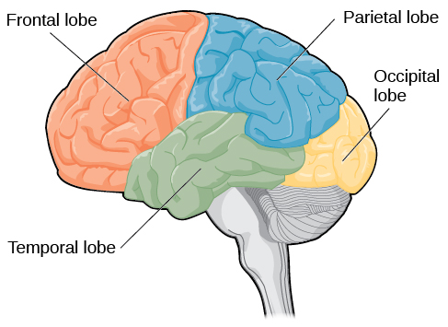
Behaviour After Stroke
What you should know:
Behaviour changes are commonly related to damage to the frontal lobe
Behaviour changes are not attention seeking, but are most likely due to the stroke, and may be the person’s way of expressing their needs
Notes:
Behaviour changes are commonly related to damage to the frontal lobe
Behaviour changes are not attention seeking, but are most likely due to the stroke and may be the person’s way of expressing their needs

Slide 109
Behaviour After Stroke
What you should know:
Changes may not be consistent
Stroke can have an impact on personality
Some people may have less control over their emotions
Laughing or crying at inappropriate times can occur
Behaviour changes can impact a person’s quality of life
Notes:
Changes may not be consistent. There may be good days, bad days and variations throughout the day
Stroke can have an impact on personality which can be hard on the person with stroke, their loved ones or other caregivers
Some people may have less control over their emotions and/or get upset over things that would not usually bother them
Laughing or crying at inappropriate times can occur; this is referred to as emotional lability
Behaviour changes can impact a person’s quality of life and can lead to negative outcomes such as social isolation and depression

Slide 110
Behaviour After Stroke
Smart Tips:
Identify what triggers responsive behaviours and share information with the team
Be aware when someone is starting to feel anxious or frustrated and consider how you might respond
Notes:
Smart Tips “Always follow the care plan”. This section pertains to recognizing changing behaviour
Recognize
Identify what triggers responsive behaviours and share information with the team
Be aware when someone is starting to feel anxious or frustrated and consider how you might respond (e.g. removing the person from a loud environment)

Slide 111
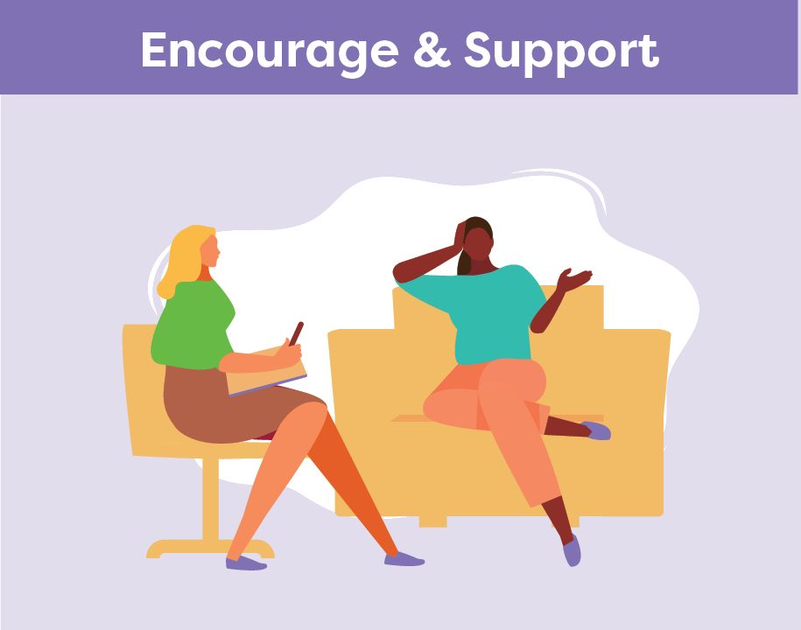
Behaviour After Stroke
Look for ways to promote independence
Offer to take a break
Explain what you are planning to do
Identify coping strategies
Encourage involvement in meaningful activities
Notes:
This section pertains to providing encouragement and support
Look for ways to promote independence
Offer to take a break to reduce frustration and try again later
Explain what you are planning to do and involve the person in their care
Identify coping strategies to support a person to manage their emotions
Encourage involvement in meaningful activities

Slide 112
Behaviour After Stroke
Get to know the person and what they enjoy
Speak in a quiet, calm manner
Reinforce positive behaviour
Keep a consistent routine and respect preferences when possible
Offer reassurance that loss of emotional control is common after stroke
Use a problem solving approach to care
Share known triggers and effective coping strategies with the team
Notes:
This section pertains to strategies:
Get to know the person and what they enjoy
Speak in a quiet, calm manner and be patient
Reinforce positive behaviour and when appropriate, inform the person when their behaviour is inappropriate
Keep a consistent routine and respect preferences when possible
Reassure the family and the person with stroke that loss of emotional control is common after stroke
Use a problem solving approach to care- expect to try a number of strategies before you find one that works, and what works today may not work another time, keep trying!
Share known triggers as well as any effective coping strategies with the team

Slide 113
Behaviour After Stroke
Seek extra support
Family can help you learn more about the person you are caring for
Recreation Therapists are skilled in supporting persons with stroke to engage in meaningful activities
If you are struggling with behaviour challenges, connect with the team to involve other professionals or access additional supports
Smart Tips for Stroke Care (2023) was created by members of the Regional Stroke Networks of Ontario. This material may be shared without permission from the authors, without changes and with source credited.
Notes:
Knowing what the person enjoys can help with providing care. Family can help you learn more about the person you are caring for. Share this information with the team
Recreation Therapists are experts in supporting persons with stroke to engage in meaningful activities. It may be helpful to involve them in the persons care
If you are struggling with behaviour challenges, connect with the team about accessing supports in your area
Occupational therapists can help with cognitive or functional limitations that cause frustration
Speech Language Pathologists can help with communication support
Physiotherapists can help if there’s pain

Slide 114
TOPIC:
Mobility After Stroke

Slide 115
Mobility After Stroke
Mobility is the ability to move one’s body (e.g. moving in or out of bed, transferring to a chair, and walking)
A stroke can cause weakness to one side of the body (hemiplegia), changes in sensation and altered muscle tone
This can impact a person’s ability to move
Regular mobility is important. It can improve function, decrease pain, enhance mood, and prevent skin breakdown and contractures
Notes:
Mobility is defined as the ability to move one’s body. Examples of mobility include moving in or out of bed, transferring to a chair, and walking.
A stroke can cause weakness to one side of the body (hemiplegia), changes in sensation and altered muscle tone.
This can impact a person’s ability to move.
Regular mobility is important. It can improve function, decrease pain, enhance mood, and prevent skin breakdown and contractures.

Slide 116
Mobility After Stroke
What you should know:
There are many factors that can impact mobility including:
The Person’s Abilities | The Environment | The Caregiver
Communication Cognition Weakness and muscle tone Balance and posture Coordination Vision and perception Sensation Mood and fatigue Motivation Pain | Lighting Equipment Space Resources available Organizational policies and procedures | Knowledge Skill Confidence Wellness Size/height Familiarity with the person
Notes:
The Person’s Abilities
Communication
Cognition
Weakness and muscle tone
Balance and posture
Coordination
Vision and perception
Sensation
Mood and fatigue
Motivation
Pain
The Environment
Lighting
Equipment
Space
Resources available
Organizational policies and procedures
The Caregiver
Knowledge
Skill
Confidence
Wellness
Size/height
Familiarity with the person

Slide 117
Mobility After Stroke
What you should know:
Practicing safe mobility can:
Prevent falls
Prevent injuries
Promote independence and active participation
Promote better health of the person with stroke
Notes:
Regularly implementing safe mobility can:
Prevent falls (~40% of all persons with stroke will fall within the first year)
Prevent injuries to the person with stroke (especially shoulder subluxation/dislocation)
Prevent injury to the caregiver
Promote independence and active participation
Promote better health of the person with stroke

Slide 118
Mobility After Stroke
General Principles of Safe Mobility
Plan for extra help if needed
Encourage the person to do as much as they can
Your goal is not to lift the person but to support them
Always follow your organization’s lift policies
Do not rush
Recognize that the person’s energy levels can change throughout the day
Notes:
Smart Tips- Always follow the care plan!
Plan for extra help if needed. Do not attempt to assist a person alone if you are unsure of what they can do. It is always better to have more help
Encourage the person to do as much as they can. This will allow the person to feel safer and more in control of the movement, and will minimize the risk of injury
Your goal in assisting with mobility is not to lift the person with stroke, but to support them in the mobility activities they can consistently and safely do. Always follow your organizations lift policies
Do not rush. Move slowly and gently. This will allow the person to participate more successfully and minimize anxiety
Recognize that the person’s energy levels can change throughout the day. This may affect their ability to mobilize, and they may require more assistance if fatigued

Slide 119
Mobility After Stroke
General Principles of Safe Mobility
Consider the person’s deficits that may impact mobility:
Weakness
Which side has been affected by the stroke?
Ability to move each limb?
Sensation
Can they feel their arm/leg?
Do they know where it is positioned?
Pain?
Muscle Tone
Is the limb stiff and difficult to move or is it limp and floppy?
Notes:
This slide is optional. It contains additional detail not found in the Mobility section of the Smart Tips for Stroke Care guide.
Smart Tips- Always follow the care plan!
Consider the person’s deficits that may impact mobility
For example:
Weakness
•Which side has been affected by the stroke?
•Ability to move each limb?
Sensation
•Can they feel their arm/leg?
•Do they know where it is positioned?
•Pain?
Muscle Tone
•Is the limb stiff and difficult to move or is it limp and floppy?

Slide 120
Mobility After Stroke
General Principles of Safe Mobility
Consider the person’s deficits that may impact mobility:
Balance
Can they sit on their own?
Can they stand without assistance?
Do they stand on both feet?
Posture
Can they sit and stand upright?
Do they push themselves over
Notes:
This slide is optional. It contains additional detail not found in the Mobility section of the Smart Tips for Stroke Care guide.
Smart Tips- Always follow the care plan!
Consider the person’s deficits that may impact mobility
For example:
Balance
Can they sit on their own?
Can they stand without assistance?
Do they stand on both feet?
Posture
Can they sit and stand upright?
Do they push themselves over

Slide 121
Mobility After Stroke
General Principles of Safe Mobility
Consider the person’s deficits that may impact mobility:
Perception
Do they neglect one side?
Cognition
Are they alert?
Are they able to learn?
Can they maintain their attention?
Notes:
This slide is optional. It contains additional detail not found in the Mobility section of the Smart Tips for Stroke Care guide.
Smart Tips- Always follow the care plan!
Consider the person’s deficits that may impact mobility
Perception
Do they neglect one side?
Cognition
Are they alert?
Are they able to learn?
Can they maintain their attention?

Slide 122
Mobility After Stroke
General Principles of Safe Mobility
Consider the person’s deficits that may impact mobility:
Communication
Can they understand language and follow instructions?
Can they speak?
Personality
Do they have a fear of moving/falling?
Are they impulsive?
Notes:
This slide is optional. It contains additional detail not found in the Mobility section of the Smart Tips for Stroke Care guide.
Smart Tips- Always follow the care plan!
Consider the person’s deficits that may impact mobility
Communication
Can they understand language and follow instructions?
Can they speak?
Personality
Do they have a fear of moving/falling?
Are they impulsive?

Slide 123
Mobility After Stroke
Smart Tips:
Prepare the environment
Communicate the plan to the person and any helpers
Be mindful of the person’s affected arm during mobility activities and handle very carefully
Notes:
Smart Tips- Always follow the care plan! This section pertains to steps you should take before you start:
Prepare the environment. Ensure the necessary equipment is nearby, the space is clear, and the lighting is adequate. (i.e. mechanical lift is working and charged, have a wheelchair close by in case patient needs to sit down).
Get to know the person/plan of care their abilities, recommendations for equipment and techniques to best assist them.
Communicate the plan to the person and any helpers before you start to move. Use simple, clear instructions, and demonstrate the action if needed. Check that they have understood
The hemiplegic shoulder can easily be injured during mobility. Be mindful of the person’s arm during mobility activities and handle very carefully. A shoulder injury (i.e. a shoulder subluxation) can make it very challenging for the patient to recover function in that arm.

Slide 124
Mobility After Stroke
Be mindful of any lines (e.g. feeding tube, oxygen)
Think about your own body mechanics:
keep your body close to the person
bend your knees
keep your back straight
avoid twisting
Notes:
Be mindful of a feeding tube (or other lines/ tubes/ wires) as you move.
Think about your own body mechanics:
make sure to keep your body close to the person you are helping to move
bend your knees
keep your back straight
avoid twisting

Slide 125
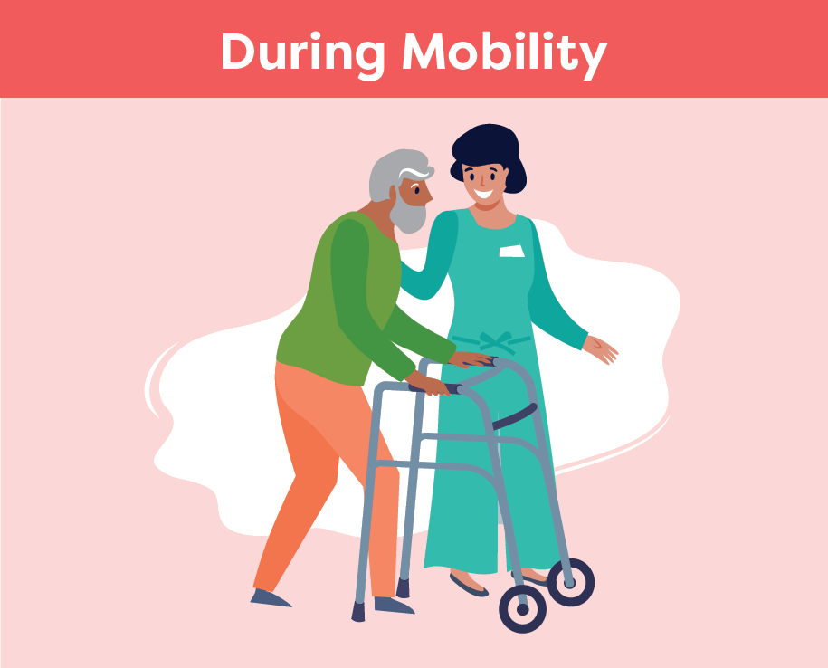
Mobility After Stroke
Smart Tips – Always follow the care plan!
Position yourself on the person’s affected side and as close as possible
Continue to communicate with the person
Offer verbal and visual cues for each step of the activity
Provide support at the shoulder blade, the hip, or waist
Never hold onto clothing or pull on the person’s affected arm
Notes:
Smart Tips- this section pertains what should happen during mobility
Position yourself on the person’s affected side and as close as possible (front/side). Be sure not to block the direction of movement or the person’s vision of the path of movement
Continue to communicate with the person. Offer verbal and visual cues for each step of the activity and allow time for them to understand and respond
Provide support at the shoulder blade, the hip, or waist to help guide the movement. Never hold onto clothing. Never pull on the person’s affected arm
See SMART TIPS for Stroke Care: Transfers after Stroke for additional details on transfers.

Slide 126
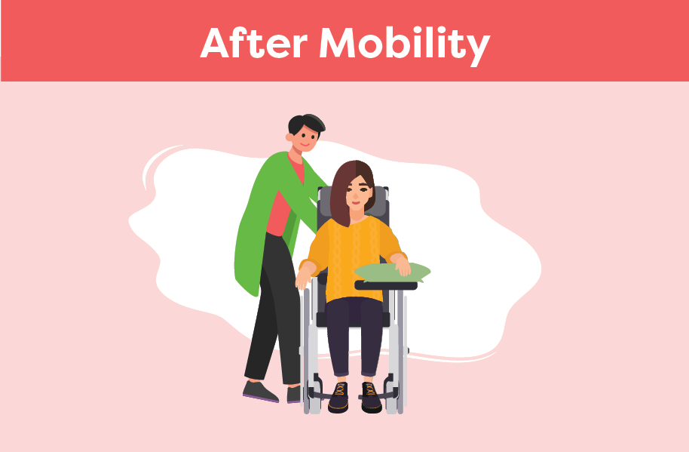
Mobility After Stroke
Before you leave, ensure that the person is well supported, safe and comfortable
Ensure that all necessary items are within reach
Check on the person and offer position changes frequently
Let the team know if there is a change in mobility status
Notes:
Smart Tips- this section pertains to things you should do after mobility
Before you leave, ensure that the person with stroke is well supported and is in a safe and comfortable position (See Smart Tips for Stroke Care- Positioning in a chair/ wheelchair after stroke)
Ensure that all necessary items (i.e. call bell) are within reach
Check-in on the person and offer position changes frequently
Let the team know if there is a change in their mobility status

Slide 127
Mobility After Stroke
Seek extra support
Occupational Therapists and Physiotherapists are skilled in mobility and transfers. It may be helpful to involve them in the person’s care
If communication is impacting mobility, consider consulting a Speech Language Pathologist
Smart Tips for Stroke Care (2023) was created by members of the Regional Stroke Networks of Ontario. This material may be shared without permission from the authors, without changes and with source credited.
Notes:
Seek extra support
Occupational Therapists and/or Physiotherapists are skilled in mobility and transfers. It may be helpful to involve these team members if you have questions
It may also be beneficial to speak to the speech language pathologist to determine communication strategies as these have significant implications for mobility (i.e. patient may need tools to communicate that they are in pain/uncomfortable during mobilization).

Slide 128
TOPIC:
Bed Mobility, Transfers and Ambulation After Stroke

Slide 129
Bed Mobility, Transfers and Ambulation After Stroke
A stroke can cause weakness, altered muscle tone, loss of coordination, changes in sensation and decreased body awareness
Careful handling of the person during movement can improve safety and comfort
Notes:
A stroke can cause weakness, altered muscle tone, loss of coordination, changes in sensation and decreased body awareness. These can impact a person’s ability to move
Careful handling of the person during movement can improve safety and comfort.

Slide 130
Bed Mobility, Transfers and Ambulation After Stroke
What you should know:
The safety and success of any mobility activity depends on a number of factors
There are four main types of movement which include:
Bed Mobility
Transitional Movements
Transfers
Ambulation
Always protect and never pull on the affected arm when moving
Notes:
The safety and success of any mobility activity depends on a number of factors (See Smart Tips for Stroke Care – Mobility After Stroke).
There are four main types of movement which include bed mobility (e.g. rolling), transitional movements (e.g. lie to sit, sit to stand), transfers (e.g. pivot or stepping to move between surfaces such as bed and chair), and ambulation (e.g. walking).
Always protect and never pull on the affected arm when moving (See Smart Tips for Stroke Care - The Hemiplegic Arm and Hand)

Slide 131
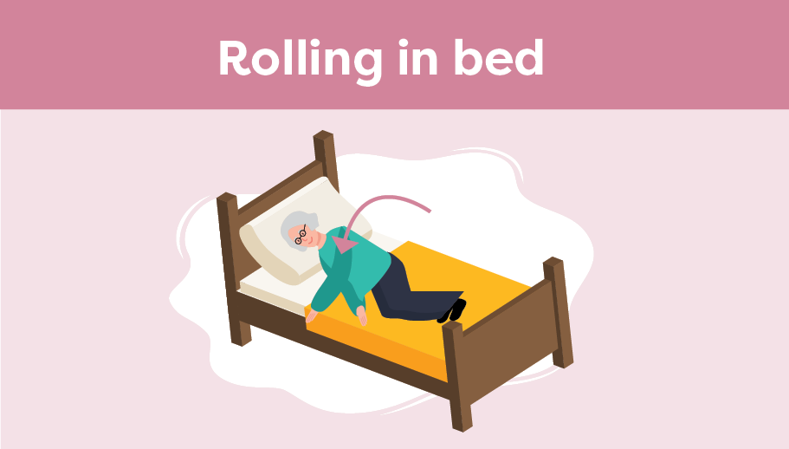
Bed Mobility, Transfers and Ambulation After Stroke
Smart Tips:
Before rolling, ask/ help the person to:
Bend their knees and place feet flat on the bed
Initiate the roll by allowing the knees to fall, turning the head, and reaching with the arm towards the direction of the roll, bringing their arm with the rest of the body
Assist the person by helping at the back of the shoulder blade and hip as needed; never pull on the affected arm
Notes:
Smart Tips –This section pertains to rolling in bed
Always follow the care plan and lift policies at your organization!
Before rolling, ask/ help the person to:
Bend their knees and place feet flat on the bed
Initiate the roll by allowing the knees to fall, turning the head, and reaching with the arm towards the direction of the roll, bringing their arm with the rest of the body
Assist the person by helping at the back of the shoulder blade and hip as needed, never pull on the affected arm
Other bed mobility tasks include shifting upwards or side to side in bed.
All of these movements may require the use of a draw sheet and an additional helper.

Slide 132
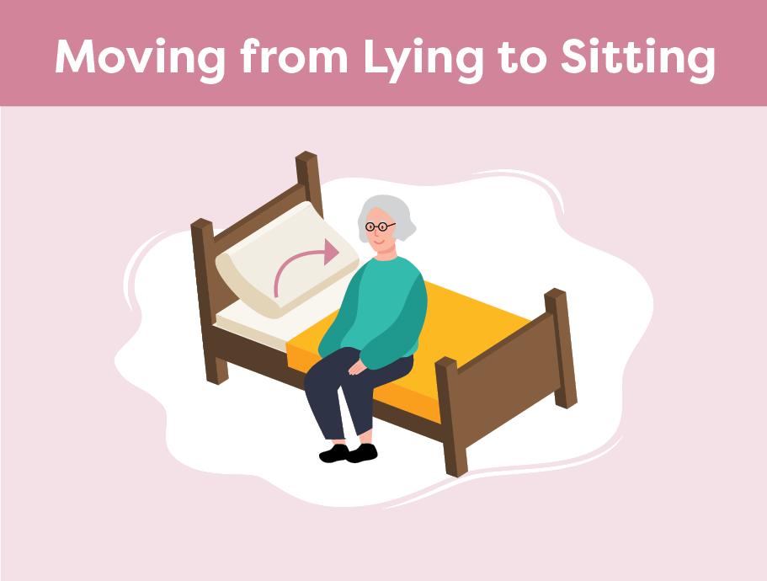
Bed Mobility, Transfers and Ambulation After Stroke
Once on their side, ask/ help the person to:
Bring their feet over the edge of the bed by moving their knees up towards their chest
Push up with the bottom arm to sit up. If assistance is needed, place one hand underneath the bottom ribs near the shoulder blade, and one hand on the upper hip
Once sitting safely, lower the height of bed if possible, to allow feet to be in contact with the floor
Notes:
Smart Tips- this section pertains to moving from lying to sitting:
Once on their side, ask the person (or help them) to:
Bring their feet over the edge of the bed by moving their knees up towards their chest
Push up with the bottom arm to sit up. If assistance is needed, place one hand underneath the bottom ribs near the shoulder blade, and one hand on the upper hip.
Never pull on the person’s arm
Once sitting safely, lower the height of bed if possible to allow feet to be in contact with the floor

Slide 133
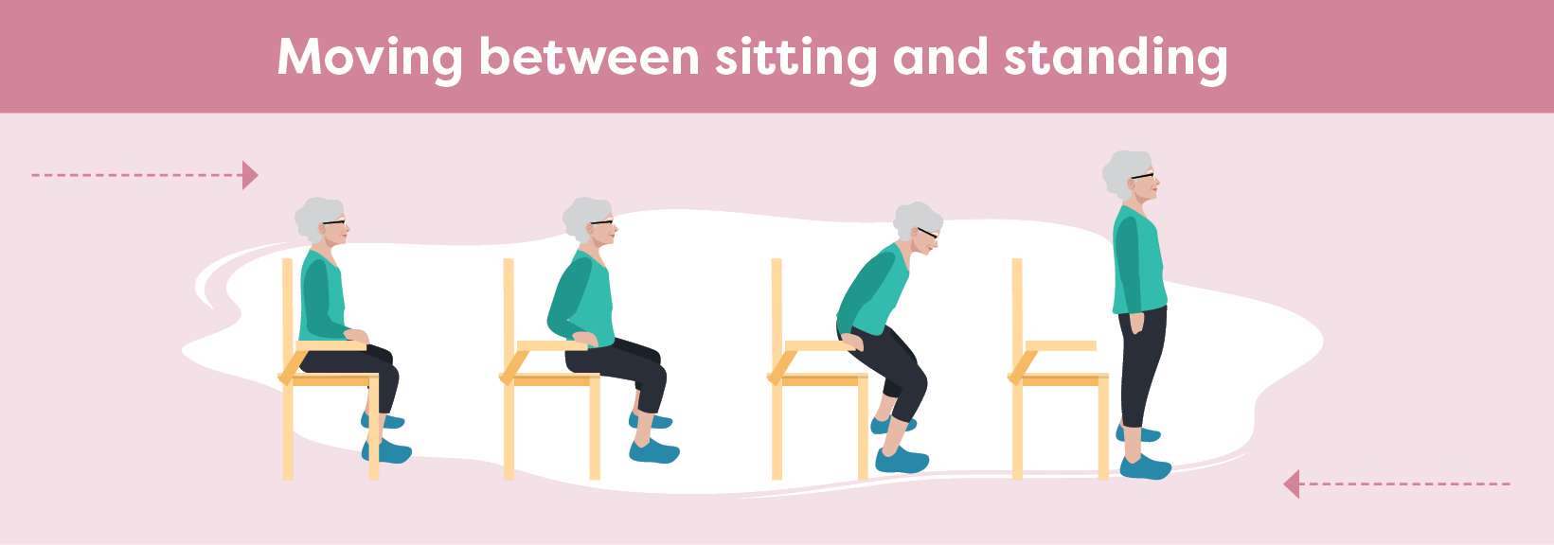
Bed Mobility, Transfers and Ambulation After Stroke
Sit to Stand
Stand on the persons affected side
Ask/help the person to:
Shift hips towards front edge of the sitting surface
Place feet shoulder width apart, with heels under the knees
Sit up tall and bend forward at the hips while looking ahead
Push up from the bed with both hands, if able- do not pull on walker
Push through both legs with weight equally distributed
Notes:
This section pertains to Moving from Sitting to Standing:
Stand on the person’s affected side
Ask the person (or help them) to:
Shift their hips forward towards the edge of the sitting surface
Position the feet shoulder width apart, with the heels on the floor under the knees
Sit up tall, then bend forward at the hips while looking forward (not at the floor) with back straight
Push up from the bed with both hands, if able. DO NOT allow the person to pull on the walker to stand (or any other person/item/gait aid)
Push through their legs with their weight equally distributed on both legs. If assistance is needed, assist under the buttocks

Slide 134
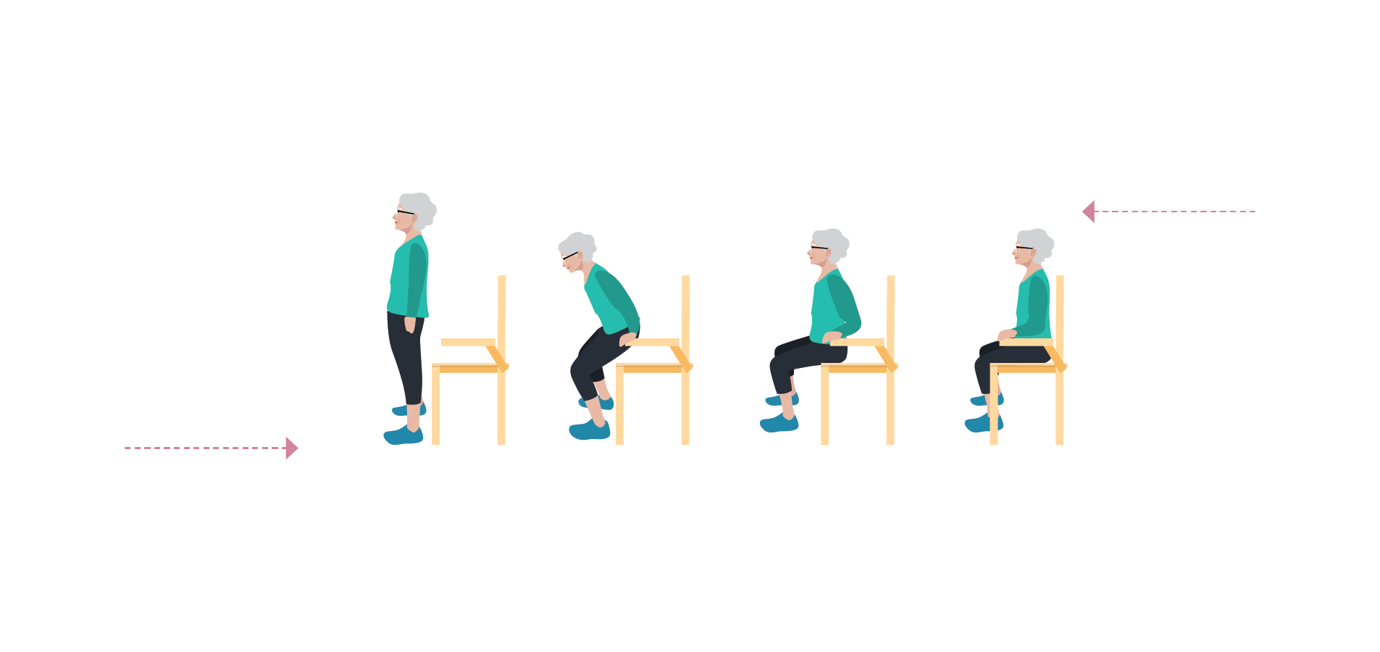
Bed Mobility, Transfers and Ambulation After Stroke
Stand to Sit
Stand on the persons affected side
Ask/help the person to:
Before sitting, ensure the back of their legs are touching the sitting surface
Reach back to place their hand(s) on armrests or the sitting surface
Bend hips then knees to lower themselves slowly
Shift their hips back on the sitting surface
Notes:
This section pertains to Moving from Standing to Sitting
Before sitting, the person should feel the back of their legs touching the edge of the sitting surface (e.g. chair, bed, etc.)
Ask the person (or help them) to:
Reach back to place their hand(s) on armrests or the sitting surface
Bend forward slightly, then bend their knees to lower themselves slowly to sitting
Shift their hips back on the sitting surface

Slide 135
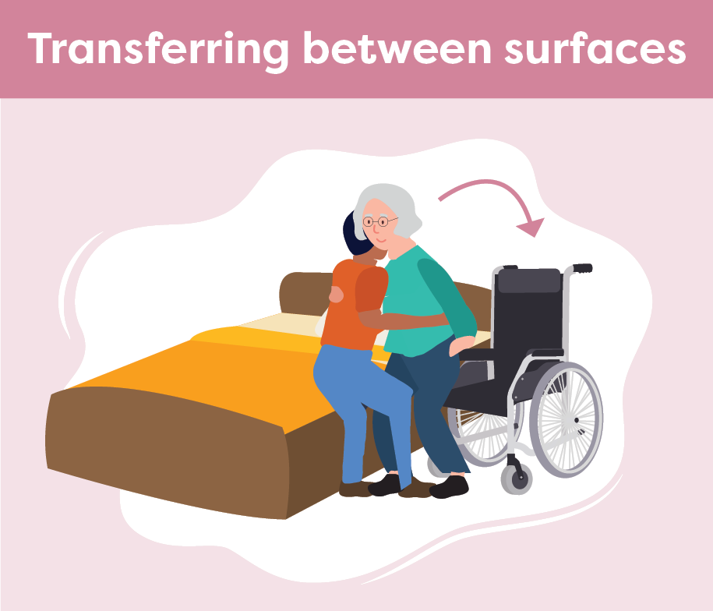
Bed Mobility, Transfers and Ambulation After Stroke
Have the person move towards their stronger side
Position the chair/ commode close to the bed
Ensure brakes are applied and arm/foot rests are removed
Ask the person to shift their hips forward to the edge of the sitting surface
Notes:
This section pertains to transferring between surfaces such as bed to chair, chair to commode, etc.:
It may be easier for the person to move towards their stronger side, if possible
Position the chair/commode as close to the bed as possible
Ensure brakes are applied and arm/foot rests are out of the way
Ask the person (or help them) shift their hips forward to the edge of the sitting surface

Slide 136
Bed Mobility, Transfers and Ambulation After Stroke
Position yourself close to the person, on their weaker side
Guide the person onto their feet and help them shift their hips from one surface to the other
Cue the person to reach towards the surface they are transferring to
Notes:
Position yourself as close to the person as possible on their weaker/affected side, without blocking their movement
Following the care plan for the individual, guide the person onto their feet and help them shift their hips from one surface to the other
Cue the person to reach towards the surface they are transferring to
If a second helper is needed, they can help guide the hips from behind (this may require demo)

Slide 137
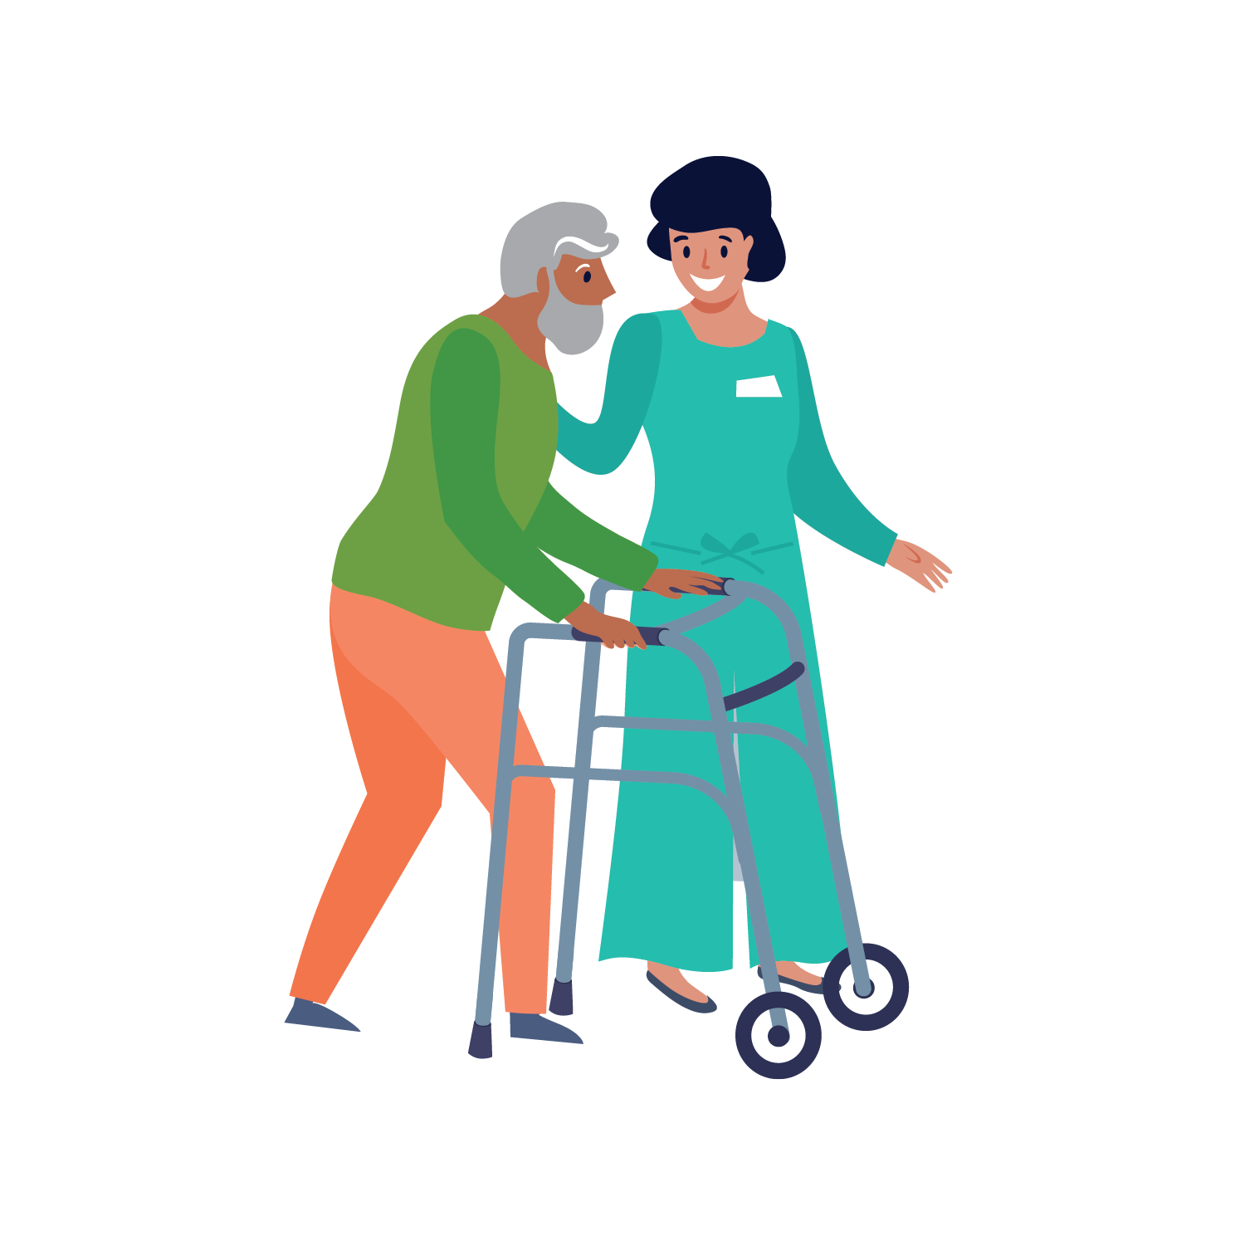
Bed Mobility, Transfers and Ambulation After Stroke
Walking
Once standing, pause to ensure balance before walking.
If a gait aid is used, have it nearby
While walking, stand on the affected side and stay close to steady the person as needed
Encourage the person to look ahead, not at the floor
Notes:
This section pertains to support during ambulation or walking
Once standing, pause to ensure balance before walking.
If a gait aid is used, have it nearby
While walking, stand on the affected side, maintaining a close distance to steady the person as needed
Encourage the person to look up/forward to where they are going rather than at the floor
Assist the person to avoid obstacles in their path if vision or spatial awareness is affected

Slide 138
Bed Mobility, Transfers and Ambulation After Stroke
Seek extra support
Physiotherapists and Occupational Therapists are skilled in mobility and transfers. It may be helpful to involve them if there are questions or concerns
Notify the team if you notice a change in the person’s ability to transfer or ambulate
Smart Tips for Stroke Care (2023) was created by members of the Regional Stroke Networks of Ontario. This material may be shared without permission from the authors, without changes and with source credited.
Notes:
Physiotherapists and Occupational Therapists are skilled in mobility and transfers. It may be helpful to involve them if there are questions or concerns
Notify the team if you notice a change in the person’s ability to transfer or ambulate

Slide 139
TOPIC:
Positioning in Bed After Stroke

Slide 140
Positioning in Bed After Stroke
Careful positioning can:
improve joint alignment
Increase awareness of the affected side
reduce fatigue
improve comfort and safety
A stroke can impact a person’s ability to position themselves in bed due to:
weakness (hemiplegia)
changes in sensation and body awareness
altered muscle tone
Notes:
A stroke can cause:
weakness (hemiplegia)
changes in sensation and body awareness
altered muscle tone impacting a person’s ability to position themselves in bed
Careful positioning can:
improve joint alignment
Increase awareness of the affected side
reduce fatigue
improve comfort and safety

Slide 141
Positioning in Bed After Stroke
What you should know:
A stroke can cause a lack of sensation. It is important to monitor the skin for redness or signs of skin breakdown
After a stroke, a person’s sense of where their body is in space can be decreased. This can make positioning difficult
Development of shoulder and/or arm pain is common after a stroke. Support the affected arm to prevent pain and injury
Notes:
A stroke can cause a lack of sensation on one side of the body, so it is important to monitor the person’s skin for redness or other signs of skin breakdown
After a stroke, a person’s sense of where their body is in space may be decreased, which can make positioning difficult
Development of shoulder and/or arm pain is common after a stroke. The affected arm should always be well supported to prevent pain and injury (See Smart Tips for Stroke care- Hemiplegic Arm and hand)

Slide 142
Positioning in Bed After Stroke
What you should know:
Proper positioning can increase comfort and safety
A comfortable position can help ensure proper rest, and assist with fatigue throughout the day
Positioning the person on the affected side for a period of time can increase circulation, sensation and awareness
Notes:
Proper positioning using recommended equipment such as pillows/rolled towels/equipment specific to the needs of the person can increase comfort and safety
A comfortable position can help ensure proper rest, and assist with fatigue throughout the day
Positioning the person on the affected side for a period of time as part of the regular position changing schedule has benefits such as increasing circulation, sensation and awareness

Slide 143
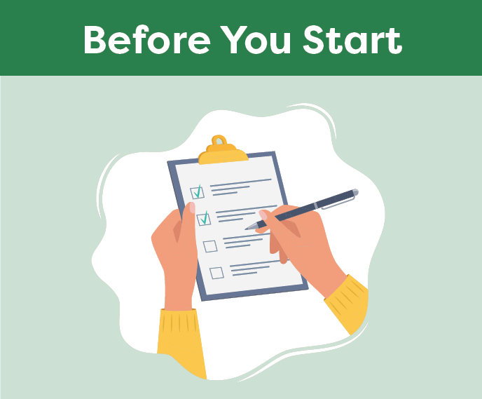
Positioning in Bed After Stroke
Smart Tips:
Explain to the person what you are going to do and encourage them to participate
Ensure you have everything you need to position the person safely
Use good body mechanics to avoid injury
Notes:
Smart Tips- Always follow the care plan! This section pertains to what you should do Before You Start
Explain to the person what you are doing and encourage them to participate
Ensure you have everything you need to position the person safely, such as extra help, or devices/equipment (i.e. slider sheet) as required
Ensure good body mechanics to avoid injury

Slide 144
Positioning in Bed After Stroke
Take your time. Position the person by moving slowly and gently, be mindful of the person’s arm as you move
Avoid pulling on the person’s affected shoulder/arm as this can cause irreversible injury
Ensure the head of bed is at the recommended height
Notes:
Smart Tips- this section pertains to safety considerations
Take your time. Position the person by moving slowly and gently, be mindful of the person’s arm as you move
Avoid pulling on the person’s affected shoulder/arm as this can cause irreversible injury
Ensure the head of bed is at the recommended height (especially if the person has difficulty swallowing)

Slide 145
Positioning in Bed After Stroke
Ensure necessary items are within the person’s view and reach (on the unaffected side)
Check that the person is comfortable before you leave the room
Check on the person regularly and offer position changes frequently
Notes:
Make sure all necessary items are within the person’s view and reach (e.g. call bell) on the unaffected side
Check that the person is comfortable before you leave the room. Consider whether you would be comfortable in this position.
Check on the person regularly and offer position changes frequently (e.g. every 2 hours)
Use bed rails according to facility policy

Slide 146
Positioning in Bed After Stroke
Center head and shoulders in the bed
Support/elevate affected arm on a pillow, positioned slightly away from the body
Place the palm down with fingers straight
Place folded towel beside affected thigh to prevent leg from rolling outwards
Use recommended equipment to reduce pressure under heel if needed
Notes:
The proposed examples are based on the ideal position of a person with stroke. Some individuals may have limitations that make these recommendations uncomfortable or even impossible. Please consider comfort first as you position the person.
This section pertains to positioning the person on their back
Ensure the head and shoulders are centered in the bed
The affected arm should be supported/elevated on a pillow and positioned slightly away from the body with the elbow extended and the elbow crease facing slightly upward.
Place the palm down with fingers straight
Place folded towel (or similar) beside affected thigh to prevent leg from rolling outwards
Use recommended equipment to reduce pressure under heel especially if the person is unable to move their leg

Slide 147
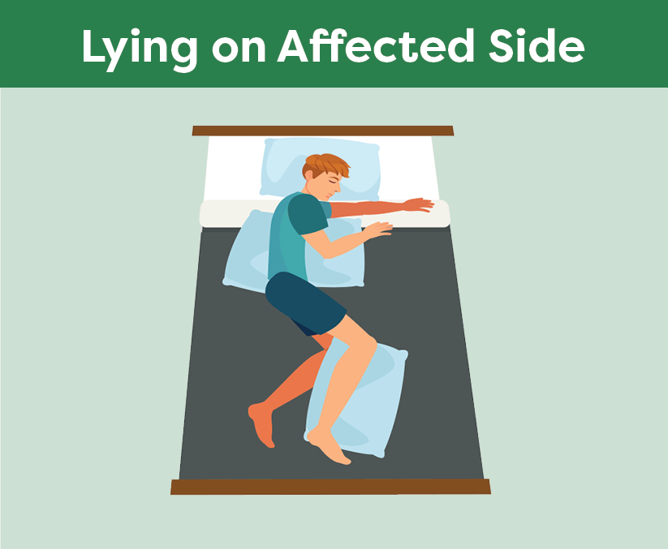
Positioning in Bed After Stroke
Ensure the person is not lying directly on top of their affected shoulder.
Support the unaffected arm forward on a pillow
Place a pillow lengthwise behind their back so the person does not roll backwards
Position the person with both legs bent, pillow in between knees and ankles
Notes:
This section pertains to lying on the person’s affected side:
Ensure the person is not lying directly on top of their affected shoulder. Draw the shoulder blade slightly forward, and have the elbow extended and hand supported with the palm up, fingers straight
Support the unaffected arm forward on a pillow
Place a pillow lengthwise behind their back so the person does not roll backwards
Position the person with both legs bent, pillow in between knees and ankles

Slide 148
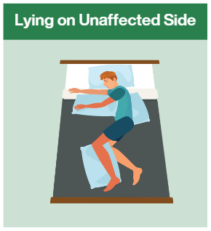
Positioning in Bed After Stroke
Support the affected arm forward on two pillows
Elevate the hand as needed, with fingers spread
Place a pillow lengthwise behind their back
Position the person with both legs bent at the hips and knees
Place a pillow in between knees and ankles
Notes:
This section pertains to lying on the person’s unaffected side:
Support the affected arm forward on two pillows.
Elevate the hand as needed with fingers spread
Place a pillow lengthwise behind their back so the person does not roll backwards
Position the person with both legs bent at the hips and knees, a pillow in between knees and ankles
Please note - When lying on the unaffected side, some people feel trapped if they cannot move their affected side.

Slide 149
Positioning in Bed After Stroke
Seek extra support
All team members have a role to play in positioning a person with stroke
Occupational Therapists and Physiotherapists are skilled in positioning
Smart Tips for Stroke Care (2023) was created by members of the Regional Stroke Networks of Ontario. This material may be shared without permission from the authors, without changes and with source credited.
Notes:
All team members have a role to play in positioning a person with stroke
Occupational Therapists and Physiotherapists are skilled in positioning. It may be helpful to involve them in the person’s care

Slide 150
TOPIC:
Positioning in a Chair/WheelchairAfter Stroke

Slide 151
Positioning in a Chair/Wheelchair After Stroke
A stroke can affect a person’s ability to move or position themselves
This may increase their risk for:
falls
injury
pain
skin breakdown
responsive behaviours
It can impact their ability to spend time out of bed and/or participate in activities
Notes:
After a stroke, a person’s ability to move and position themselves can be difficult
This may increase their risk for falls, injury, pain, skin breakdown and/or responsive behaviours (due to frustrations, discomfort, inability to move themselves). Refer to the Smart Tips for Stroke Care – Behaviour After Stroke section for more details on responsive behaviours.
It can impact their ability to spend time out of bed and/or participate in activities

Slide 152
Positioning in a Chair/Wheelchair After Stroke
What you should know:
Development of shoulder and arm pain is common. The arm should always be well supported while sitting to help prevent pain
Proper positioning will increase comfort and safety
Use of equipment should be specific to the needs of the person
A stroke can cause a lack of sensation on one side of the body, so it is important to monitor the person’s skin for signs of breakdown
Notes:
Many persons with stroke may experience pain and changes in muscle tone. Development of shoulder and arm pain is common. The arm should always be well supported while sitting to help prevent pain (See Smart Tips for Stroke Care - Hemiplegic Arm and Hand After Stroke)
Proper positioning will increase comfort and safety
Use of equipment should be specific to the needs of the person
A stroke can cause a lack of sensation on one side of the body, so it is important to monitor the person’s skin for signs of breakdown. Skin breakdown can happen when the person cannot feel pressure, wetness, temperature and the effects of pain

Slide 153
Positioning in a Chair/Wheelchair After Stroke
What you should know:
A change in a person’s sense of where their body is in space can result in poor positioning of arms, legs and trunk/torso
The trunk/torso and one side of the body can be weaker (hemiplegia) which can make it difficult to stay centred and in the best sitting position
Notes:
After a stroke, the person’s sense of where their body is in space (because of neglect, decreased awareness etc.) can be altered, resulting in poor positioning of arms, legs and trunk/torso
After a stroke, the trunk/torso and one side of the body can be weaker (i.e. hemiplegia) which can make it difficult to stay centred and in the best sitting position

Slide 154
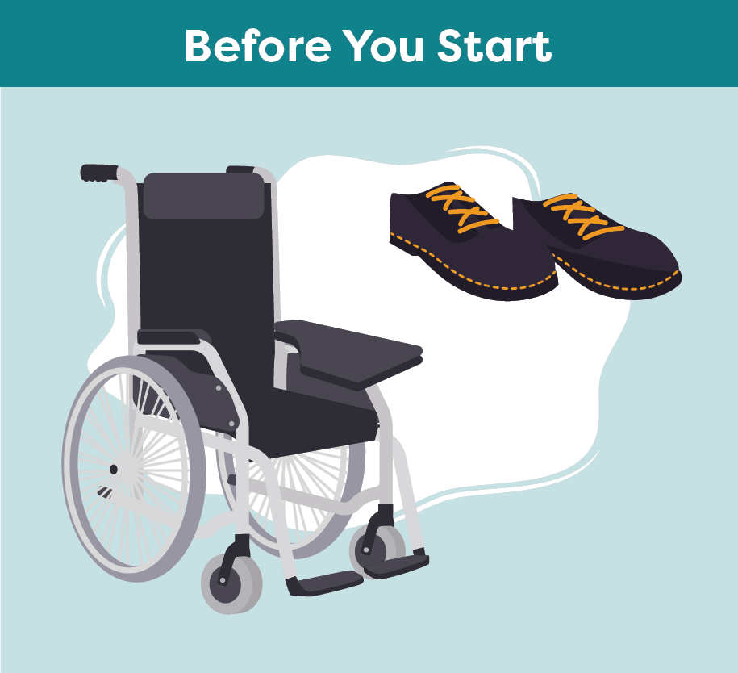
Positioning in a Chair/Wheelchair After Stroke
Smart Tips:
Make sure the person is wearing safe and suitable footwear
Ensure you have the needed equipment/parts
Ensure the seat is clear
Be sure that the chair/wheelchair is in good working order, the brakes are on, and if required, footrests are attached as indicated
Notes:
Smart Tips – Always follow the care plan!
This section pertains to what you should do before you start:
Make sure the person is wearing safe and suitable footwear that will not slip off (closed heel, closed toe, non-slip sole, well fastened)
Ensure you have the needed equipment (e.g. lap tray, footrest, seatbelt) available and ready to apply and that the seat is clear
Be sure that the chair/wheelchair is in good working order, the brakes are on, and if required, footrests are attached as indicated

Slide 155
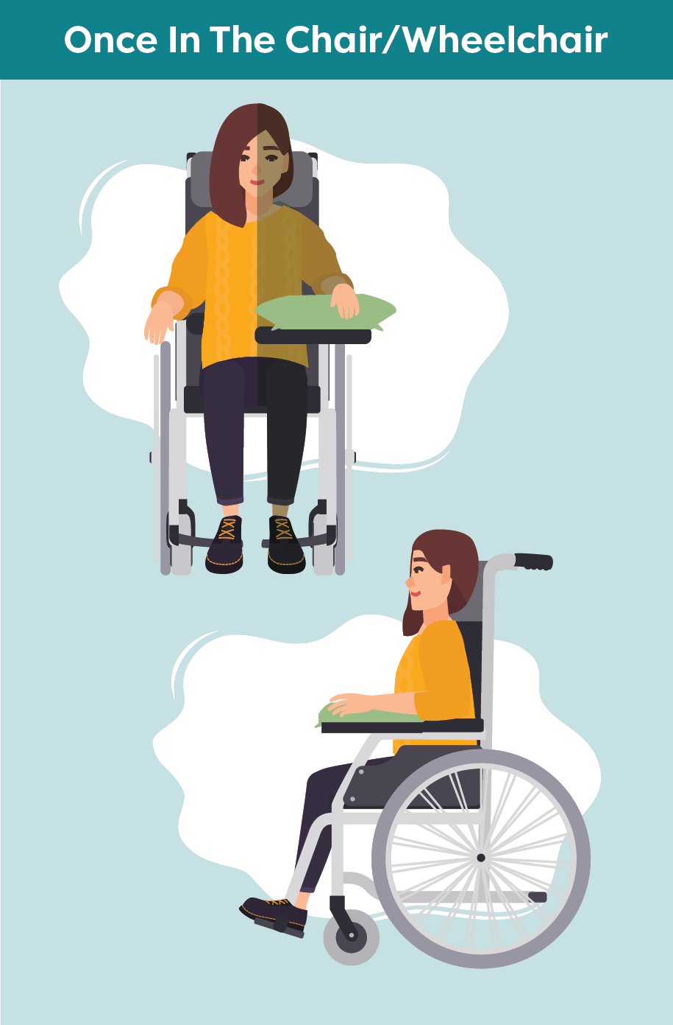
Positioning in a Chair/Wheelchair After Stroke
Hips should be centred all the way back in the chair, with knees and hips level
The trunk/torso should be centred
Feet should be flat, directly under the knees and safely placed on the floor or footrest(s)
The affected arm should be well supported, slightly away from the person’s side, with the hand forward and palm down
Notes:
Smart Tips – This section pertains to positioning once in the chair or wheelchair
Be sure the hips are all the way back in the centre of the chair and that knees, and hips are level
The trunk/torso should be centred
Check that the feet are flat and directly under the knees and safely placed on the floor or footrest(s)
Make sure that the affected arm is well supported (i.e. use of pillows or positioning devices as recommended). The arm should be slightly away from the person’s side with the hand forward and palm down
*Encourage presenter to use the graphics to demonstrate and highlight each bullet as per positioning descriptor.

Slide 156
Positioning in a Chair/Wheelchair After Stroke
Before leaving, ensure that the person is well supported and comfortable
Check the person frequently to make sure they remain properly positioned
Notes:
Before you leave, ensure that the person is well supported and comfortable.
Do frequent checks to make sure they remain properly positioned

Slide 157
Positioning in a Chair/Wheelchair After Stroke
Seek extra support
Occupational Therapists and Physiotherapists are skilled in proper sitting and positioning
There are many options to customize the seating system and help is available
Smart Tips for Stroke Care (2023) was created by members of the Regional Stroke Networks of Ontario. This material may be shared without permission from the authors, without changes and with source credited.
Notes:
Occupational Therapists and Physiotherapists are experts in proper sitting and positioning. It may be helpful to involve them in the person’s care.
There are many options to customize the seating system and help is available

Slide 158
TOPIC:
Meaningful Activity After Stroke

Slide 159
Meaningful Activity
After Stroke
Meaningful activities can provide enjoyment, a sense of purpose and define who a person is
Activities may include engagement in leisure, social, cultural and/or spiritual activities
Impairments can make it challenging to engage in meaningful activities
Participation can help with recovery and build a sense of belonging
Notes:
Meaningful activities can provide enjoyment, a sense of purpose and define who a person is.
These activities may include engagement in leisure, social, cultural and/or spiritual activities.
After a stroke, impairments can make it challenging for a person to engage in meaningful activities.
Supporting persons with stroke to participate can help with their recovery and build a sense of belonging.

Slide 160
Meaningful Activity
After Stroke
What you should know:
An individual will participate if activity is meaningful/interesting
Days without meaningful experiences can lead to social isolation, loneliness and depression
Meaningful activities can contribute to improved recovery
Notes:
An individual is more likely to participate in an activity if it is meaningful/interesting to them
Without meaningful experiences, days can feel long and empty, which can lead to social isolation, loneliness and depression
Meaningful activities can contribute to improved recovery, including physical fitness, mood and overall well-being

Slide 161
Meaningful Activity
After Stroke
Engaging in meaningful experiences can provide opportunities for:
socializing and meeting new people
a feeling of belonging
physical activity
a sense of control over one’s life
a creative outlet
stress relief
a sense of accomplishment
cultural experience
improved self-confidence
adjustment to a disability
structuring a person’s day
enhanced quality of life
Notes:
Engaging in meaningful experiences can provide opportunities for:
socializing and meeting new people, leading to friendship and feeling they belong
physical activity
a sense of control over one’s life
a creative outlet
stress relief
a sense of accomplishment
cultural experience
improved self-confidence
adjustment to a disability
structuring a person’s day
enhanced quality of life

Slide 162
Meaningful Activity After Stroke
Smart Tips:
Who?
What?
Where?
When?
Why?
How?
Notes:
Smart Tips – Always follow the care plan! This section pertains to the 5 W’s and How
Ask questions to determine meaningful activities:
Who do you like to do activities with?
What do you like to do?
Where do you like to do these activities?
When do you like to do these activities?
Why do you like to do these activities?
How do you do these activities?

Slide 163
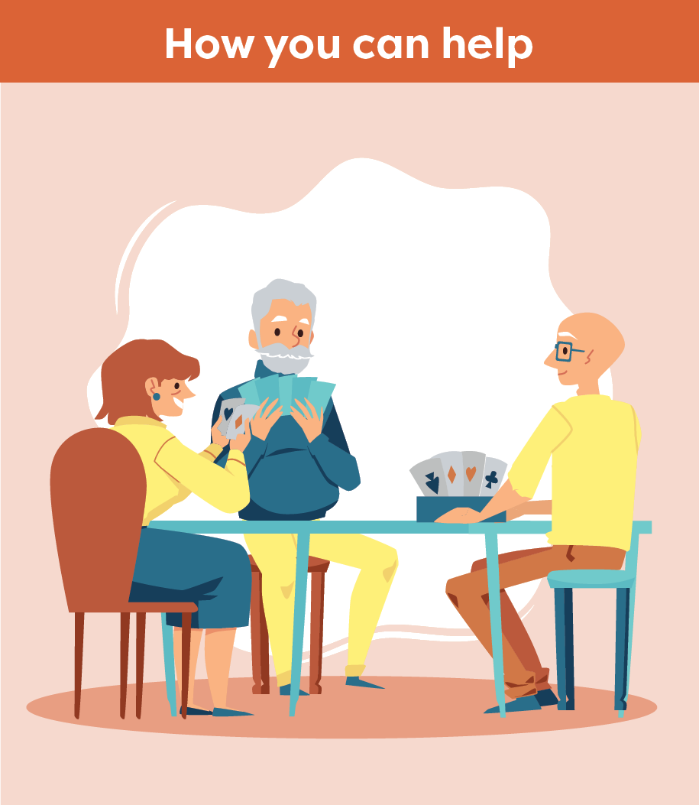
Meaningful Activity
After Stroke
Choose activities that are meaningful
Encourage participation
Help prepare for their activity
Think of ways to modify the activity
Find others with similar interests
Notes:
Smart Tips – Always follow the care plan! This section pertains to how you can help
Choose activities that are meaningful, enjoyable and important to the person;
Encourage participation
Support the person with stroke to prepare for their activity – get any assistive devices ready (e.g. hearing aids, glasses, mobility device)
Think of ways to modify the activity for successful participation (e.g. use card holders, encourage seated exercise, use large print bingo cards/playing cards)
Find other individuals who have similar interests

Slide 164
Meaningful Activity
After Stroke
Use strategies to accommodate abilities
Talk to family members, caregivers or friends about the person’s interests
Encourage family members, caregivers or friends to bring in some favourite items
Adjust food activities if the person with stroke has swallowing difficulties to promote inclusion
Notes:
Smart Tips – Always follow the care plan!
Use strategies to accommodate different levels of ability in communication, cognition, perception, vision, etc.
Talk to family members, caregivers or friends about the person’s interests
Encourage family members, caregivers or friends to bring in some favourite items (e.g. music, books, games, word searches)
Adjust food activities if the person with stroke has swallowing difficulties (i.e. dysphagia) to promote inclusion. Talk to a Registered Dietitian and/or Speech Language Pathologist if you have questions. (See Smart Tips for Stroke Care – Eating and Swallowing After Stroke)

Slide 165
Meaningful Activity
After Stroke
Seek extra support
Occupational Therapists and Recreation Therapists are skilled in supporting participation in meaningful activities
It may be helpful to involve them in the person’s care- especially if you notice the person is not participating or is becoming isolated
Smart Tips for Stroke Care (2023) was created by members of the Regional Stroke Networks of Ontario. This material may be shared without permission from the authors, without changes and with source credited.
Notes:
Occupational Therapists and Recreation Therapists are experts in supporting persons with stroke to engage in meaningful activities.
It may be helpful to involve them in the person’s care - especially if you notice the person is not participating or is becoming isolated

Slide 166
Acknowledgments
We wish to recognize the dedicated group of healthcare professionals who contributed to the writing or review of SMART TIPS for Stroke Care.
Writing group
Eileen Britt, Regional Rehab and Community Coordinator, Central South Stroke Network
Margo Collver, Regional Community and LTC Coordinator, Southwestern Ontario Stroke Network
Heather Jenkins, Regional Education Coordinator, Stroke Network of Southeastern Ontario
Anik Laneville, Occupational Therapist, Best Practice Team, Champlain Regional Stroke Network
Michelle Mohan, Regional Education Coordinator, Toronto West Stroke Network
Kayla Purdon, Regional Community and LTC Coordinator, Stroke Network of Southeastern Ontario
Tara Thomas Tarcza, Regional Community and LTC Coordinator (Interim), Central East Stroke Network Maggie Traetto, Regional Community and LTC Coordinator, West GTA Stroke Network
Sue Verrilli, Regional Education Coordinator, Northeastern Ontario Stroke Network
Jenna Weck, Regional Community and LTC Coordinator, Central East Stroke Network
We also wish to thank Over the Atlantic for their support, patience, passion and creativity in bringing the content of this resource to life.

